Slide 1
Disadvantaged Business Enterprise (DBE) and Airport Concession DBE (ACDBE) Reevaluation Process
Presented by the Texas Unified Certification Program (TUCP)

Slide 2
History of the DBE Program
The DBE program was established in the early 1980s to fulfill Congress’ mandate to remedy past and ongoing discrimination for these firms engaged in surface transportation industries and eventually in airport concessions.
DBEs and ACDBEs are small businesses that are 51% owned and controlled by socially and economically disadvantaged individuals.
Congress authorized these programs, requiring state DOTs and local transportation agencies that receive federal financial assistance to establish DBE participation goals within their contracting programs, including contract-specific DBE goals.

Slide 3
History of the DBE Program (cont.)
Recipients (state and local government agencies, or authorized organizations) of the United States Department of Transportation (USDOT) funding:
Certify firms as DBEs and ACDBEs,
Track the selection of those firms and
Track payments on work committed and performed on FAA, FHWA, and FTA-assisted contracts, and airport concessions (for ACDBEs).
This program is only applicable to agencies and companies that receive USDOT funding or have a federally assisted contract:
Airports, Transit, and Highways.

Slide 4
Texas Unified Certification Program (TUCP) Agencies
City of Austin
City of Houston
Corpus Christi Regional Transportation Authority
North Central Texas Regional Certification Agency
South Central Texas Regional Certification Agency
Texas Department of Transportation

Slide 5
USDOT Interim Final Rule (IFR)
On October 3, 2025, USDOT issued an Interim Final Rule (IFR) calling for the removal of all race and gender-based preferences and references in the DBE and ACDBE programs.
The IFR called for the reevaluation of all currently certified DBE and ACDBE firms whose owners met the presumption of social and economic disadvantage based on group membership to determine eligibility based on the IFR with no reference to race or sex.
Additionally, all DBE and ACDBE goals are on hold until DBE and ACDBE firms are reevaluated under to the new criteria.

Slide 6
Requirements of the USDOT IFR
Individuals must prove social and economic disadvantage without reference to race or gender through:
Personal Narrative
Personal Net Worth Statement
Documentation received should come from the owner(s) who were determined eligible and relied upon for the firm’s disadvantaged status as of October 3, 2025.
For more information visit the TxDOT IFR page.

Slide 7
DBE Impact During Reevaluation Transition Period
Suspended processing of new DBE/ACDBE applications.
Suspended processing of annual Declaration of Eligibility (DOE).
Removed Interstate Certified firms.
Removed DBE/ACDBE goals on federally assisted procurements:
Transit, Highway/Tollway, Airport, and Local, Regional and State (Cities, Counties, MPO)
No enforcement of DBE/ACDBE goal commitments.
NOTE: All other contract laws must be enforced including non-discrimination, prompt payment and enforceable executed contract agreements

Slide 8
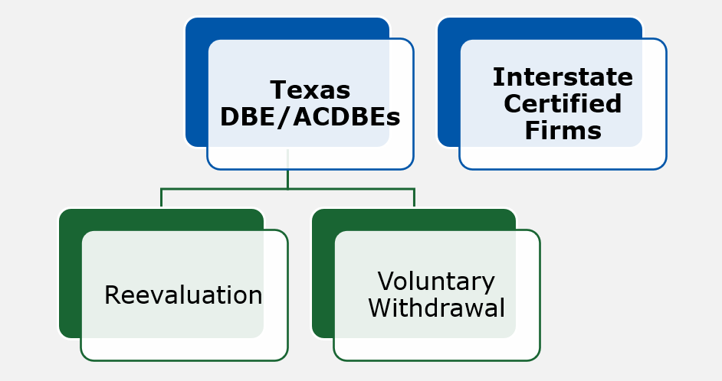
Reevaluation Options
Figure 1 - Personal Net Worth Statement Form

Slide 9
Reevaluation Options for Interstate Certified Firms
1,929 Interstate Certified firms (as of October 3, 2025)
All DBEs/ACDBEs certified in Texas through the interstate certification process will be delisted.
Firms may reapply for interstate certification in Texas following successful reevaluation by their jurisdictions of original certification (JOC).
Texas will acknowledge and resume processing interstate certifications upon completion of its reevaluation of Texas-based firms.

Slide 10
Status of DBE/ACDBE Firms for Reevaluation
TUCP DBE/ACDBE Database total: 6,598 certified firms
Delist Interstate Certified DBE/ACDBE firms
Identify duplicate firms certified as a DBE and ACDBE
Approximate number of firms eligible for reevaluation: 4,043

Slide 11
Instructions for Voluntary Withdrawal
If a DBE or ACDBE firm decides not to pursue reevaluation:
Written notice for withdrawal to the certification agency
Submit a ticket through the portal that says "Withdraw DBE/ACDBE Certification" in the subject line.
Certification partners will process voluntary withdrawal requests during the reevaluation process.

Slide 12
DBE/ACDBE Reevaluation Process
This is an individual reevaluation, not the business reevaluation. It’s about the qualifying individuals:
A qualifying individual is an individual owner whose ownership and control are relied upon for DBE/ACDBE certification.
If there is more than one qualifying owner of the firm whose ownership and control are relied upon for DBE/ACDBE certification, each owner must complete and submit their own separate documentation.
Must establish the existence of disadvantage by a preponderance of evidence (e.g., more likely than not) as defined by the DBE/ACDBE IFR.

Slide 13
Post-Submission Process
Timeline to submit required documents: March 30 – April 30, 2026
The TUCP has a dedicated team managing the reevaluation process which will evaluate the necessary documentation.
All firms will be delisted from the Certification Directory until eligibility is determined.
DBEs/ACDBEs will submit reevaluation documents electronically through their original certification portals.

Slide 14
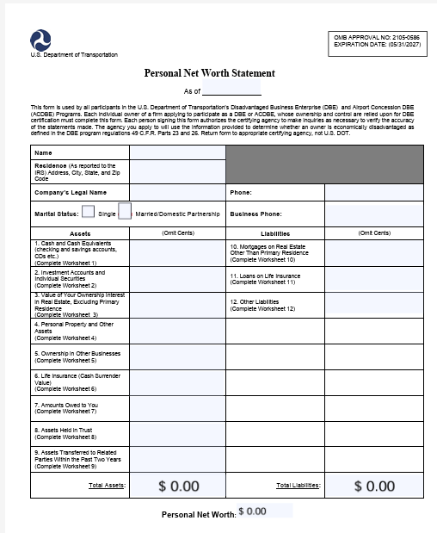
Personal Net Worth Statement Form Overview
Current Net Worth: Not to exceed $2.047 Million
Owner exclusions:
Ownership interest in the applicant firm.
Owner's share of equity in primary residence.
All assets in qualified retirement accounts.
Must report the accounts, the value of assets in them, and any significant terms and restrictions.
Download PNW Statement form.
Figure 1 - Personal Net Worth Statement Form
Notes:
Suggestion: Complete the worksheets before completing the summary statement

Slide 15
Personal Net Worth Statement Form Overview (cont.)
Owner inclusions in PNW:
Ownership interest in other firms.
Full value of contents of their primary residence, or 50% if cohabitation with spouse/domestic partner.
Motor and recreational vehicles (titled in name).
Proportional share of the balance of debt.
NOTE: If PNW is exceeded, not eligible to be a DBE firm.
Notes:
Suggestion: Complete the worksheets before completing the summary statement

Slide 16
Reporting Assets for the PNW Statement Form
Report assets at their current fair market values as of the date of your Personal Net Worth (PNW) form.
For joint ownership, report only the value of your ownership unless the worksheet directs otherwise.
Do not report the value of the interest in the DBE firm.
Notes:
Assets such as:
Cash and Cash Equivalents
Transfers Within Preceding Two Years (Exclude transfers to applicant or DBE.)
Investment Accounts and Individual Securities
Real Estate
Personal Property and Other Assets
Ownership in Other Businesses
Life Insurance
Amounts Owed to You
Assets Held in Trust
Liabilities like:
Mortgages
Loans on Life Insurance
Other Liabilities

Slide 17
Reporting Liabilities for the PNW Statement Form
Report current balances.
Report only your own, direct liabilities.
Do not report guarantees or other contingent liabilities.
Do not report business debt, debt secured by retirement assets, or any amount you owe, directly or indirectly, to the DBE firm.
Notes:
Assets such as:
Cash and Cash Equivalents
Transfers Within Preceding Two Years (Exclude transfers to applicant or DBE.)
Investment Accounts and Individual Securities
Real Estate
Personal Property and Other Assets
Ownership in Other Businesses
Life Insurance
Amounts Owed to You
Assets Held in Trust
Liabilities like:
Mortgages
Loans on Life Insurance
Other Liabilities

Slide 18
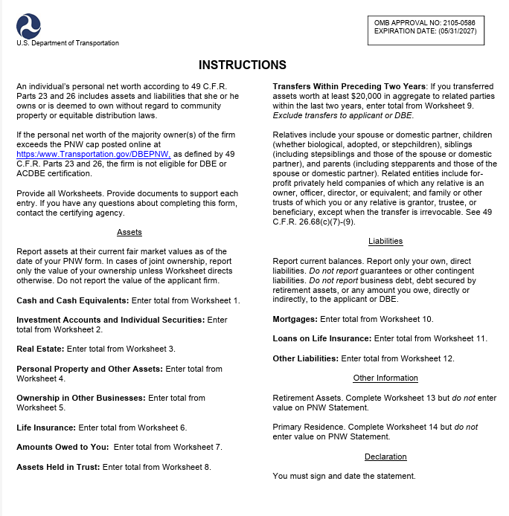
Other Information for the PNW Statement Form
Other Information
Retirement Assets
Do not enter value on PNW Statement.
Primary Residence
Do not enter value on PNW Statement.
Declaration
You must sign and date the statement.
Figure 1 – Instructions for Personal Net Worth Statement Form
Notes:
Assets such as:
Cash and Cash Equivalents
Transfers Within Preceding Two Years (Exclude transfers to applicant or DBE.)
Investment Accounts and Individual Securities
Real Estate
Personal Property and Other Assets
Ownership in Other Businesses
Life Insurance
Amounts Owed to You
Assets Held in Trust
Liabilities like:
Mortgages
Loans on Life Insurance
Other Liabilities

Slide 19
Instructions for Constructing a Personal Narrative
Should be based on individualized experiences within American society.
Describe and provide supporting documentation of specific incidents of economic hardship, systemic barriers, and denied opportunities, including dates, context, and outcomes.
Demonstrate how these incidents impeded the owner’s progress or success in education, employment or business.
Compare your experiences to others who did not face the same disadvantages.
Do not rely on or refer to race or sex, in whole or in part.

Slide 20
Things to Remember for Personal Narrative
This is an individual reevaluation - not a business reevaluation.
A qualifying individual is an individual owner whose ownership and control are relied upon for DBE/ACDBE certification.
If there is more than one qualifying owner of the firm whose ownership and control are relied upon for DBE/ACDBE certification, each owner must complete and submit their own separate documentation.

Slide 21
Referencing Social Disadvantage
Social disadvantage: individual experience explaining the impact, magnitude, and frequency of the impediment(s) as it pertains to you personally.
Education
Employment
Business History and/or
Other Experiences and Circumstances
Do not rely on generalizations or group experiences.
Do not rely on or refer to race or sex, in whole or in part.
Only include parts that pertain to their lived experience.

Slide 22
Referencing Education
Specific instances of economic hardship, systemic barriers, and denied opportunities in education, and
The negative impact that each specific occurrence has had on the qualifying individual’s entry or advancement in the business world.
Notes:
Provide supporting documentation of these instances, such as:
Applications, denials, or other communication(s) from colleges, universities, or vocational schools
Proof of income, or lack thereof, at the time the denial of access to higher education or continued education occurred
Evidence of barriers or hindrances that prevented entry into or completion of continuing education

Slide 23
Referencing Employment & Business History
Employment History
Specific instances of barriers to employment, denial of opportunities and financial struggles, and
Impact of those instances on the qualifying individual’s entry or advancement in the business world.
Business History
Specific instances of economic hardship, systemic barriers, and denied opportunities in that impeded the owner’s progress or success in business.
Notes:
Provide supporting documentation of these instances, such as:
Positions held
Check stubs
Salary or wages
Complaints filed
Correspondence from employers or potential employers

Slide 24
Referencing Other Experiences & Circumstances
Other specific instances of economic hardship, systemic barriers, and denied opportunities outside of education, employment, or business history.
Instances impeded the owner’s progress or success, and the impact of the impairment.
Provide supporting documentation or relevant information.

Slide 25
Referencing Economic Disadvantage
Include descriptions of specific instances or impediments in which their ability to compete in the free enterprise system has been impaired due to diminished capital and credit opportunities as compared to others in the same or similar line of business who are not socially disadvantaged;
the financial and/or business consequences of these impediments, and
the impact it has had on the owner’s entry into the business world or advancement in business, including the magnitude and frequency of harm.
NOTE: This section does not satisfy any component of the Personal Net Worth Statement (PNW) requirements of the reevaluation process.
Notes:
Provide supporting documentation, such as:
• Fair market value of all assets
• Dollar value of working capital
• Copies of tax liability statements, judgments, or levies
• Proof of diminished capital
• Personal income, including loss of income, dates and reasons
• Proof of unexpected expenses

Slide 26
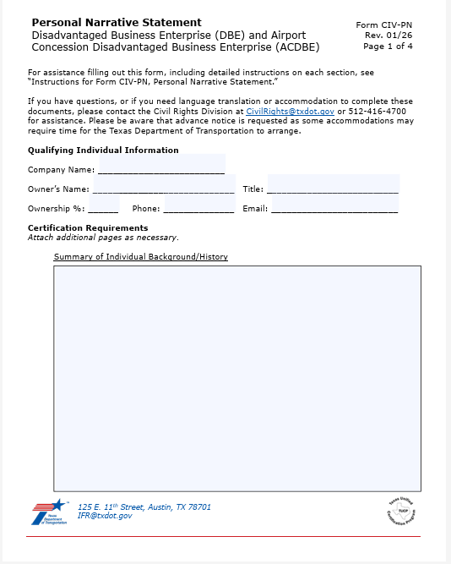
Personal Narrative Form
TUCP and TxDOT providing a form to submit Personal Narrative information.
This Personal Narrative (PN-CIV) form is provided for convenience.
Personal Narratives submitted through other formats will be accepted if they meet requirements.
Download personal narrative form.
Figure 1 - Personal Narrative Form

Slide 27
Other Documentation for Reevaluation Process
Complete copy of the latest filed personal tax return, including all schedules and W-2s.
Current personal bank statement.

Slide 28
TUCP Review Steps
Review Personal Net Worth Statement first.
Missing information or deficiencies to support your narrative will have 10 calendar days to cure.
Review Personal Narrative Statement second.
Missing information or deficiencies to support your narrative will have 10 calendar days to cure.
Only include info that reflects your individualized experience, not group/area experience.
No mention or reference to race or gender.

Slide 29
Reevaluation Process Outcomes
Two possible results:
Recertification
DBE/ACDBE firm has met the new eligibility criteria
Firm will be readded to the directory
Decertification
Firm does not meet the new eligibility criteria
Option to appeal to USDOT or resubmit in 6 months (typically a year but modified for this process)

Slide 30
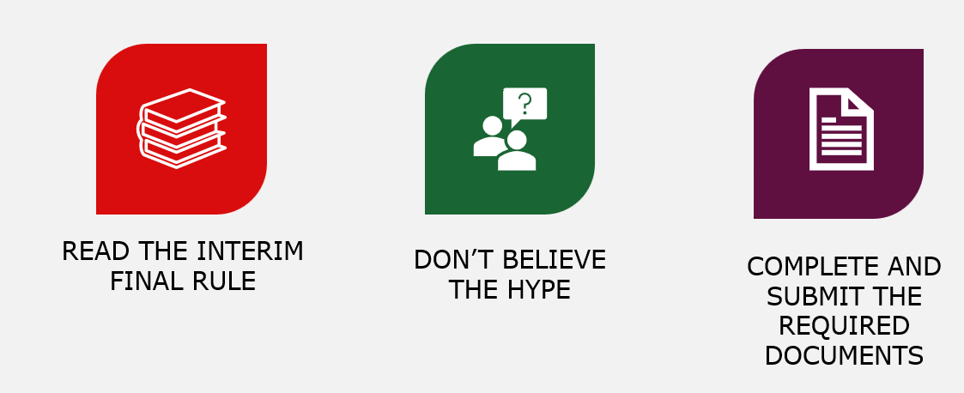
What do you do now?

Slide 31
Reevaluation Process Timeline
Timeline to submit required documents:
March 30 – April 30, 2026

Slide 32
Have questions? Reach out!
Email: ifr@txdot.gov
TUCP Partner Portals:
City of Austin
City of Houston
Corpus Christi Regional Transportation Authority
North Central Texas Regional Certification Agency
South Central Texas Regional Certification Agency
Texas Department of Transportation

