Slide 1
Project Information Form (PIF) Initiation and Completion Process
Texas Department of Transportation’s Advance Funding Agreement (AFA) Development Process

Slide 2
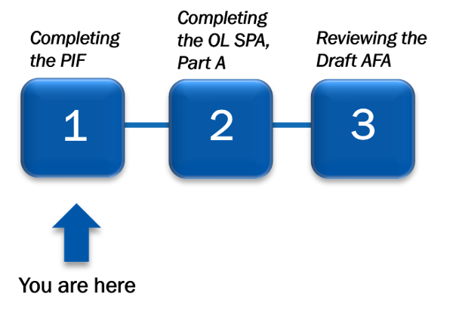
Overall Process
In Step 1, the Local Government (LG) representative collaborates with the Texas Department of Transportation Contract Specialist (TxDOT CS) in DocuSign eSignature to complete a Project Information Form (PIF).
Figure 1 – The AFA Development Process with Step 1 highlighted

Slide 3
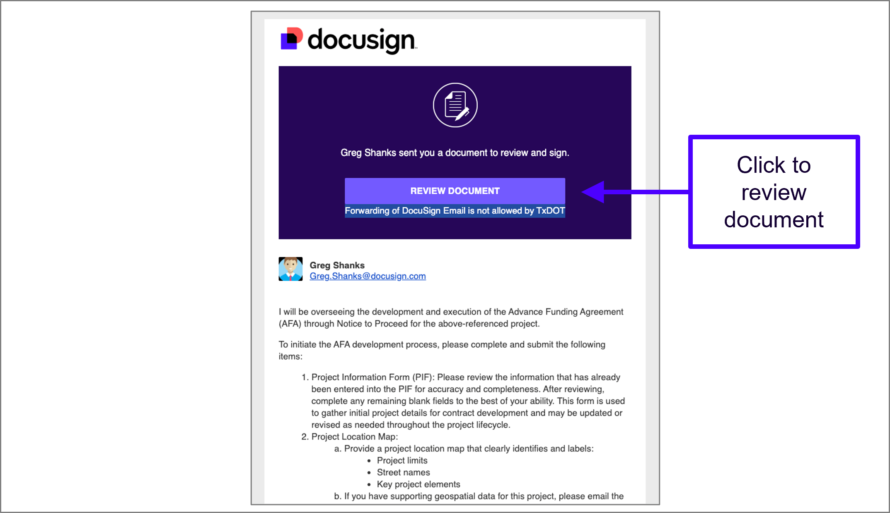
Receive Email Notification
The LG representative receives the DocuSign eSignature envelope email notification with instructions from the TxDOT CS.
Read the instructions.
Click the Review Document button to begin.
Figure 2 – Email notification when the draft PIF is routed to the LG user in DocuSign eSignature

Slide 4
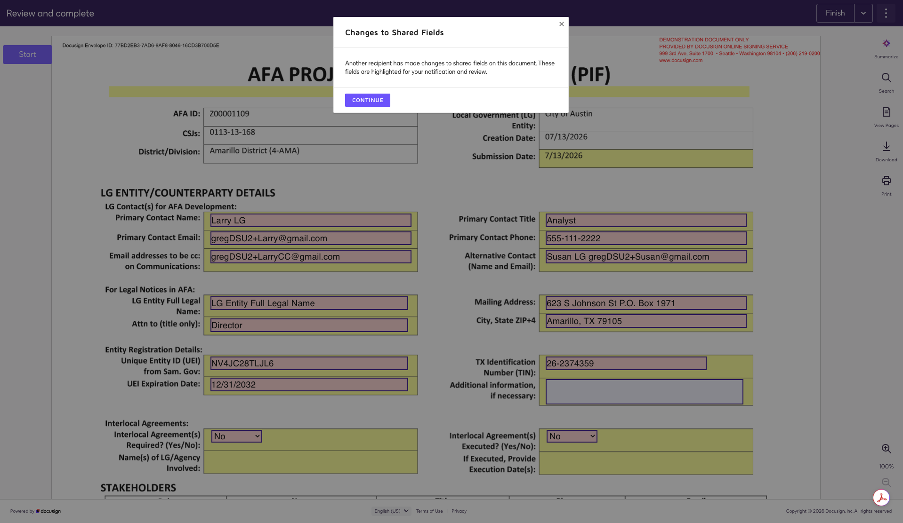
Enter Project Information Form (PIF)
The TxDOT CS has already edited shared fields on the form.
You have the option to edit any of the yellow highlighted fields, editing details provided by the TxDOT CS, as well as to provide new details in the form.
Note: After editing the form and completing your session, the TxDOT CS will initial your changes and potentially route the PIF back to you for continued collaboration until the form details are finalized.
Figure 3 – Contact information fields on the PIF as it appears in DocuSign eSignature

Slide 5
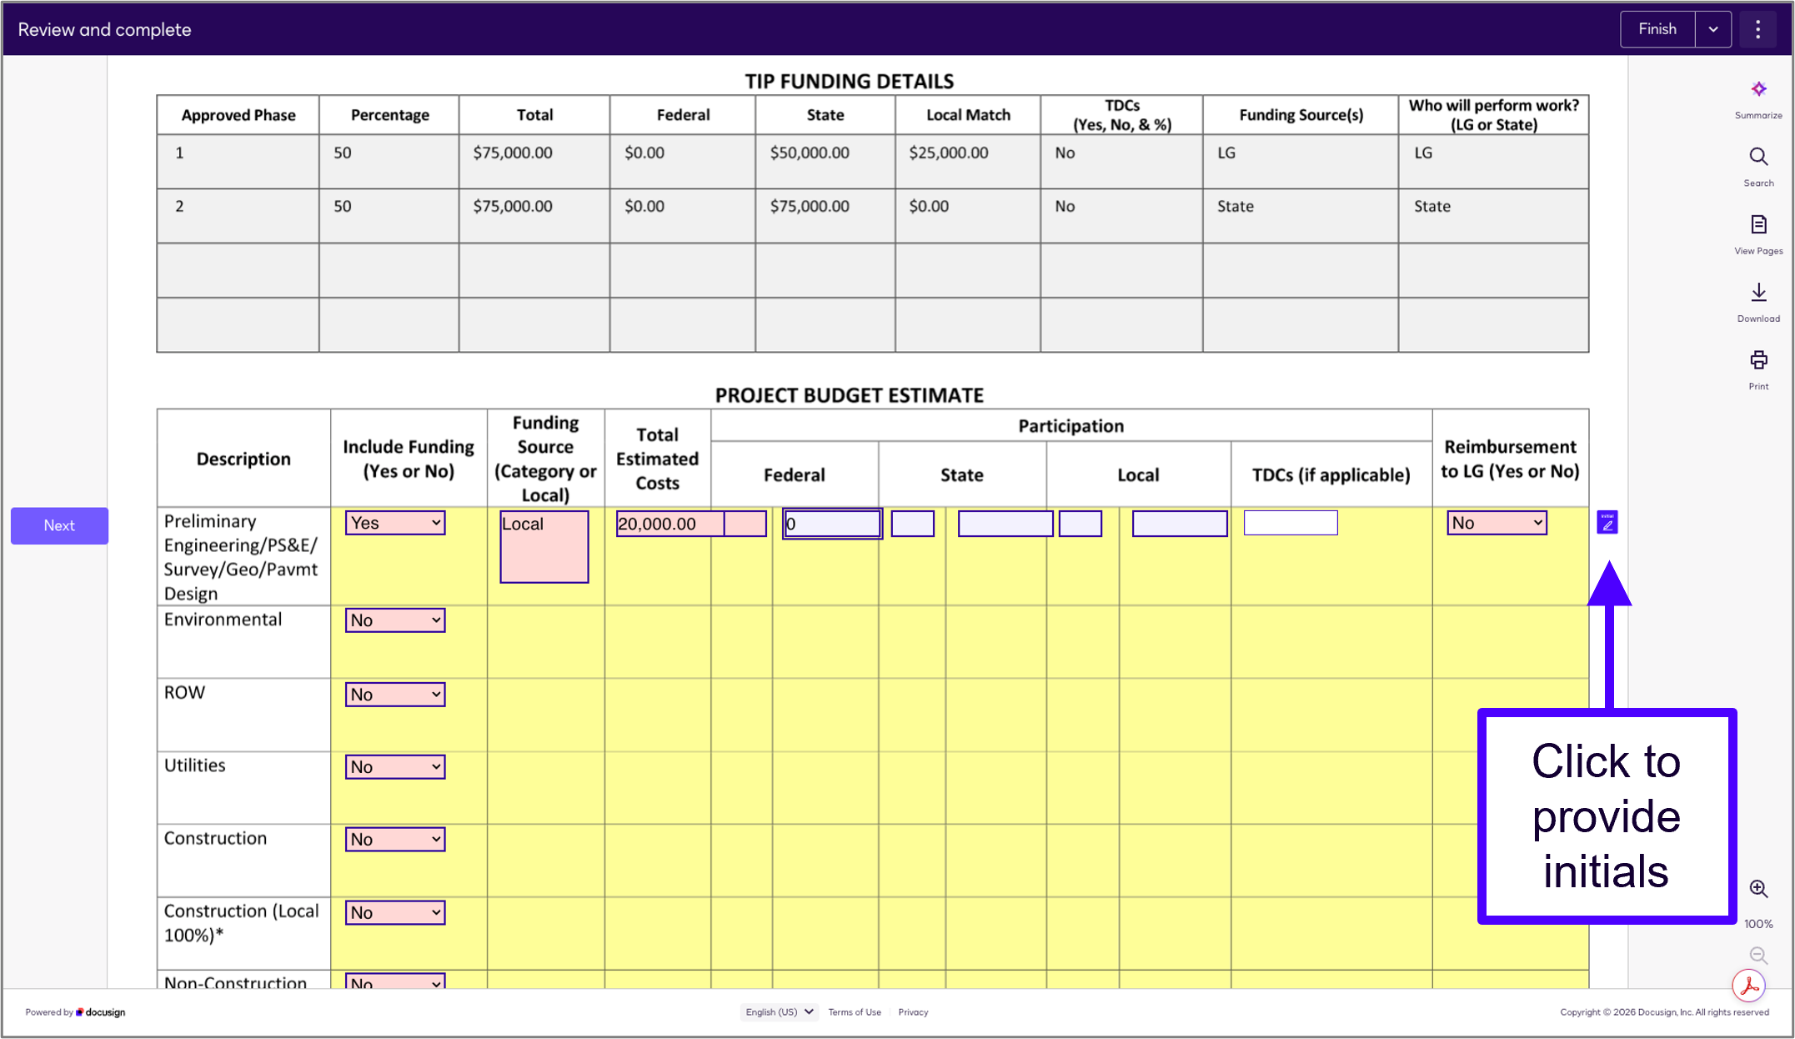
Fill in the PIF
Continue to review PIF details and edit yellow highlighted fields to provide information as needed.
Note: You cannot edit Transportation Improvement Program (TIP) Funding Details.
Figure 4 – Funding information fields on the PIF as it appears in DocuSign eSignature

Slide 6
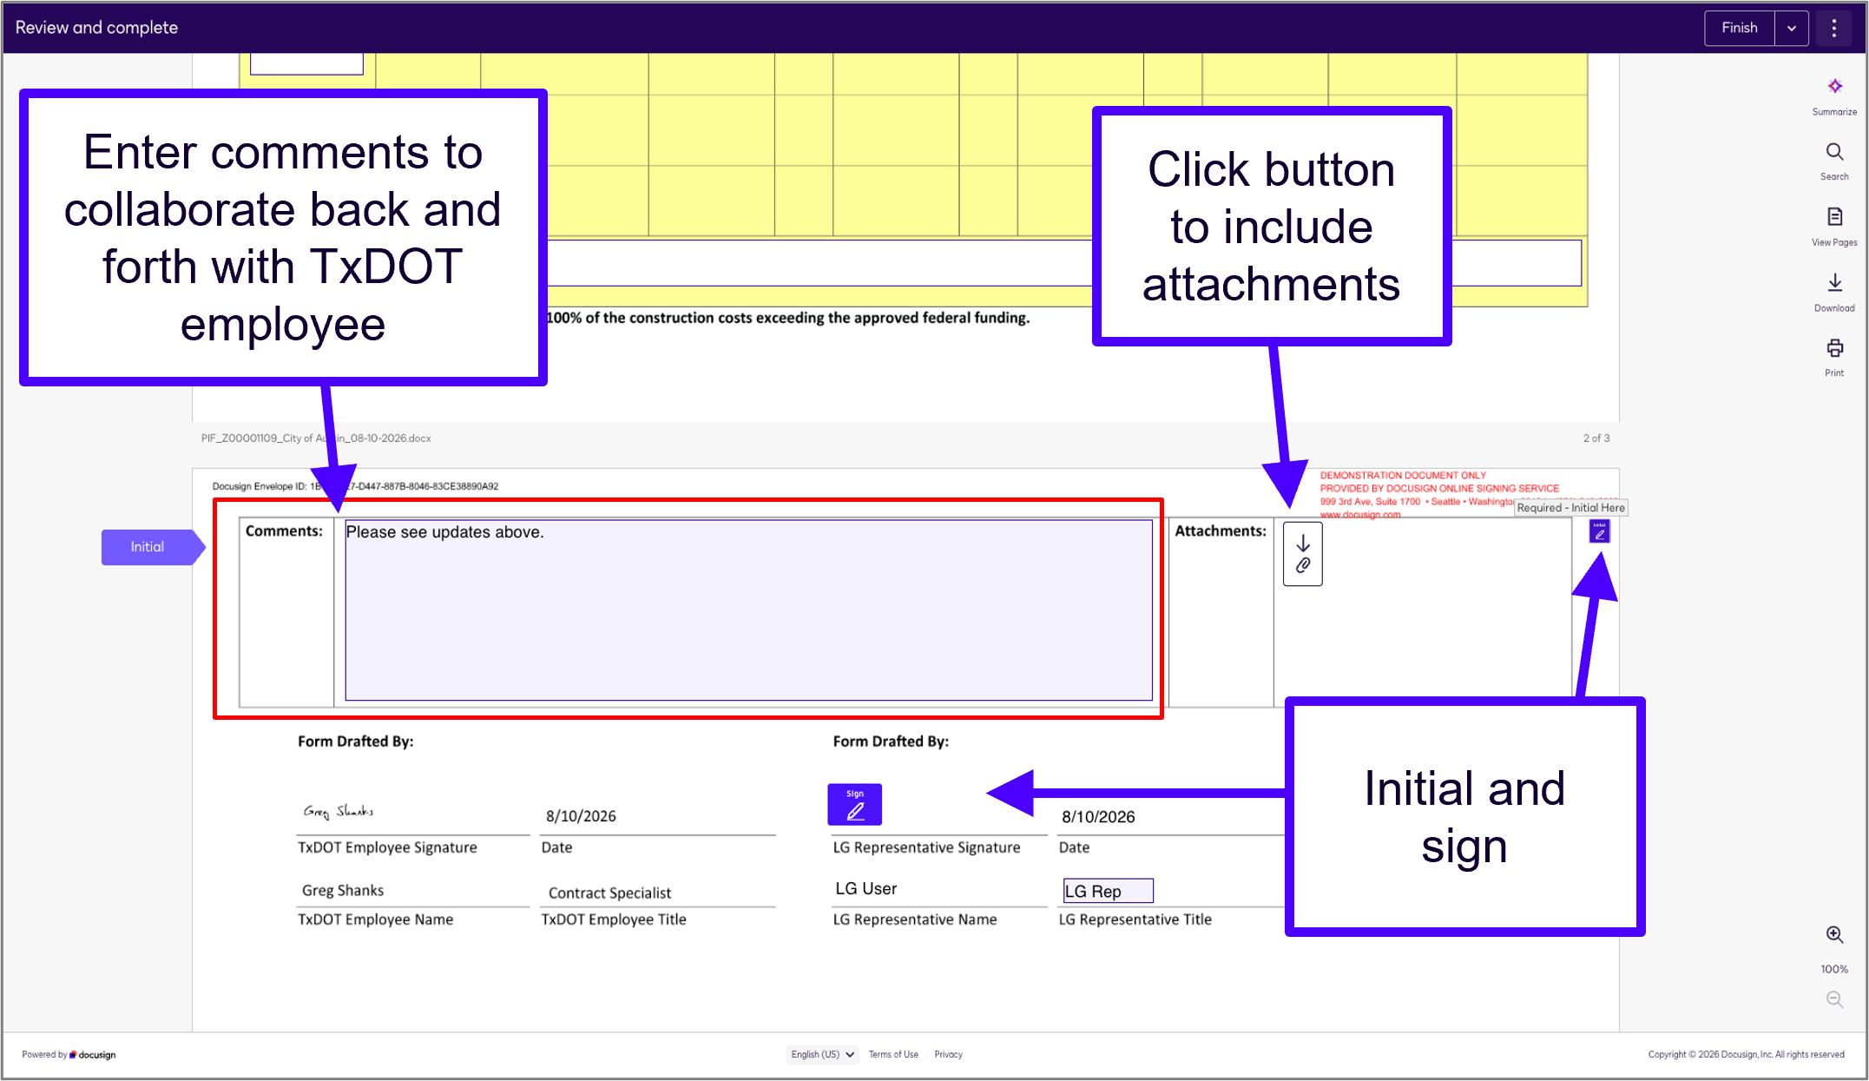
Add Comments, Initial, and Sign
Enter comments to communicate updates or questions to the TxDOT CS.
Attach any documents that may be needed (e.g. the map and resolution)
Initial where prompted, sign at the bottom, and press Finish.
An email will be sent to the TxDOT CS to review the PIF.
Figure 5 – Options to “sign” and “finish” the PIF in DocuSign eSignature

Slide 7
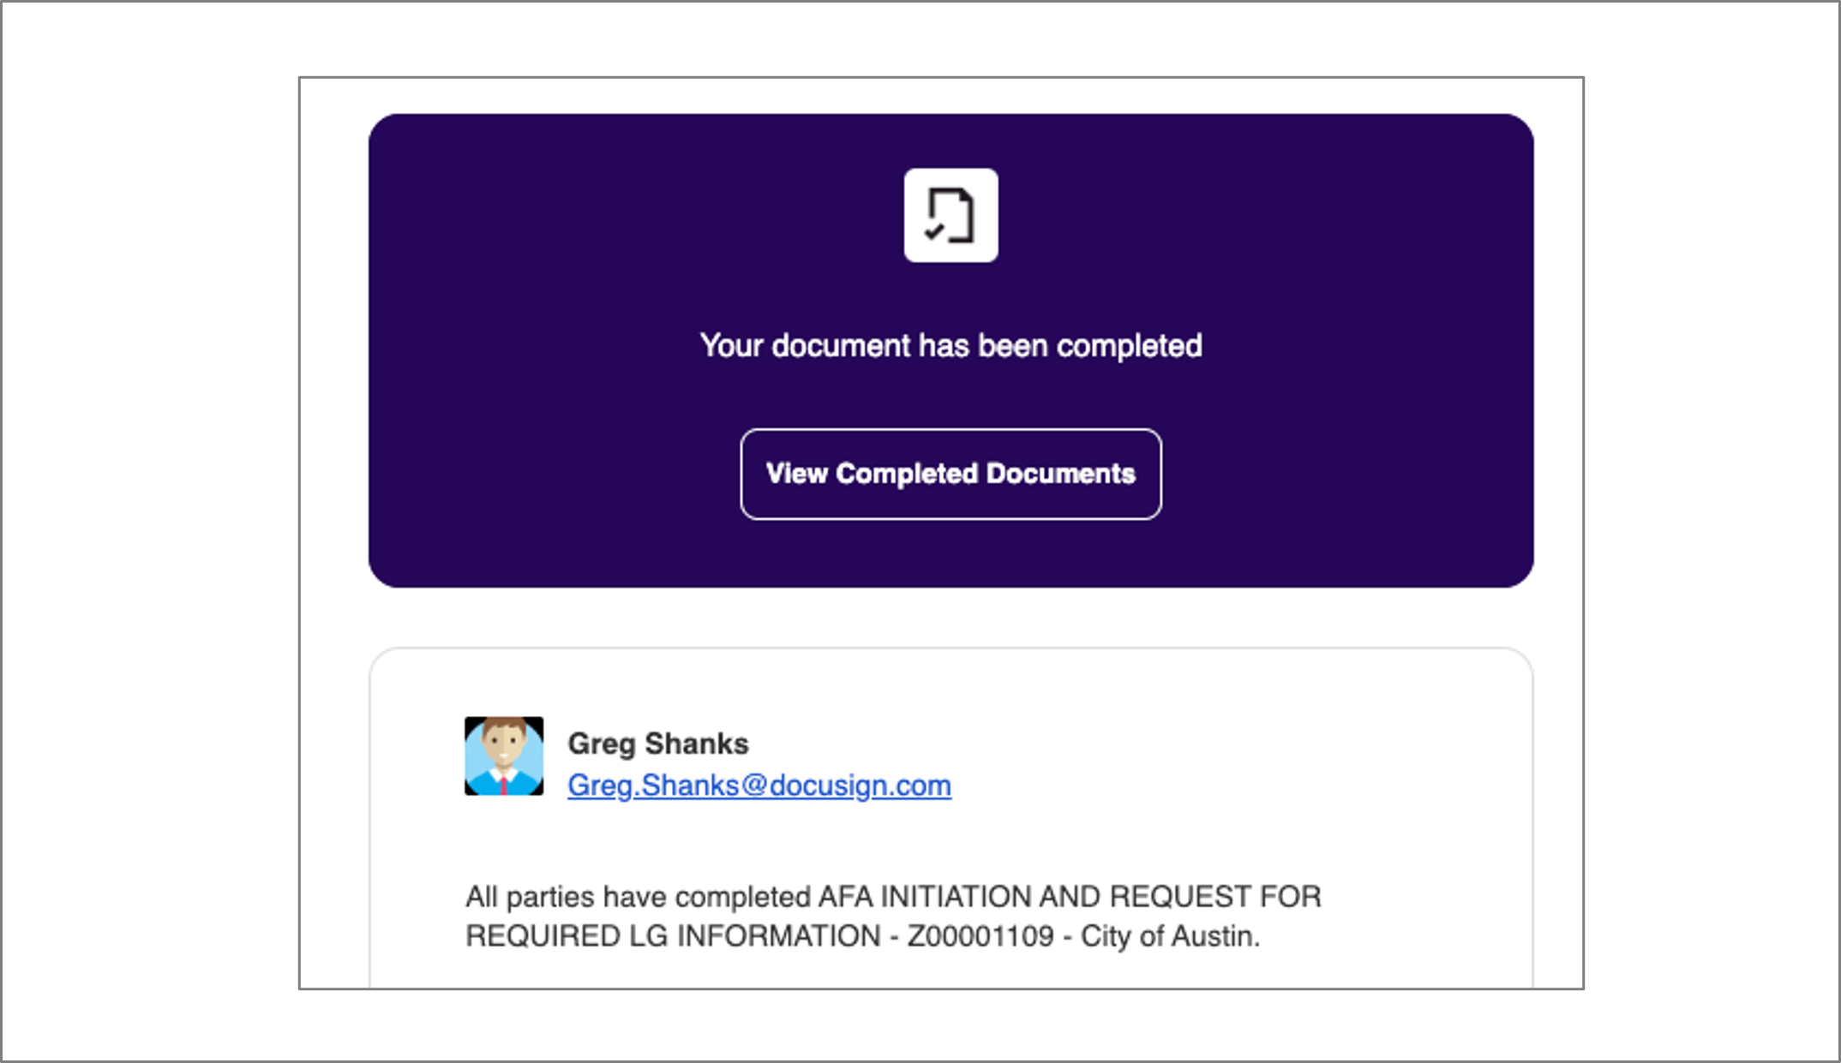
PIF Completion Email
Once all necessary back-and-forth to collaborate on the Project Information Form is finished, you will receive an email confirming that the PIF has been completed.
Click the View Completed Documents button to access a copy of the final document.
Figure 6 – Email notification when the PIF has been completed

Slide 8
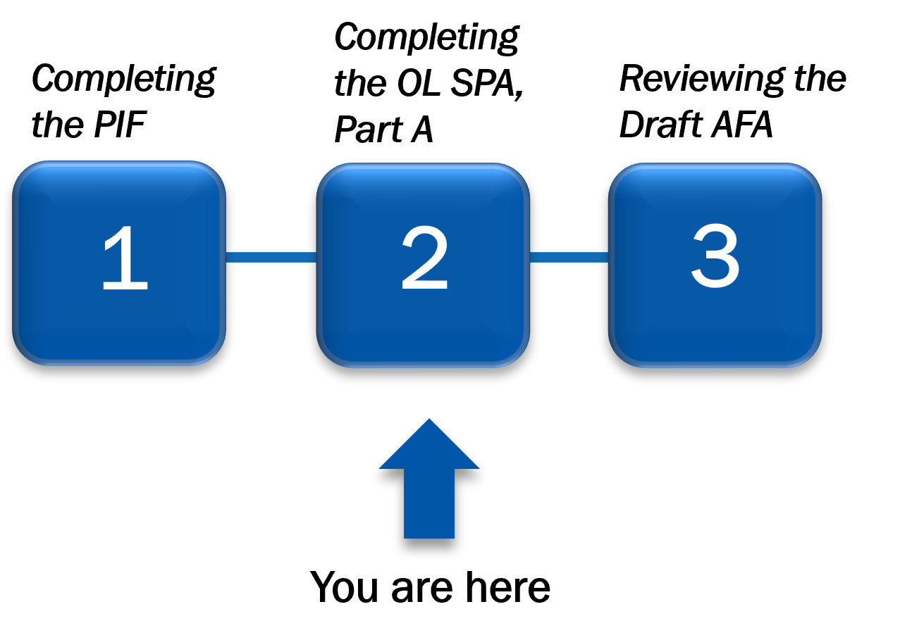
Coming Up Next…
Continue to the next presentation for a walkthrough of the Step 2: Complete the Oversight Level Special Approval, Part A. If you have questions about this process, please email your district contact as listed on TxDOT’s AFA Development Process webpage.
Figure 7 – The AFA Development Process with Step 2 highlighted

