Slide 1
Complete Oversight Level Special Approval (OL SPA), Part A
Texas Department of Transportation’s Advance Funding Agreement (AFA) Development Process

Slide 2
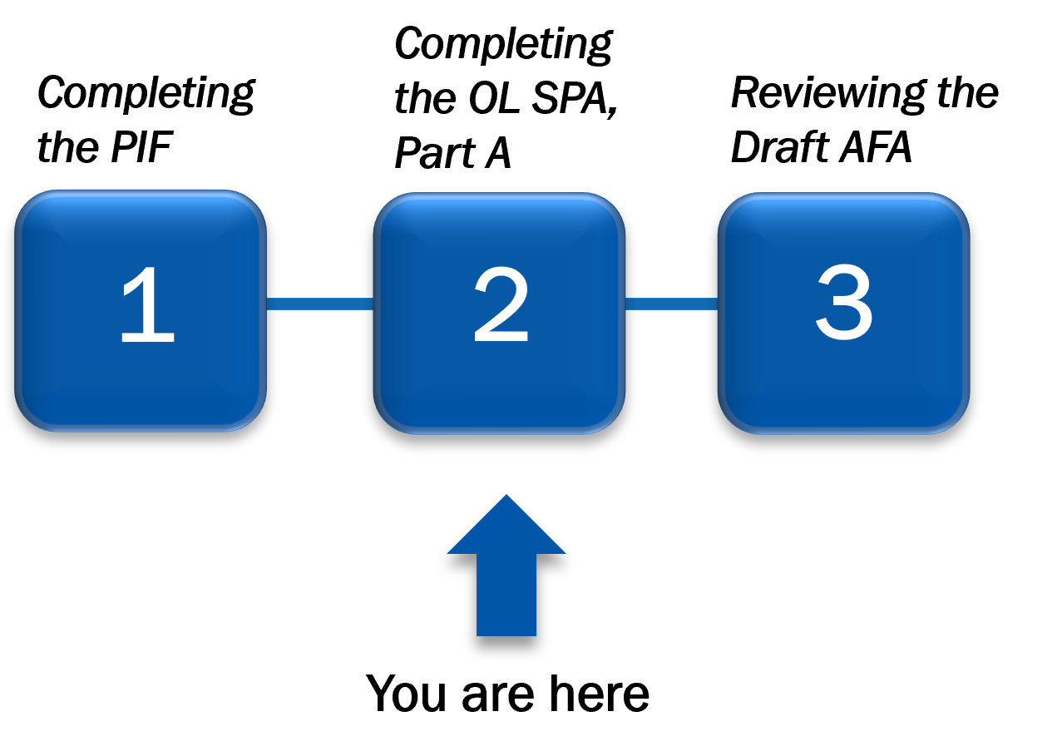
Overall Process
In Step 2, the Local Government (LG) representative collaborates with the Texas Department of Transportation (TxDOT) Employee in DocuSign eSignature to complete the Oversight Level Special Approval (OL SPA), Part A.
Figure 1 – The AFA Development Process with Step 2 highlighted

Slide 3
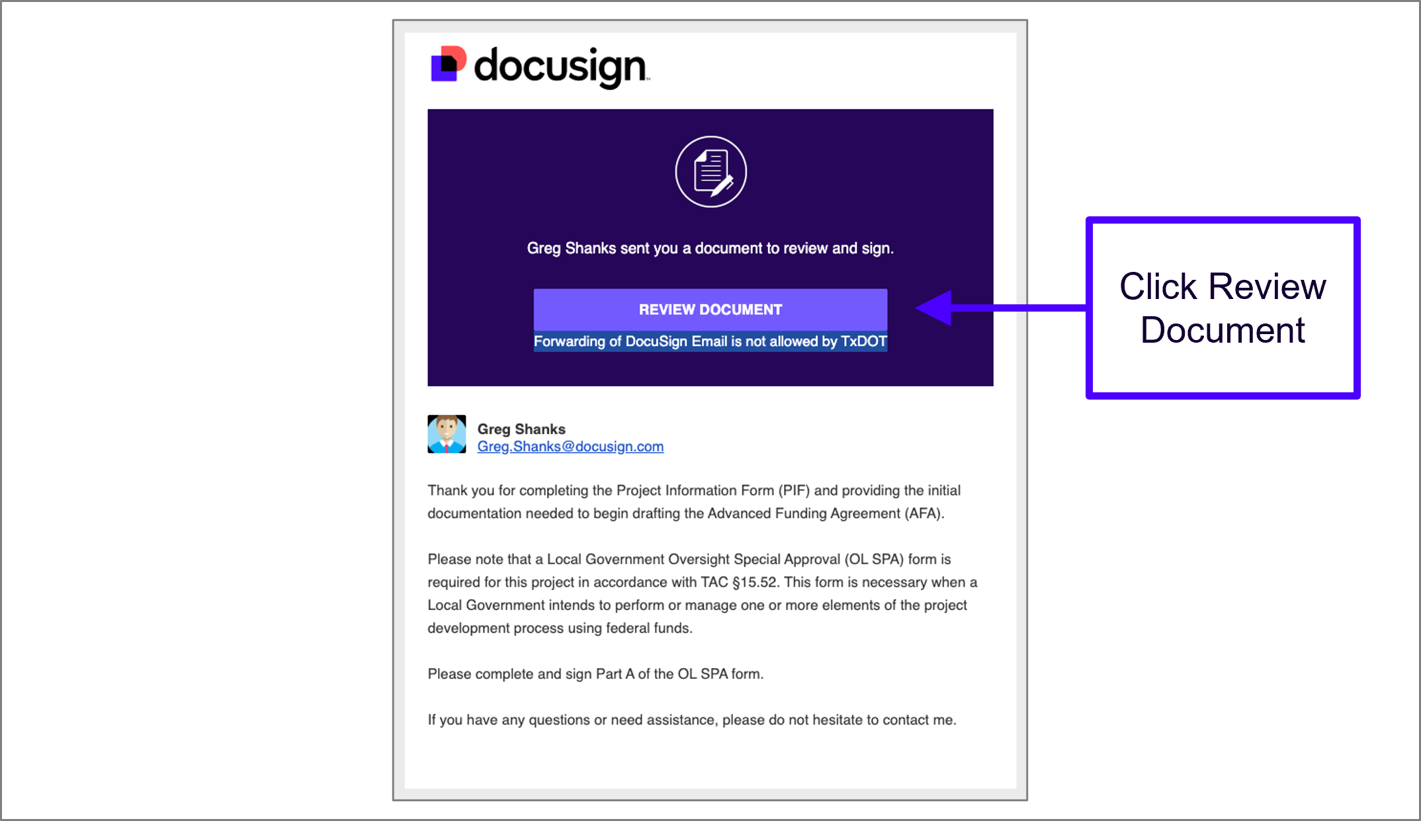
Receive OL SPA, Part A Email Notification
As soon as the OL SPA document has been generated, the LG representative is sent a DocuSign eSignature envelope email notification to complete the fields on the document.
Emails are delivered for subsequent rounds of collaboration on the document with TxDOT employee.
Figure 2 – Email notification that the LG User receives when the OL SPA, Part A is routed to them in DocuSign eSignature.

Slide 4
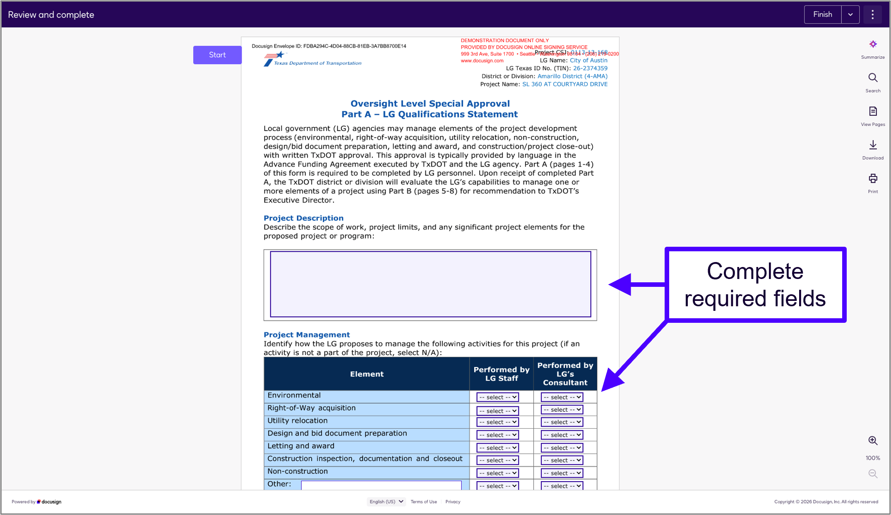
Begin Completing OL SPA, Part A
Complete the required fields on the document.
Figure 3 – Navigating OL SPA, Part A as it appears in DocuSign eSignature

Slide 5
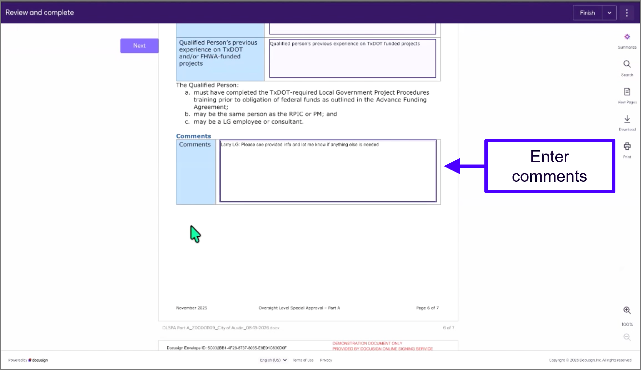
Add Comments
Enter questions or feedback in the comments field to be returned to the TxDOT employee.
Figure 4 – Adding comments in the OL SPA, Part A as it appears in DocuSign eSignature

Slide 6
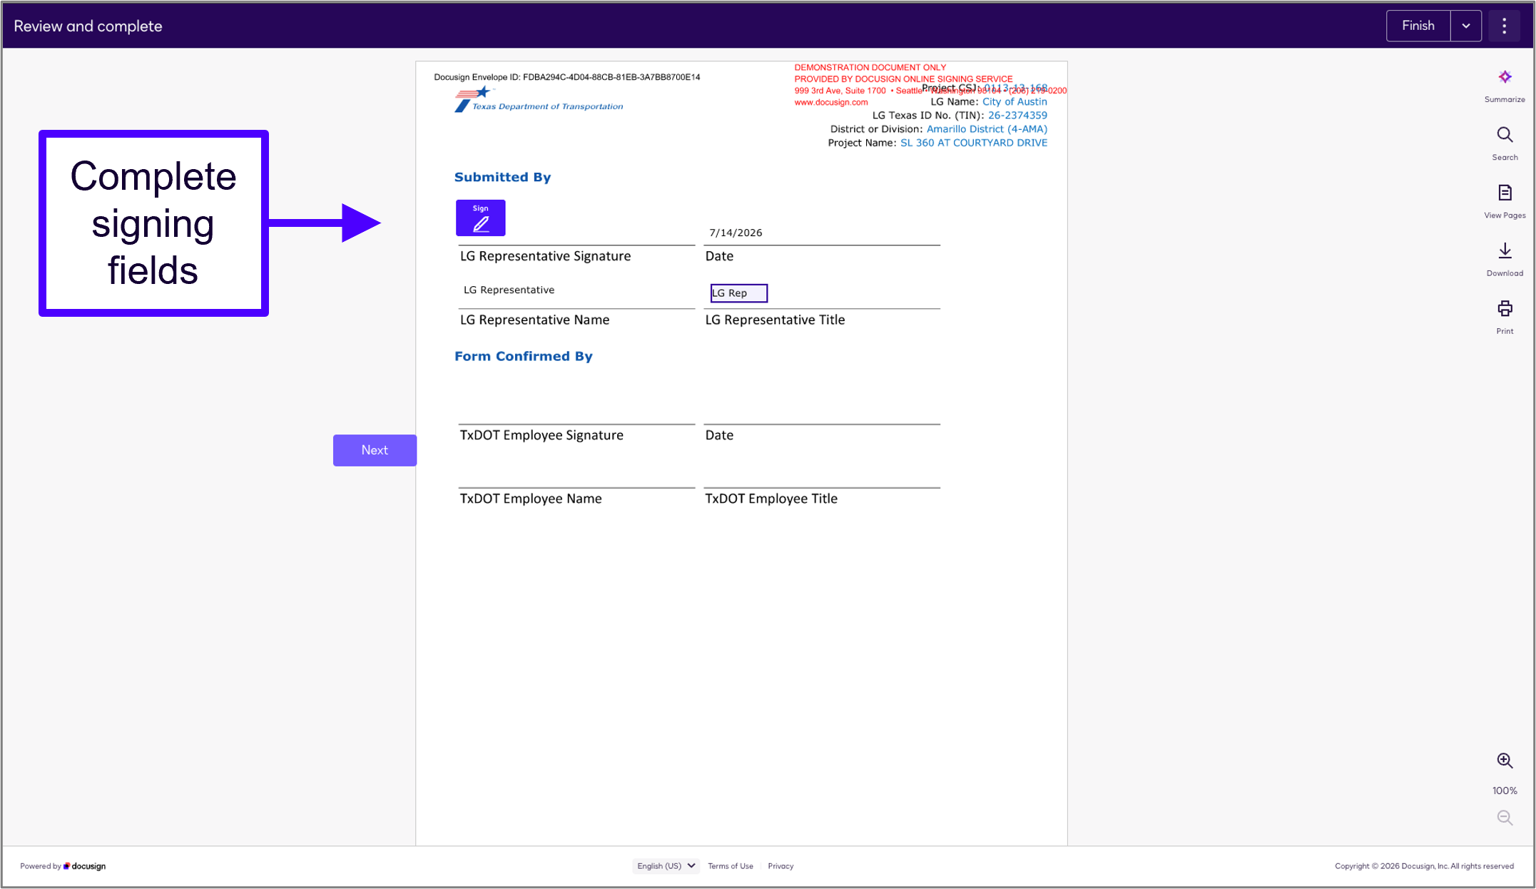
Complete Signing Fields
Once all the fields are complete, complete the signing fields at the bottom of the form.
Press Finish button.
The TxDOT employee will review the document and return it with any changes or comments.
Figure 5 – LG User’s options to “sign” and “finish” the OL SPA, Part A as it appears in DocuSign eSignature

Slide 7
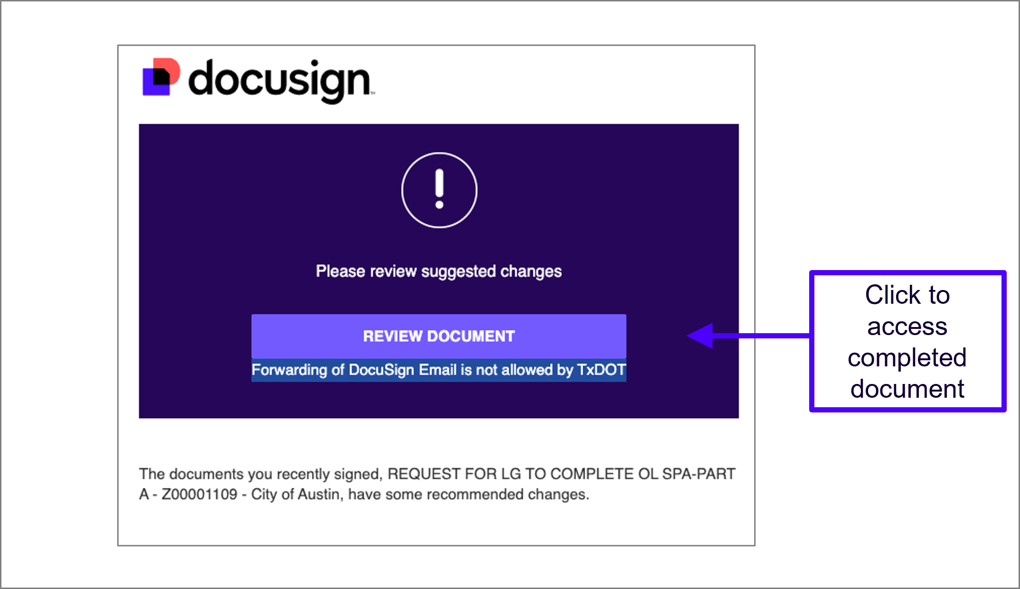
Changes Made to Document
If there are more changes or comments, the LG user will receive another email to access the updated document to review.
Figure 6 - Email notification received to alert the LG user to continue reviewing and editing the OL SPA, Part A.

Slide 8
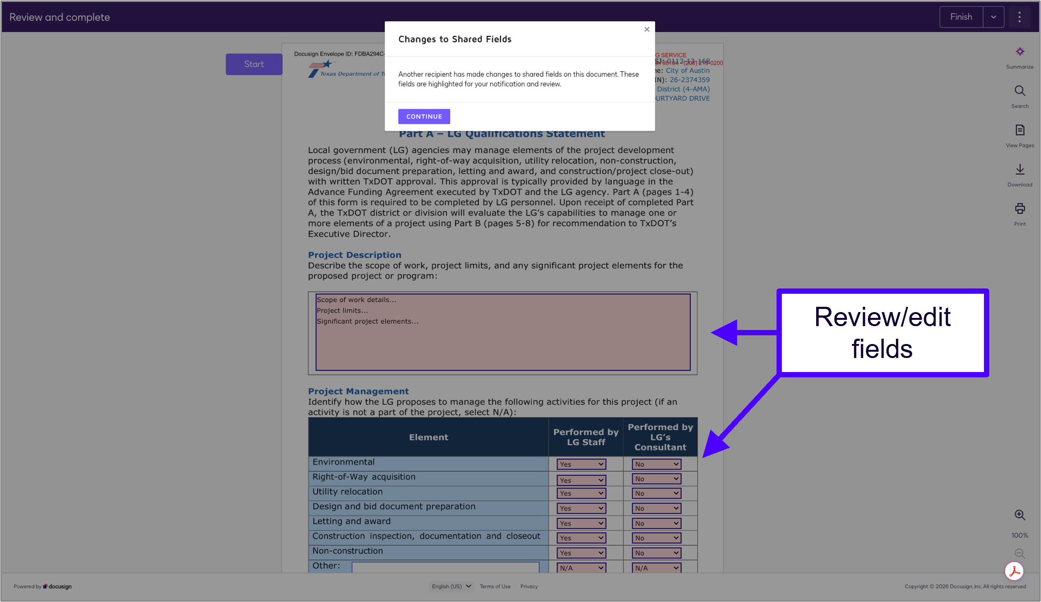
Review Changes to Form
Review the OL SPA, Part A changes and edit any fields, as needed.
Enter any additional comments to return to the TxDOT employee and initial where prompted to send back.
Figure 7 – Reviewing OL SPA, Part A and entering comments in DocuSign eSignature

Slide 9
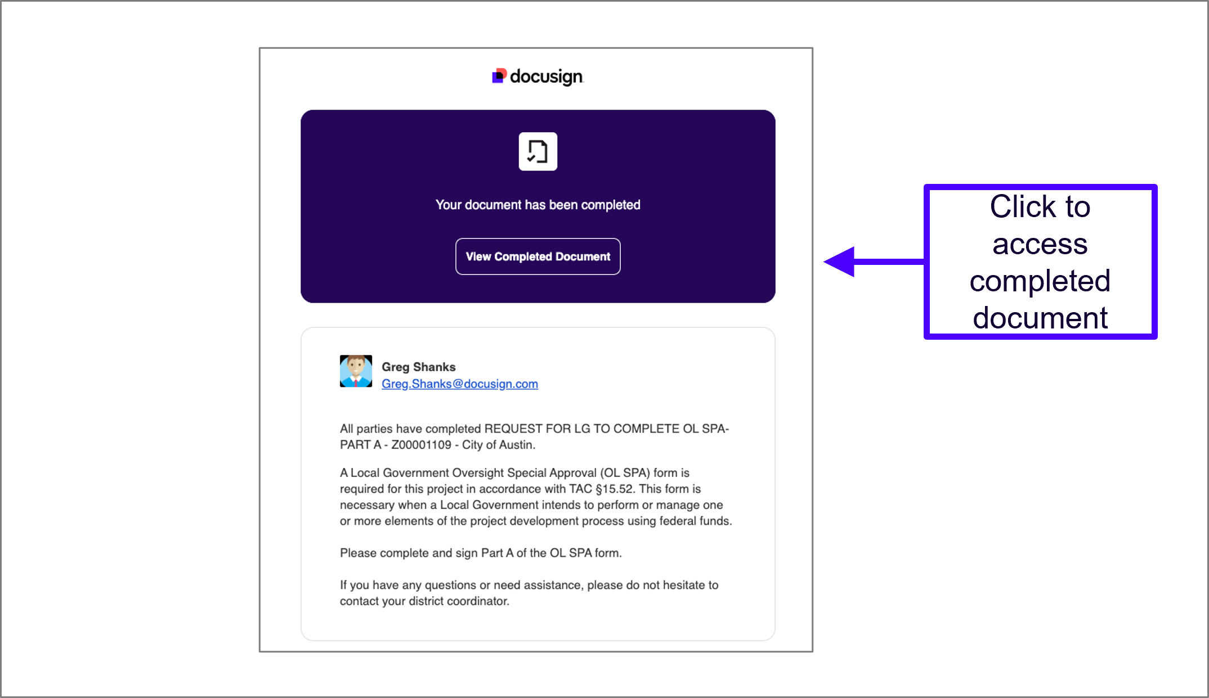
Receive OL SPA, Part A Confirmation Email
Once collaboration and editing is complete, the LG user will receive a confirmation email with link to download the completed document.
Figure 8 – Screenshot illustrating the email received by both the LG user and the TxDOT employee when the OL SPA, Part A is complete.

Slide 10
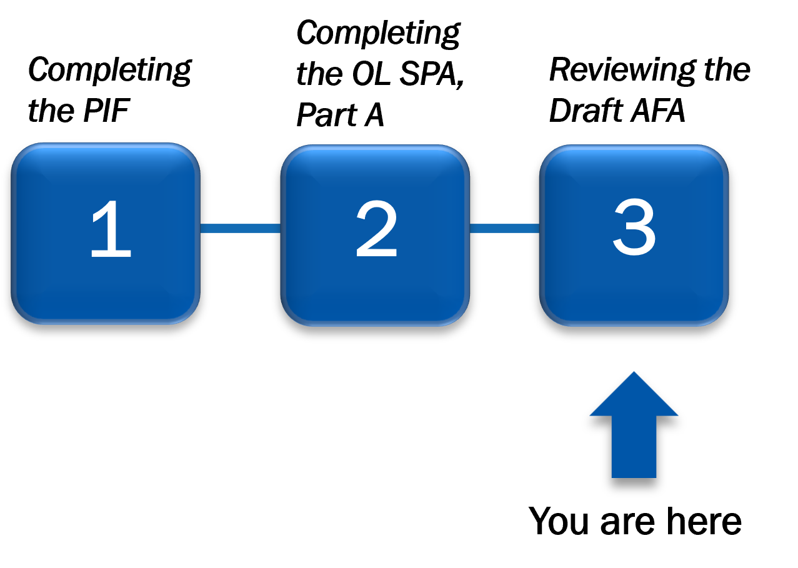
Coming Up Next…
Continue to the next presentation for a walkthrough of the Step 3: Review the Draft AFA. . If you have questions about this process, please email your district contact as listed on TxDOT’s AFA Development Process webpage.
Figure 9 – The AFA Development Process with Step 3 highlighted

