Slide 1
Local Government (LG) Task: Review Draft Advance Funding Agreement (AFA)
Contract Services Division’s AFA Development Process

Slide 2
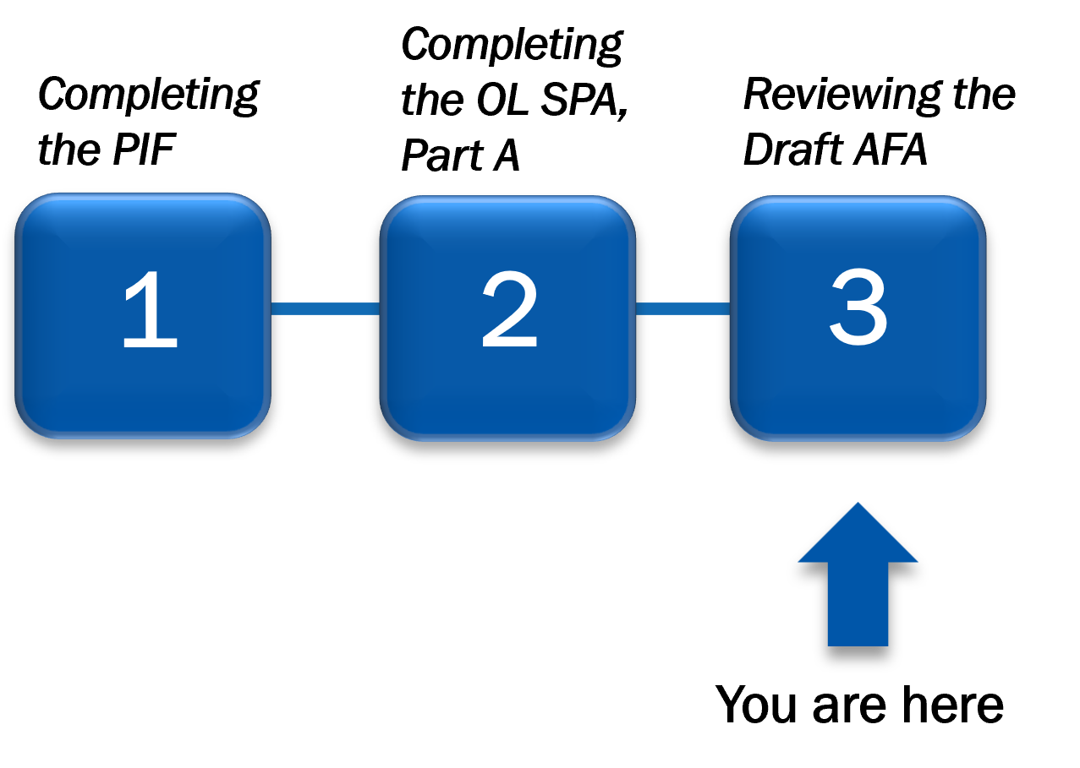
Overall Process, Local Government Tasks
In Step 3, LG representative reviews the draft AFA and confirms project details are correct.
Figure 1 – The AFA Development Process with Step 3 highlighted

Slide 3
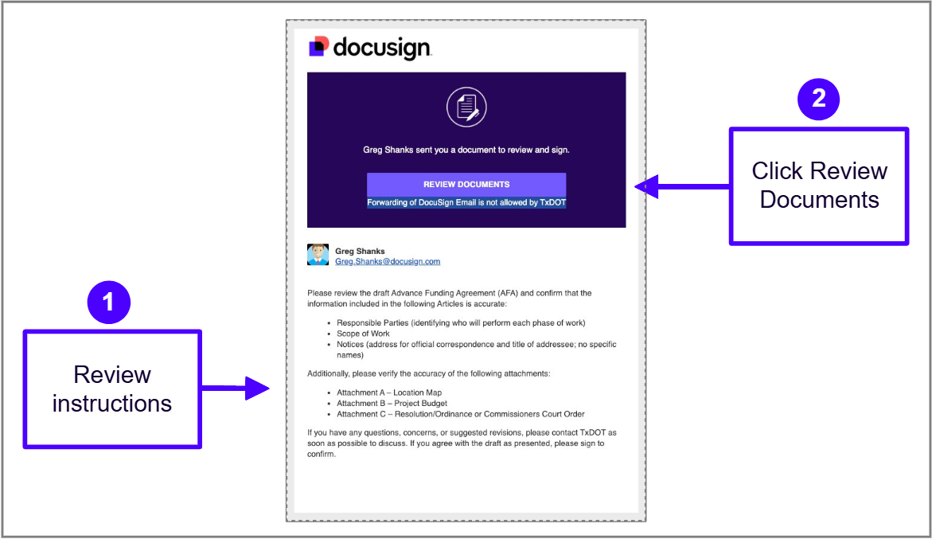
Local Government Receives Email Notification
The LG User receives an email notification and instructions for the Draft AFA.​
​Read the instructions.​
Click the Review Documents button to access the envelope.​
Figure 2 – DocuSign CLM envelope notification to LG user.

Slide 4
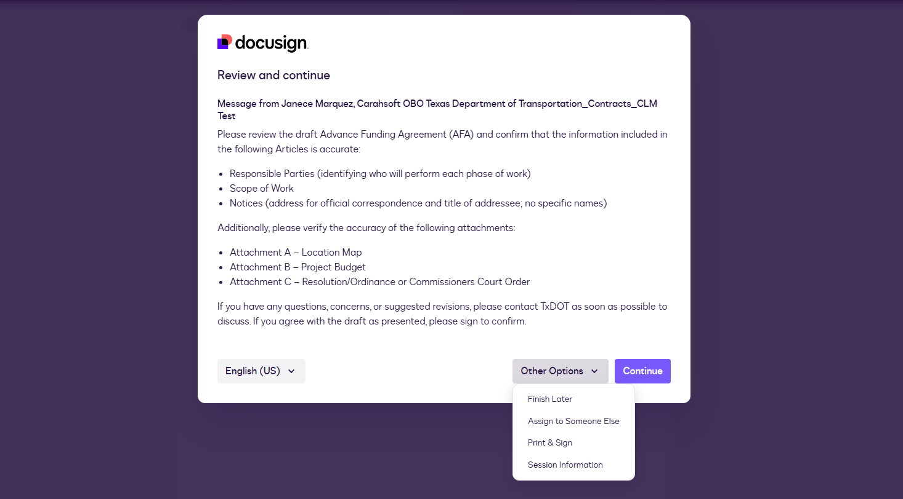
Local Government User Accesses the Envelope
Read the instructions carefully and click continue to view the document package.
If the documents need to be reviewed by someone else, click on the Other Options dropdown menu and select Assign to Someone Else.
Figure 3 – DocuSign eSignature instructions and other options page.

Slide 5
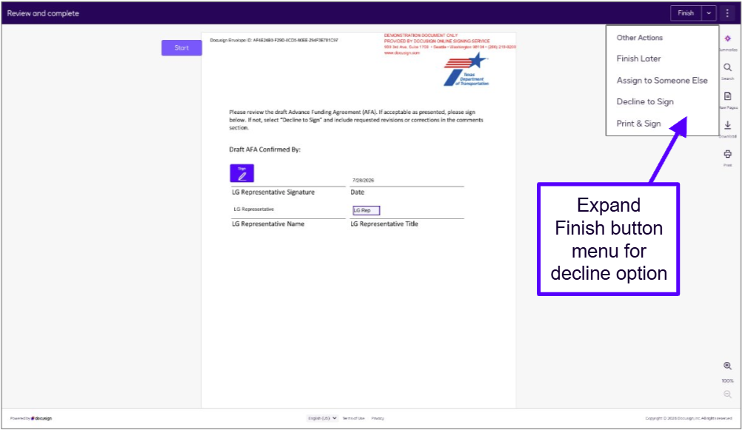
Options Available
If the LG User is not approving and signing the AFA document, they will open the Finish drop-down list and select Decline to Sign and send their comments back to TxDOT Staff who will determine the next step.
Figure 4 – Document preview in DocuSign eSignature.

Slide 6
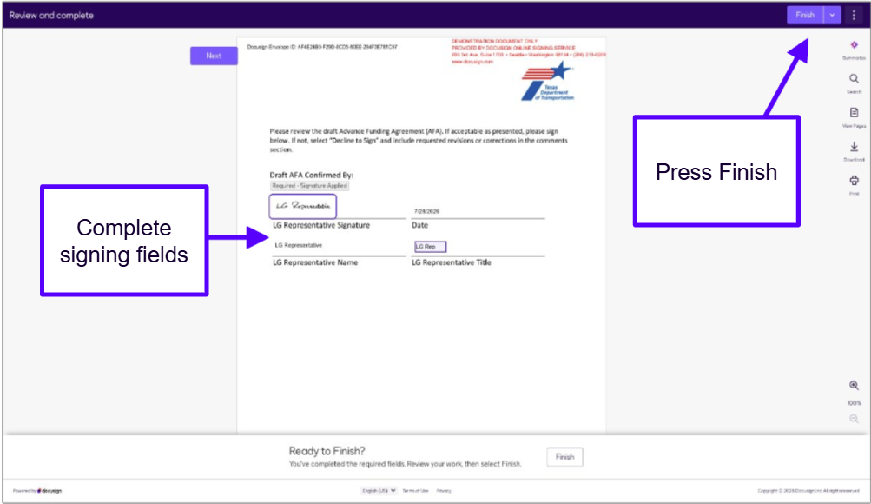
LG User Completes Required Fields
If everything looks correct and the document is approved. The Local Government representative:
Completes the required fields.
Clicks Finish to complete the review process and return the task to TxDOT staff.
Figure 5 – DocuSign eSignature, all fields completed.

