Slide 1
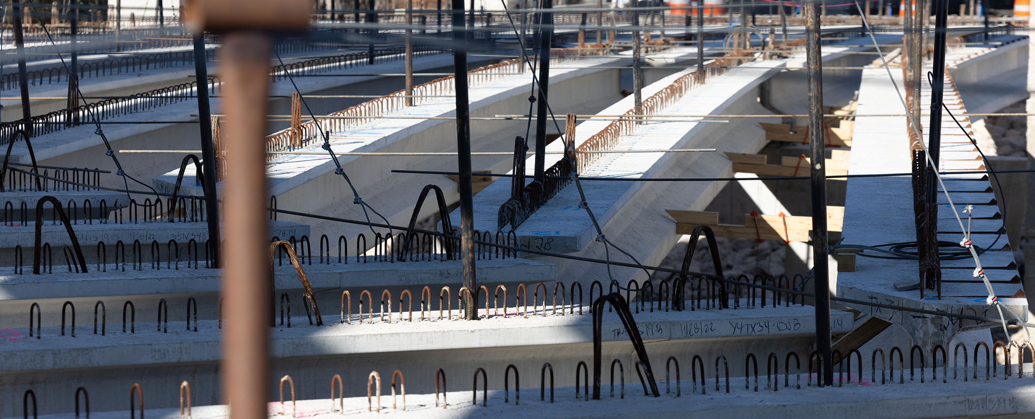
Buy America Workshop
Construction Division

Slide 2
What is required?
Iron and Steel Certifications – ALL PROJECTS
Construction Materials Certifications - SOME PROJECTS
  Determined by Buy America Material Classification sheet.
    Non-ferrous Metals, Plastics & Polymers, Glass, Drywall, Lumber,
      (SP6-30;SP6-39)
    Above Plus Fiber Optic Cable, Optical Fiber, and Engineered Wood.
      (SP6-40)
      2024 Spec: (SP6-1;SP6-5)

Slide 3
CONSTRUCTION MATERIALS

Slide 4
Required by Special Provisions
Nov 2022
Letting
Dec 2023
Letting
May 2025 Letting
Dec 2025 Letting
Original Buy America |  | BABA | BABA | BABA | BABA
(Iron and Steel) |  | Version 1 | Version 2 | Version 3 | Version 4
Contract | Item 6 | SP 006-030 | SP006-040 | SP006-005 (2024 Spec) | TBD
Language |  | SP 006-039 | SP006-001 (2024 spec)
Construction |  | CM List | CM List | CM List
Materials |  | 1. Non-Ferrous Metals, 2. Plastic and polymer-based products (PVC, composite building materials and 3. Glass (including optic glass) 4. Lumber, or 5. Drywall | <-- SAME BUT ADD: 6. Fiber Optic Cable (include drop cable) 7. Optical Fiber, and 8. Engineered Wood Adding Minor Additions does not classify Construction Material as a Manufactured Product. | No change
Buy America Paperwork | N/A | Form 2806 Version 1 | Form 2806 Version 2 | Form 2806 Version 2

Slide 5
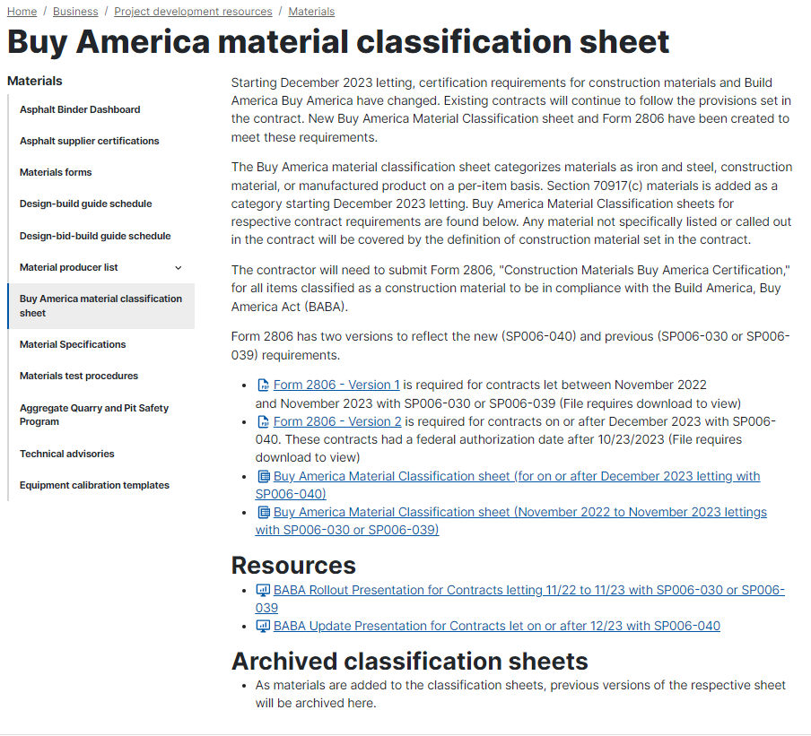
Buy America Material Classification Sheet
  Stored at same location as MPL:
  TxDOT.gov →
  Do Business →
  TxDOT Specifications →
  (bottom of page under additional Resources)
  Or
  Search “Buy America Material Classification sheet” @ txdot.gov
  SP006-005 use classification sheet for SP006-040

Slide 6
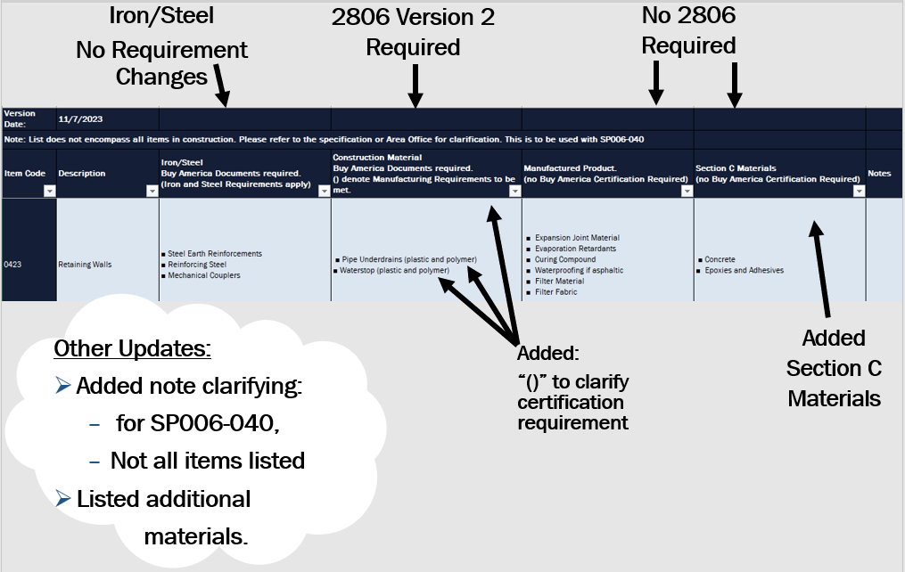
Project Records Checklist

Slide 7
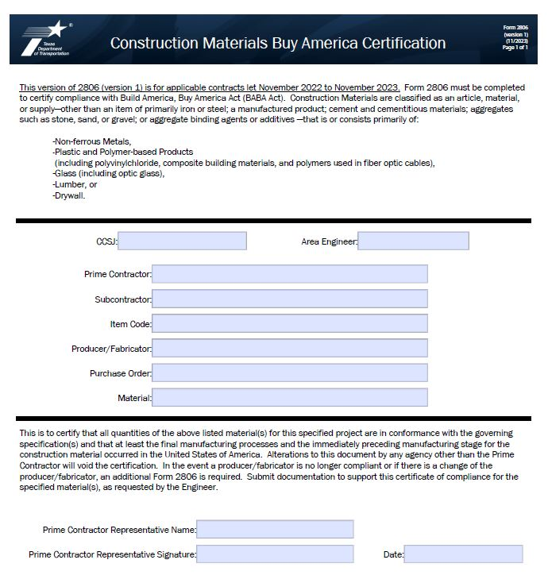
Construction Materials Buy America Certification-2806 Version 1
Example of Form 2806 Version 1 (11/2023) to be used for contracts let November 2022 to November 2023.
Information regarding SP006-030 and a Change Order for SP006-039.
Complete with Project Information:
  CSJ
  Area Engineer
  Prime Contractor Name
  Subcontractor (if applicable)
  Item Code
  Producer/Fabricator
  Purchase Order
  Material
Certified by the Prime Contractor’s Representative, including name, signature and date.
Stored under the 2806 folder.

Slide 8
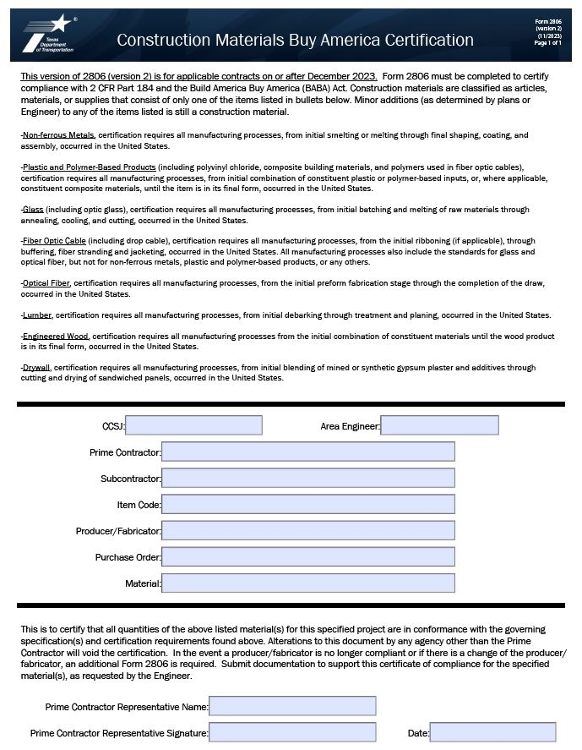
Construction Materials Buy America Certification–2806 Version 2
Example of Form 2806 Version 2 (11/2023) to be used with contracts letting on or after December 2023.
Information regarding SP006-040.
Complete with Project Information:
  CSJ
  Area Engineer
  Prime Contractor Name
  Subcontractor (if applicable)
  Item Code
  Producer/Fabricator
  Purchase Order
  Material
Certified by the Prime Contractor’s Representative, including name, signature and date.
Version 2 includes additional construction materials and information defining the materials being certified.
Stored under the 2806 folder.

Slide 9
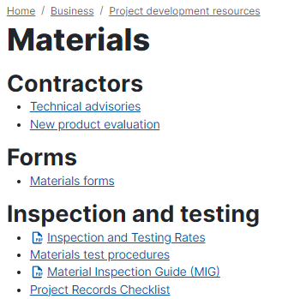
Area Office Guidance
Refer to Project Records Checklist. (found on txdot.gov)

Slide 10
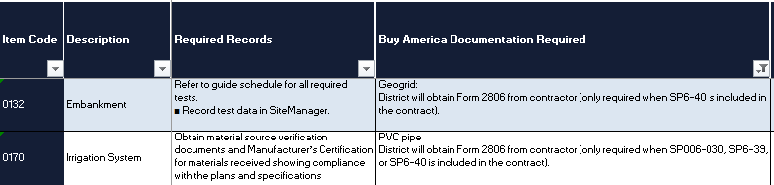
Area Office Guidance Continued
Only Area Office collects form 2806 for specific materials
Only list Standard Specifications

Slide 11
Iron and Steel

Slide 12
Required by Item 6 “Buy America”
Certification and Testing for all predominantly iron and steel products permanently installed.
For Certification
  1818 → TxDOT’s Certification form.
  Material Certification letter (covers miscellaneous iron or steel)
For Testing:
  MTRs – Mill Test Reports
    Contains Buy America certification statement

Slide 13
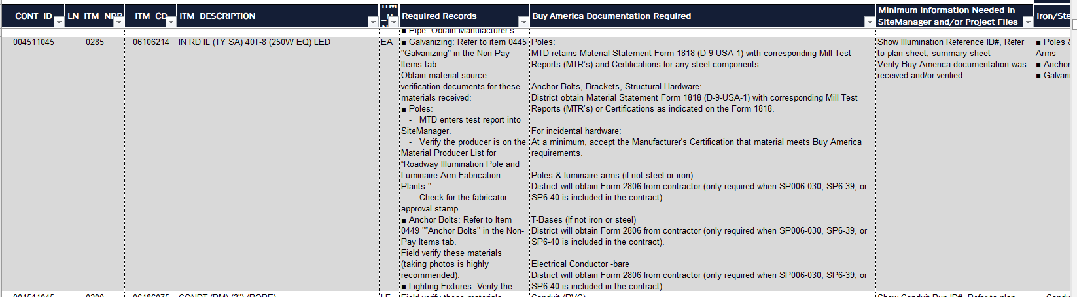
Area Office Guidance Project Records Checklist
Refer to the Project Records Checklist.
  Search txdot.gov under materials
  Standard Specifications only

Slide 14
Documentation – Office of Record
Scenario 1) Structural Tested Steel
Structural (MTD) obtains the documentation and is the office of record.
Scenario 2) MPL Steel items (not reinforcing steel)
AE Inspected – District/Area Office obtains the documentation and is the office of record. This requirement applies if the material is tracked in SiteManager or not.
Project Sample Sent to MTD - For some items identified on the project records checklist, District/Area Office obtains the documentation and submits with each sample.
Scenario 3) Reinforcing Steel
3a) Precast – MPL
3b) Cast in Place – Paperwork & Field Verification
  In addition, inspectors are to review tags and marks on all steel received, including MTD inspected and QM materials, to ensure that the materials received correspond with the test reports and are not form a foreign source.

Slide 15
1) MTD verifies Certification
Bridge Bearings
  Material codes (MC): 0435PADS00; 0441BRBEAR
Precast Concrete Beams, Deck Panels, Bent Caps
  MC: 0420PCABUT; 0420PCAP00;0420PCCOLM; 0420PCARCH; 0420PCSPAN; 0425PCBEAM; 0425PNL000
Structural Steel Bridge Members
  MC: 0407PIPLNG; 0442MISCST; 0442BRGSTL;
Steel Traffic, Pedestrian, or Combination Railing (TxDOT Standards Only)
  MC: 0450RAIL00; 0450RLPOST; 0450TUBE00
MBGF Retrofit/Transitions Anchor Plates
  MC: 0540TRANPL

Slide 16
1) MTD verifies Certification Continued
Large Roadside Sign Supports
  MC:0647SPTS00
Bridge Rail Mounted Sign Supports
  MC: 0441MISCST
Pedestrian Bridges
  MC:4007PEDBRG
Overhead Sign Supports and Sign Walkways
  MC: 0650OSS000; 0654WLKWY0
High Mast Illumination Rings/Support Assemblies
  MC:0614RINGS0
Traffic Signal Poles,
Intelligent Transportation System(ITS),
Camera, Roadway, and
High Mast Illumination Poles
  MC: 0686POLE00

Slide 17
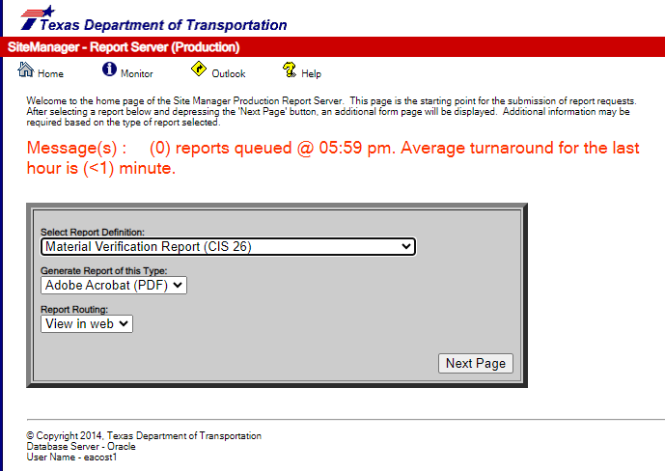
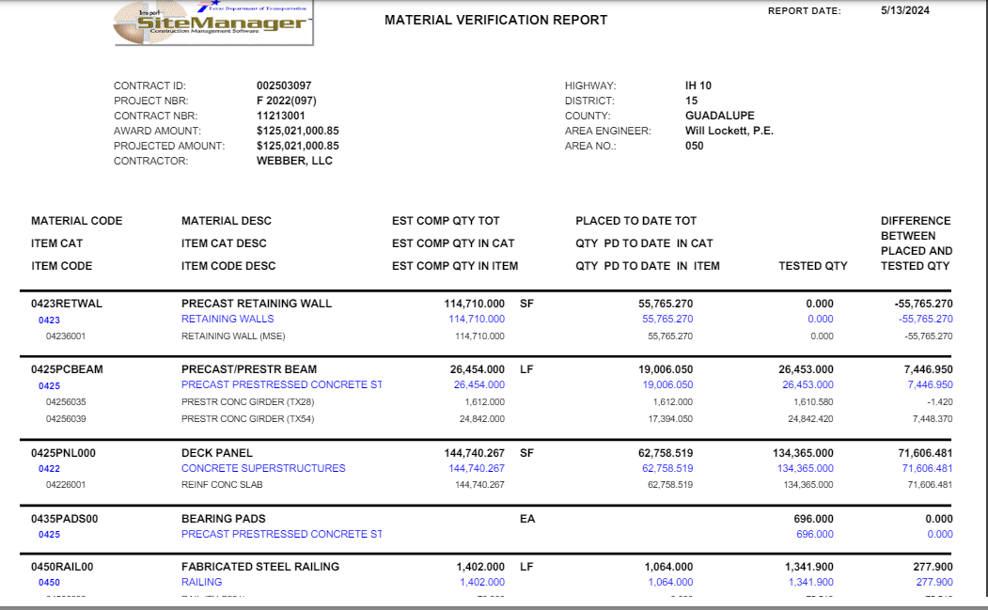
1) MTD verifies Certification - CIS 26 Report

Slide 18
2) District obtains Certification
Mechanical Couplers
Multi-Piece Tie Bars
Steel Piling
Anchor Rods
Anchor Bolts
Corrugated Metal Pipe
Frame, Grates, & Ring Covers
Chain Link Fence
Wire or Ornamental Fence
Pipe Runners
Slotted Drains
Steel Shoes (Components)
MBGF rail, steel post, hardware
Cable Barrier and post
End Treatments
Crash Cushions (permanent)
Steel pipe
Steel Earth Reinforcement
Permanent metal decking
Mail Box Assemblies
Small Roadside Sign Post, Wing channel post.
Roadside Flashing Beacons
Pedestrian Pole Assemblies
Gabion Mattress

Slide 19
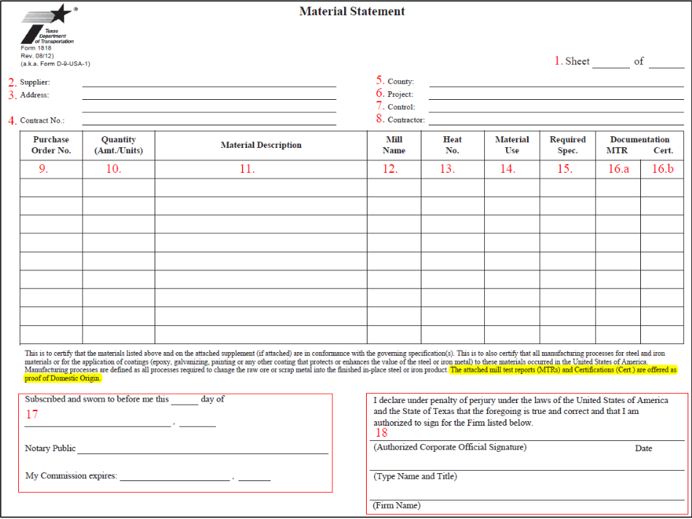
Buy America Documentation – Form 1818
All fields must be filled out completely to be an acceptable Form 1818.

Slide 20
Buy America Documentation – Form 1818 Steps 2-4
All fields must be filled out completely to be an acceptable Form 1818.
2. Supplier: Supplier, Vendor, or Distributor's Name
3. Address: Supplier, Vendor, or Distributor’s Address
4. Contract No (Optional).: Contract Number between supplier and manufacturer or utility owner

Slide 21
Buy America Documentation – Form 1818 Steps 5-8
All fields must be filled out completely to be an acceptable Form 1818.
5. County: County name of project location
6. Project: TxDOT Project name or highway name
7. Control: ROW CSJ, Construction CSJ, U#, and/or Utility ID#
8. Contractor: Contractor name performing the adjustment and identified as the selected awarded contractor in the bid tabs or fee schedule

Slide 22
Buy America Documentation – Form 1818 Steps 9-11
All fields must be filled out completely to be an acceptable Form 1818.
9. Purchase Order No.: Purchase order number from the invoice that will be submitted for billing or from the Mill Test Report (MTR).
11. Material Description: The material description should match what was identified on the cost estimate and include the item # and on the MTR or Certification.
10. Quantity (Amt./Units): Actual quantity installed with appropriate unit obtained from the cost estimate.

Slide 23
Buy America Documentation – Form 1818 Steps 12-15
12. Mill Name: Mill name from the MTR or manufacturer.
All fields must be filled out completely to be an acceptable Form 1818.
13. Heat No.: The heat number should match the heat number found on the attached MTRs. “See attached” is not an acceptable form to document..
Note: If a Certification is submitted instead of an MTR, this box will be N/A.
15. Required Spec.: Industry specifications used.
14. Material Use: What are the materials used for? Examples of acceptable items are Casing, Valve, Rebar, etc.

Slide 24
Buy America Documentation – Form 1818 Step 16
All fields must be filled out completely to be an acceptable Form 1818.
16. Documentation: MTR or Cert. should be selected, per the documentation being submitted. The attached MTRs and Certifications are offered as proof of Domestic Origin.
16.a MTR: The Mill Test Report (MTR) issued and signed by the initial fabricator stating that the Buy America materials were melted and manufactured in the United States.
16.B Cert.: Certification (Cert.) should state that all products that are composed predominately of steel and/or iron were manufactured domestically, in compliance with the BUY AMERICA provisions of 23 CFR 635.410. Certification should be project specific.
Note: Specifications, shop drawings, catalog pages, and emails are not acceptable documentation for compliance.

Slide 25
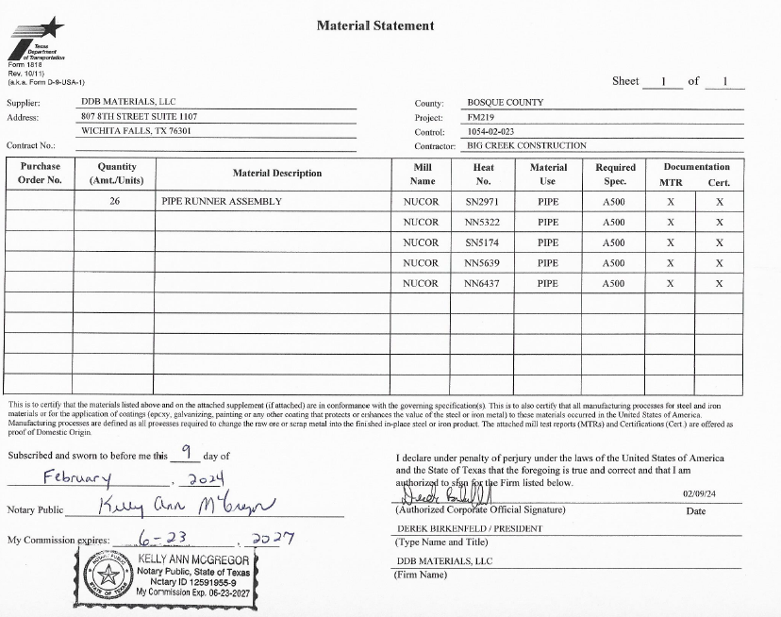
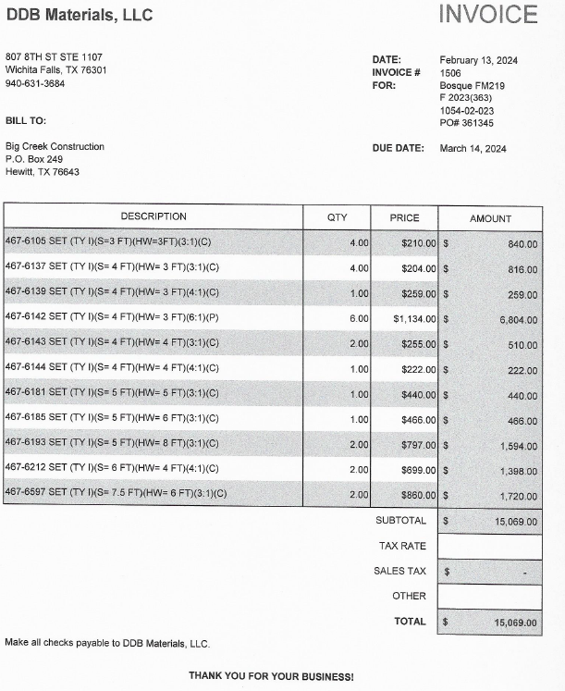
2) District obtains Certification & MTR

Slide 26
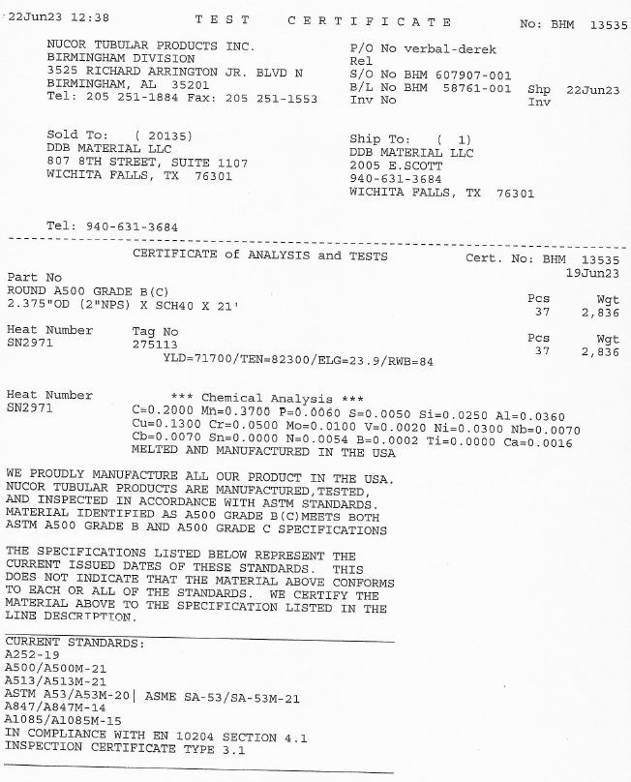
2) District obtains Certification & MTR Continued

Slide 27
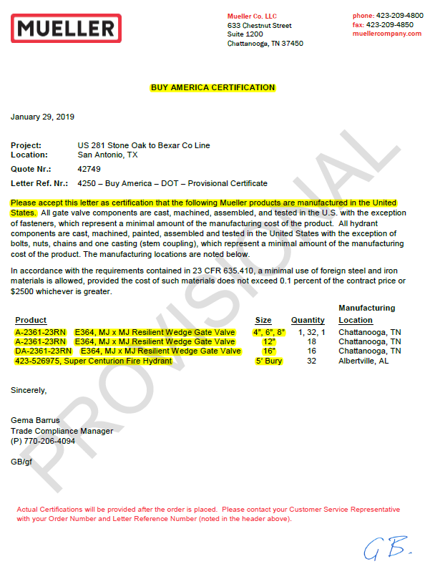
2) District obtains Certification of Compliance
Company Logo Address
Project Information
Company Letterhead
Buy America 23 CFR 635.410
Product description name from approved estimate, invoice and Form 1818
Signed by an authorized representative
Notarize as required by 1818
Name and Signature

Slide 28
3) Reinforcing Steel

Slide 29
3a) Reinforcing Steel - Precast Concrete Products
District verifies source (MTR at plant):
  Manholes, Inlets, and Junction Boxes,
  RC Pipe,
  Box Culverts,
  Concrete Railing,
  Traffic Barriers,
  Piling,
  Retaining Wall Panels and Coping, and
  Sound/Noise Wall Panels and Coping.

Slide 30
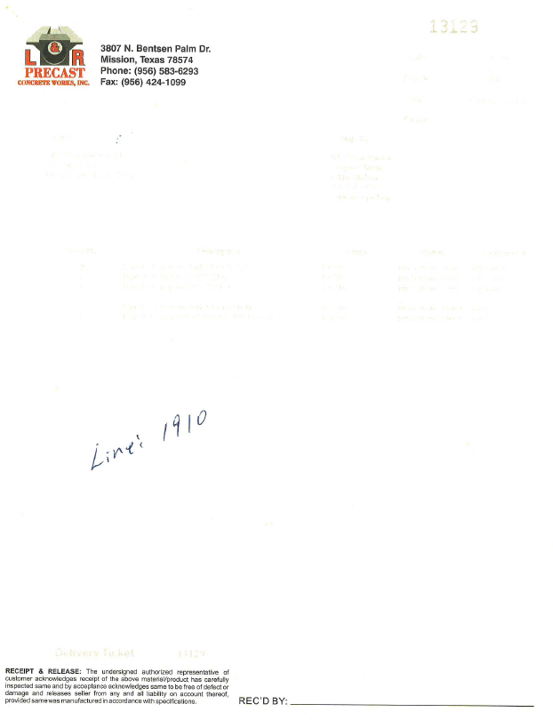
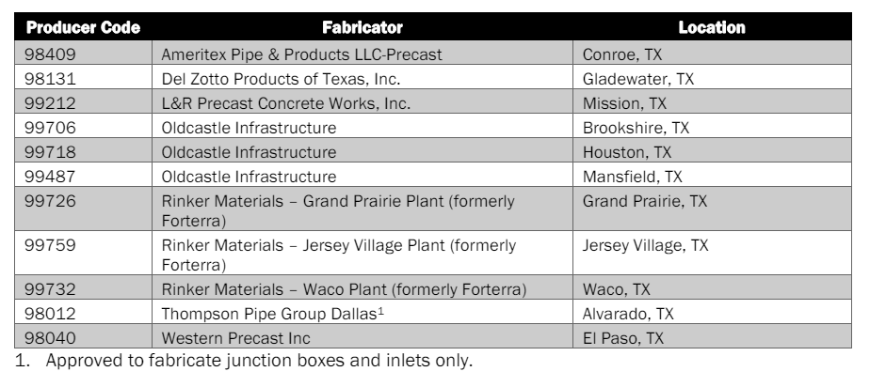
3a) Reinforcing Steel - Precast Concrete Products Cont.

Slide 31
3b) Rebar Certification – Cast in place
Reinforcing Steel Mills are all verified annually by AASHTO Product Evaluation and Audit Solutions.
  Formerly AASHTO National Transportation Product Evaluation Program (NTPEP).
1818 is not required, but source requires to be verified.
MTRs are required to meet the testing requirement.
Suppliers need to be connected to the Mill Test Report.

Slide 32
Rebar Items – To Do
Verify Source on MPL. (May be multiple sources!)
Request MTRs to pair up with Bill of Lading/invoice/supplier documentation.
  Also request to tie to line items steel
Field Verification – Take pictures of Rebar Markings
Field Verification – Verify Mill tags to where rebar is going if possible.
Record verification in DWRs.

Slide 33
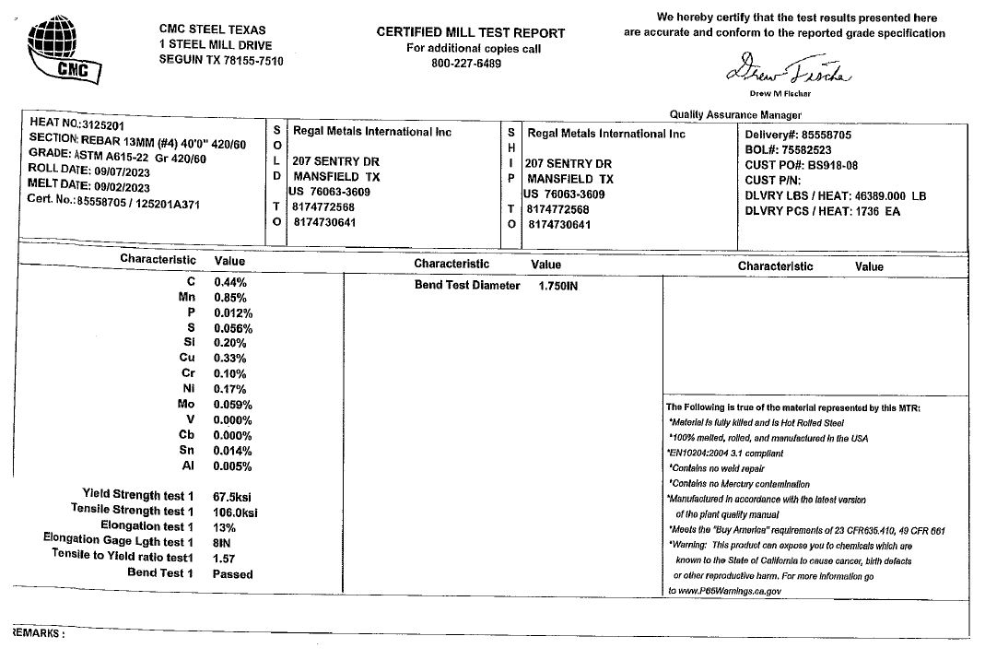
3b) Certified Mill Test Report Information

Slide 34
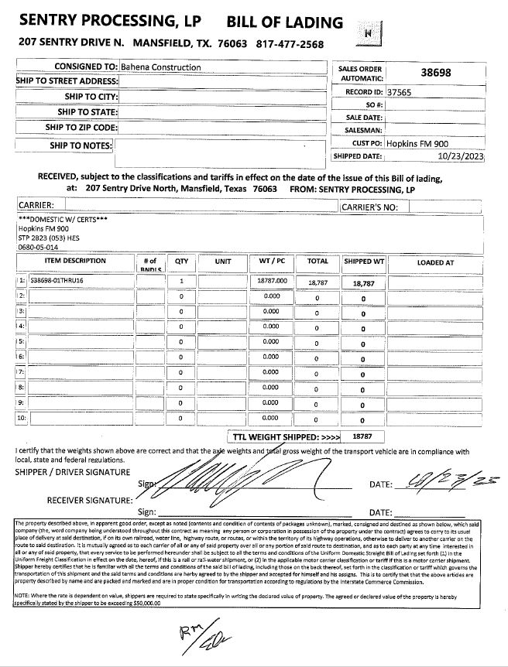
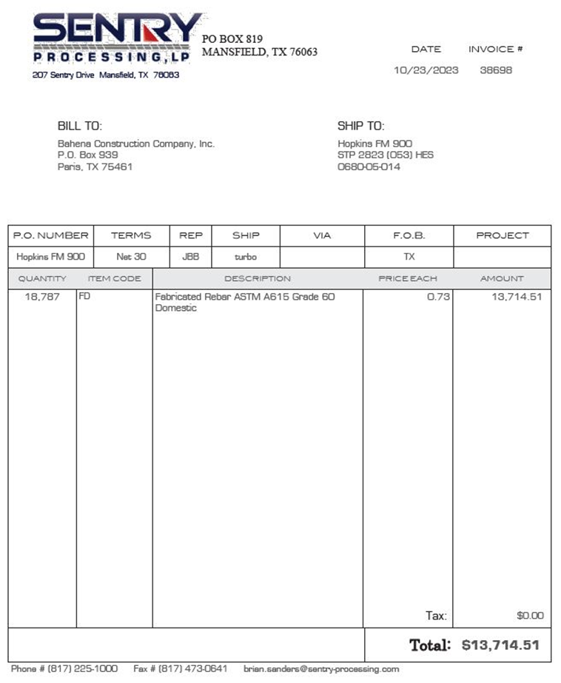
3b) Bill of Lading & Invoice

Slide 35
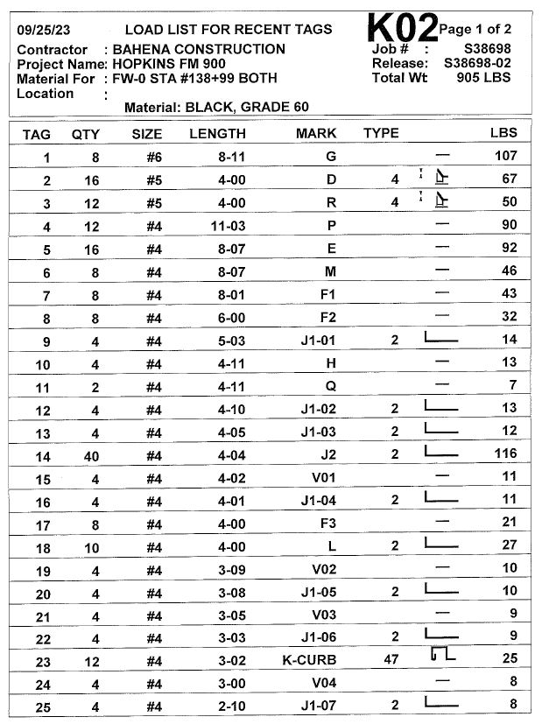
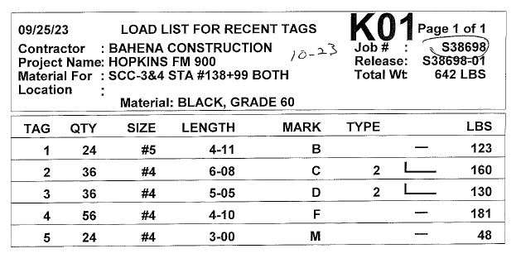
3b) Load List for Recent Tags

Slide 36
3b) Certified Mill Test Report Missing Information

Slide 37
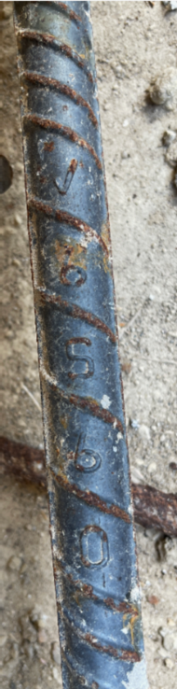
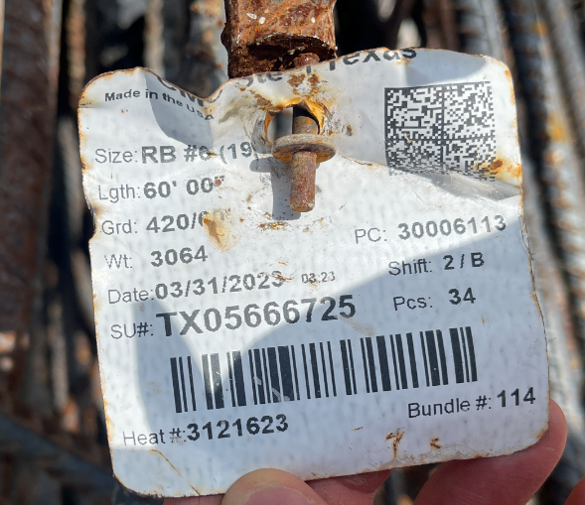
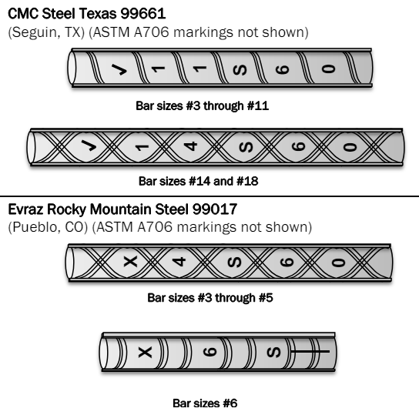
3b) Field Verification – Verify Rebar Markings

Slide 38
De Minimis

Slide 39
What is De Minimis
Allows contractors to use Foreign products up to a limit.
  Contractor to provide documentation prior.
Construction Materials:
  no more than the lesser of $1,000,000 or 5% of Total Applicable Costs for the project… Contractor must provide documentation showing under threshold in advance for Engineer’s consideration.
Iron/Steel products:
  cost, including delivery, does not exceed 0.1% of the total Contract cost or $2,500….Contractor must provide documentation showing under threshold in advance for Engineer’s consideration.

Slide 40
Tips and Tricks

Slide 41
How to make this easier?
Discuss at Pre-Con → No paperwork, no payment
Review Material Sourcing letter for required items.
Verify for Material on Hand payment.
Try to match up Heat Numbers/MTRs with Items in field
  Require notification and line numbers on MTRs
Request 1818 with item or line number identification
  Example: “467 – Pipe Runners”
Share Project Record Checklist with all parties (subs and vendors)
Set clear expectations

Slide 42


Any questions?
Eduardo.Acosta@txdot.gov
Construction Division

