Slide 1

Veteran Heroes United in Business (VetHUB) Participation &
Subcontracting Plan Requirements
Presented by: Civil Rights Division

Slide 2
Respondent Responsibilities
Mandatory Submission​
  All respondents to the solicitation requiring subcontracting plans must submit a complete plan regardless of subcontracting intentions or 0% Goal.
Good Faith Efforts​
  Respondents intending to subcontract must demonstrate good faith efforts to recruit certified VetHUB subproviders (subcontractors).​
Inclusive Subcontractor Listing​
  All proposed subproviders (subcontractors), including staffing resources, must be listed in the plan to ensure transparency.​
Self-Performing Respondents​
  Respondents self-performing entire contracts must indicate no subcontracting but still submit the required subcontracting plan sections.​

Slide 3
Overview of Key Subcontracting Plan Sections​
Respondent Information Collection​
  Section 1 gathers essential company and contact details from respondents, ensuring accurate identification.​
Self-Performance or Subcontracting Declaration​
  Section 2 requires respondents to declare their intent to self-perform or subcontract parts of the contract.​
Subcontracting Opportunities and Percentages​
  Section 4 identifies subcontracting opportunities and the expected percentage allocations for each.​
Affirmations and Good Faith Efforts​
  Sections 3, 5, and 6 include affirmations and document good faith efforts to ensure compliance and accuracy.​

Slide 4
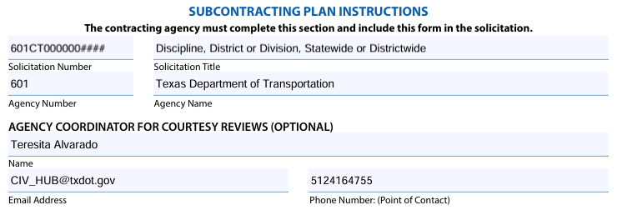
Subcontracting Plan Instructions – Page 1
Solicitation
Number
Title
Agency
Number
Name
Agency Coordinator for Curtesy Reviews
Name
Email Address
Phone Number
Figure 2- Subcontracting Plan Instructions
Figure 1- Solicitation and Agency Information
Notes:
new

Slide 5
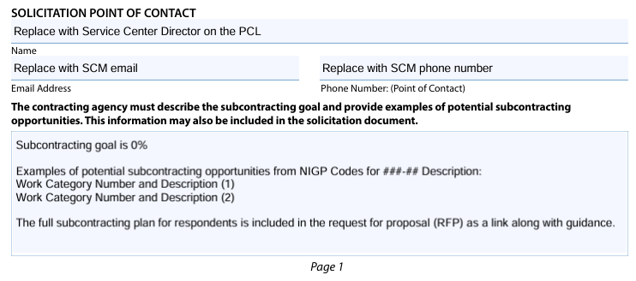
Subcontracting Plan – Solicitation Information
Solicitation Point of Contract
Name
Email Address
Phone Number
Subcontracting goal and examples of potential subcontracting opportunities.
A full list of subcontracting opportunities are provided in the Request for Proposal (RFP).
A full list of subcontracting opportunities are provided in the request for proposal (RFP).
The full subcontracting plan for respondents is included in the RFP as a link along with guidance.
Figure 3- Solicitation Point of Contact
Figure 4- Solicitation Information
Notes:
new

Slide 6
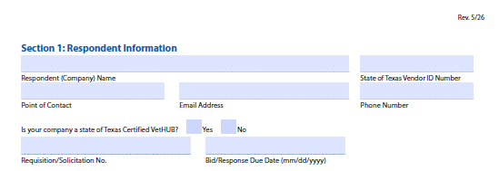
Section 1 – Respondent Information​
Essential Respondent Details​
  Include legal company name, Texas Vendor ID, and primary contact details for clear identification.​
Certification Status​
  Respondent representative must indicate if certified VetHUB with the State of Texas within the respondent information.​
Solicitation and Due Dates​
  Accurately provide solicitation number and proposal response due date to ensure timely processing.​
Accuracy Importance​
  Correct information prevents processing delays, confusion, and administrative issues during procurement, and could help to prevent disqualification.
Figure 5- Section 1: Respondent Information

Slide 7
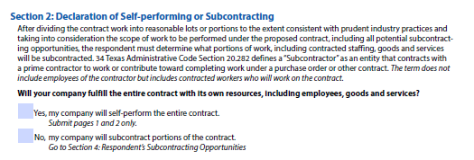
Section 2 – Declaration of Performance Method​
Self-Performance Declaration​
  Respondents must declare if all work will be completed using their own labor, materials, and services without subcontracting.​
Subcontracting Identification​
  If subcontracting is planned, respondents need to outline subcontracting opportunities clearly in the subcontracting plan.​
Importance of Accurate Declaration​
  Accurate performance declarations prevent noncompliance and enforcement issues after contract award.
Figure 6- Section 2: Declaration of Self-performing or Subcontracting

Slide 8
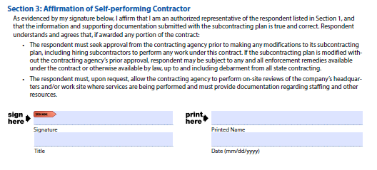
Section 3 – Self‑Performing Contractor Affirmation​
Affirmation of Self-Performance​
  Respondents certify that they will self-perform the entire contract without subcontracting unless approved.
Figure 7- Section 3: Affirmation of Self-performing Contractor

Slide 9
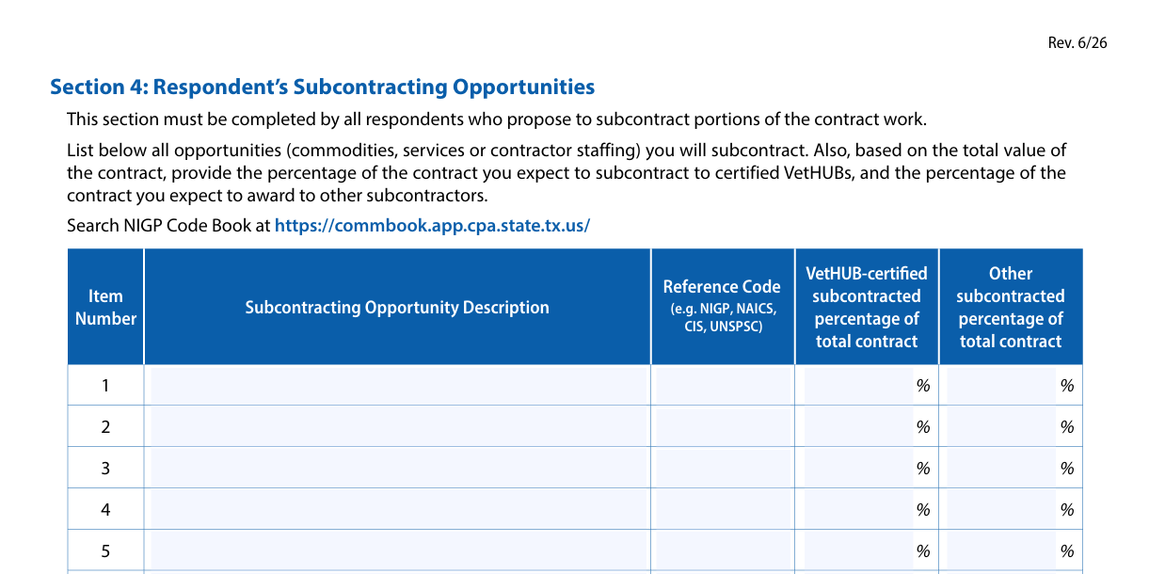
Section 4 – Subcontracting Opportunities
Listing Subcontracting Opportunities​
  Respondents must list all subcontracting opportunities with detailed descriptions of goods, services, or staffing involved.​
Including National Institute of Governmental Purchasing (NIGP) Codes and Estimates​
  Respondents include NIGP codes and estimate percentage of contract value for certified VetHUB and other subcontractors.​
Importance of Accuracy​
  Accurate completion is essential as it informs evaluation of subcontracting strategy and good faith effort documentation.​
Figure 8- Section 4: Respondent’s Subcontracting Opportunities

Slide 10
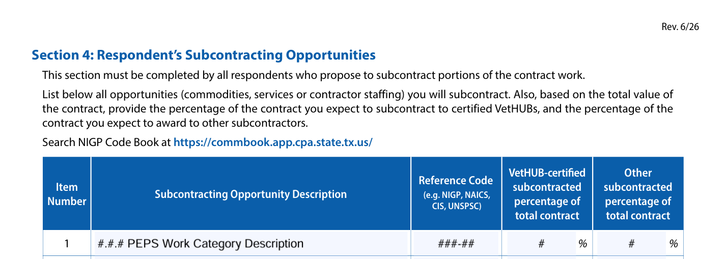
Section 4 - PEPS Example
Example of Professional Engineering Procurement Services (PEPS) Work Category in the Subcontracting Opportunity Description.
  Reference Code example is NIGP with Class & Item Code
Figure 9- Section 4: Respondent’s Subcontracting Opportunities Example
Notes:
new

Slide 11
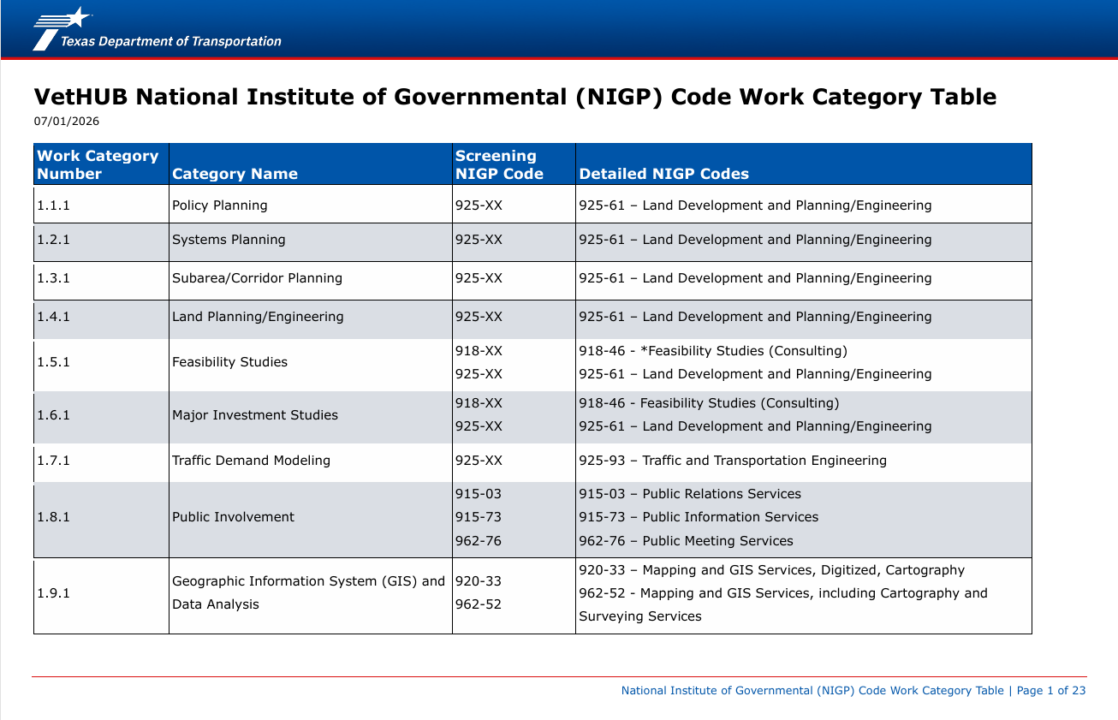
VetHUB(HUB) NIGP Work Category Table
Figure 10- VetHUB NIGP Work Category Table
Notes:
new

Slide 12
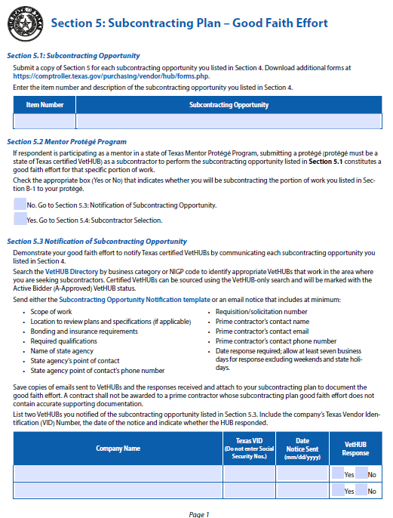
Section 5 – Good Faith Effort Overview
Purpose of Section 5​
  Section 5 ensures respondents document efforts to notify and consider certified VetHUB subcontractors for each opportunity.​
  Good faith effort is critical to compliance; inadequate documentation can lead to plan rejection or contract denial.​
  Respondents must carefully record notifications, responses, and decisions with clear evidence for transparency.​
Figure 11- Section 5: Subcontracting Plan – Good Faith Effort

Slide 13
Notification of Subcontracting Opportunity
Notification Process​
  Respondents must notify at least two certified VetHUBs by searching directories and sending written notifications.​
Essential Notification Details​
  Notifications should include scope of work, qualifications, bonding, insurance, agency, solicitation number, and deadlines.​
Response and Documentation​
  Allow seven business days for responses and retain all notifications and replies for compliance.​
Transparency and Compliance​
  Proper notifications ensure transparency, fairness, and adherence to state subcontracting requirements.
Notes:
New slide header

Slide 14
Section 5.3
Section 5.3 contains direct checkboxes or columns asking if the VetHUB subprovider (subcontractor) responded ("Yes" or "No").
The Outcome is Your Proof: If you check "No" (meaning they did not respond) or if you attach an email showing they declined or quoted too high, the attachments themselves act as your justification. The agency will read your attached email proof rather than reviewing a typed statement.
You can highlight the justification statement, highlight the specific statement or note the justification on the blank page under Section 5.4 Subcontractor Selection
You must still attach the email correspondence proof.
DO NOT attach unnecessary email thread conversations
Figure 12- Section 5.3: Notification of Subcontracting Opportunity
Notes:
(new slide from Teresita’s notes)

Slide 15
Good Faith Effort
Respondents are advised to utilize the Texas Comptroller of Public Accounts (CPA) Centralized Master Bidders List (CMBL) Directory to identify qualified, certified VetHUB and Historically Underutilized Business (HUB) subcontractors. This database must be searched to satisfy the minimum outreach requirements necessary to demonstrate a good faith effort.
Please note that searching the TxDOT Precertified Firms list alone does not satisfy the good faith effort outreach requirement. However, if a solicited VetHUB is not selected, the lack of proper qualifications or TxDOT Pre-Certification may be used as valid supporting documentation to justify your final subcontractor selection.

Slide 16
Documentation
Requirement (has not changed)
Notification of 7 days (with date) to only two VetHUBs
If the respondent replied and you didn’t choose them, highlight why
Document if the VetHUB didn’t respond
Not Required
VetHUB(HUB) Subcontracting Plan Compliance Checklist (from TxDOT)
Extra unrelated correspondence
Extra respondents beyond the required two
Figure 13- Necessary versus Not Necessary Information
Notes:
Talk with Teresita (new slides from what Teresita mentioned)

Slide 17
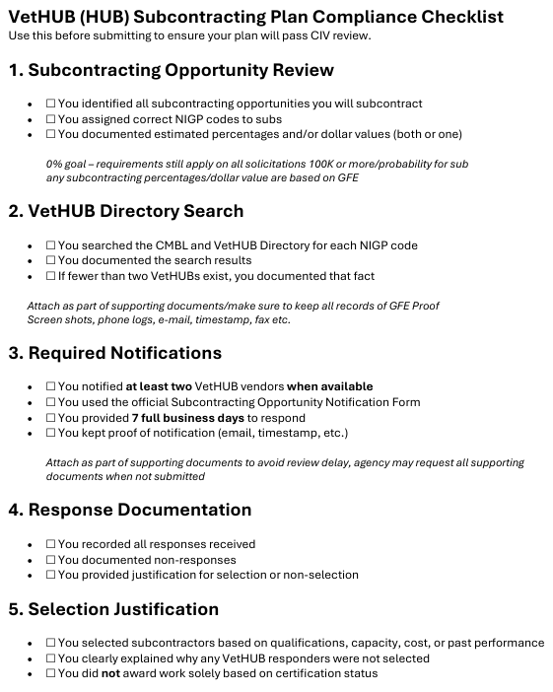

VetHUB(HUB) Subcontracting Plan Compliance Checklist
Figure 14- VetHUB (HUB) Subcontracting Plan Compliance Checklist
Notes:
new

Slide 18
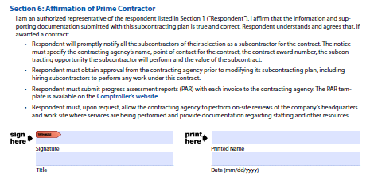
Section 6 – Prime Contractor Affirmation
Final Affirmation Signature​
  The prime contractor’s (respondent’s) authorized representative signs to certify accuracy and completeness of the subcontracting plan.​
Ongoing Compliance Obligations​
  Affirmation acknowledges duties like subcontractor notification, agency approvals, and progress reporting.​
Continuous Contract Compliance​
  Compliance is required throughout the contract lifecycle, not just during solicitation or planning phases.​
Accuracy Before Signing​
  Respondents must ensure all previous subcontracting plan sections are complete and accurate before signing the affirmation.
Figure 15- Section 6: Affirmation of Prime Contractor

Slide 19
Current Subcontracting Plan Form
Make sure to use the most current Subcontracting Plan form.
For the most current version, visit: https://comptroller.texas.gov/purchasing/vendor/hub/forms.php
IMPORTANT TO NOTE
  You must meet the requirements of the Subcontracting Plan and all other requirements for the Request for Proposal.
After Selection, commitments are documented in the Subcontracting Plan (SP) form, and we are honoring the commitments made to the subprovider (subcontractor).

Slide 20
TxDOT Civil Rights Division | VetHUB (HUB) Program
CIV_HUB@txdot.gov https://www.txdot.gov/business/disadvantaged-small-business-enterprise/hub.html
Andrea Acosta, CIV Compliance Analyst
956.763.7789 | Andrea.Acosta@txdot.gov
Teresita “Teri” Alvarado, CIV Compliance Analyst
512.416.4755 | Teresita.Alvarado@txdot.gov
Don Barwick, CIV Compliance Analyst
512.486.4682 | Don.Barwick@txdot.gov

Slide 21

Drive like a Texan English

