Slide 1
Pre-Request for Proposal (RFP) Meeting
I-20 Widening CEI Procurement
Odessa District
Solicitation No. 601CT0000006391 / RFP No. 06-6SDP5001: CEI Services for the Odessa District: IH 20 - Widening - Add Lanes Project #3 / Seg. #4: East of CR 1250 to East of SH 349

Slide 2
Table of Contents
3 | Housekeeping
4 | Ground Rules
5-6 | PEPS Resources
7-8 | CST & Attendees Introductions
9-11 | Contract Information
12-15 | Contract Selection
16-24 | Project Overview
25 | Conclusion

Slide 3
Housekeeping
Be sure to sign in with your full name on the attendee list.
Please ensure your phone is on silent/vibrate.
The meeting will not be recorded, and attendees may not use any form of audio or video recording, photography, automated transcription services, or AI-based analysis tools.
There will not be an opportunity to ask questions during the PRE-RFP Presentation
You will be given an opportunity to ask questions after the presentation via an email request.

Slide 4
Ground Rules
Communication is one-way during this presentation. The Presentation is for information purposes only
All questions must be emailed to Alan.Gonzalez@txdot.gov by 5:00 p.m. on Friday, December 05, 2025.
Subject line : “6391 ODA CEI Pre-RFP Questions”
Information to be posted online
  Attendance Log
  Pre-RFP Presentation
  Responses to relevant questions received

Slide 5
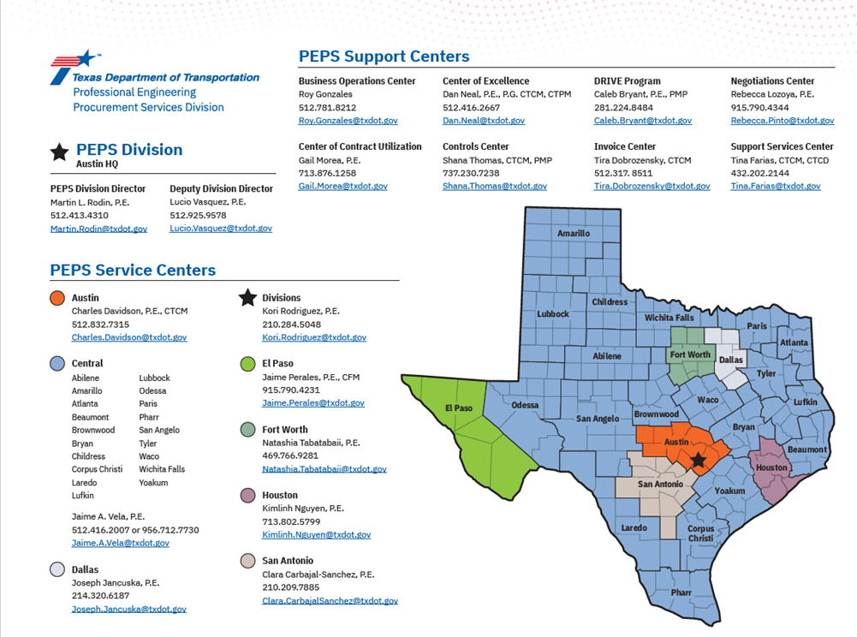
PEPS Resources
Figure 1– PEPS Division Map.

Slide 6
Professional Engineering Procurement Services (PEPS)
Central (CEN) Service Center
PEPS Procurement Team | Office | Title
Jaime A. Vela, P.E. | PEPS Central Service Center | Central Service Center Manager
Alan Gonzalez, P.E. | PEPS Central Service Center | Procurement Engineer
Cindy Barajas | PEPS Central Service Center | Contract Administrator
Table 1 – PEPS Procurement Team

Slide 7
Consultant Selection Team (CST)
Important: CST members are employees of the Odessa District. Please do not contact the District regarding this CEI contract. If you need information, please contact me.
Phone: 512-547-8406 (m)
Email: Alan.Gonzalez@txdot.gov

Slide 8
Introductions - Attendees
Your Name
Firm’s Name
Services you provide
Open to Teaming opportunities?

Slide 9
Contract Information - Overview
Odessa District is seeking to procure a CEI contract for construction Engineering and Inspection services on IH -20
Procurement process for FY 2026, Wave 2 officially kicked off on December 2, 2025.
There will be one Specific Deliverable Contract awarded on this Procurement
The Process will be Federal with Interviews
Disadvantage Business Enterprise (DBE) Goal – 0%
A list of precluded firms will be available at the time of the solicitation opening in TxDOT Procurement Portal.

Slide 10
Contract Information – Preclusion List
A final list of precluded firms will be available at the time of the solicitation opening in TxDOT Procurement Portal.
Potential Preclusions Identified so far are the following:
The preclusions are based on the work that was done under these contracts: 06-9SDP5002, 06-9SDP5003, 06-9SDP5004, and 12-8IDP5015: Entech Civil Engineers, Inc.; AIG Technical Services, LLC; B2Z Engineering, LLC; Binkley & Barfield, Inc.; Bridgefarmer & Associates, Inc.; HNTB Corporation; S&B Infrastructure, Ltd.; LJA; Stantec; TNP; and Cobb Fendley
Please note this information is subject to change – please refer to the final list that will be posted at the time of the solicitation opening.

Slide 11
Contract Information – Standard Working Categories
Category | Category Name | % of work
1.8.1 | Public Involvement | 0.50%
11.1.1 | Roadway Construction Management and Inspection | 10.00%
11.2.1 | Bridge Construction Management and Inspection | 8.00%
11.3.1 | Construction Superintendent | 5.00%
Table 2 – Example Work Categories
Please note this information is subject to change – please refer to the final list that will be posted at the time of the solicitation opening.

Slide 12
Contract Selection – Federal with Interview (DBE) A Two-Step Process
Proposal Evaluation
  Short listed providers move to interview phase
Interview Evaluation
  Interview and Contract Guide (ICG) provides instructions
Selection

Slide 13
Contract Selection – Proposal and ICG
Proposal Content
  Proposal will cover “Proposal Content” in written format.
  CST determines weightings for criteria
    Technical Approach, Project Manager’s relevant experience, Project planning and management, and Key Staff’s relevant experience
  Past Performance is used only in Proposal evaluation.

Slide 14
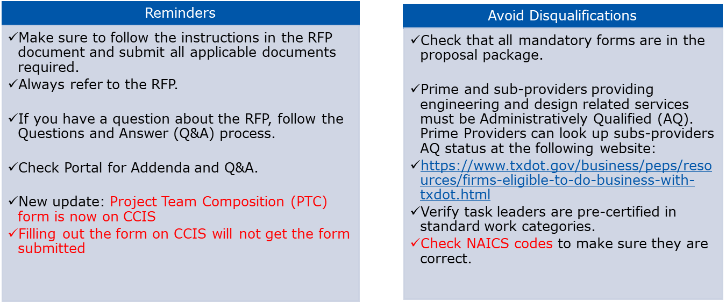
Contract Selection – Proposal Package
Figure 2– Best Practices

Slide 15
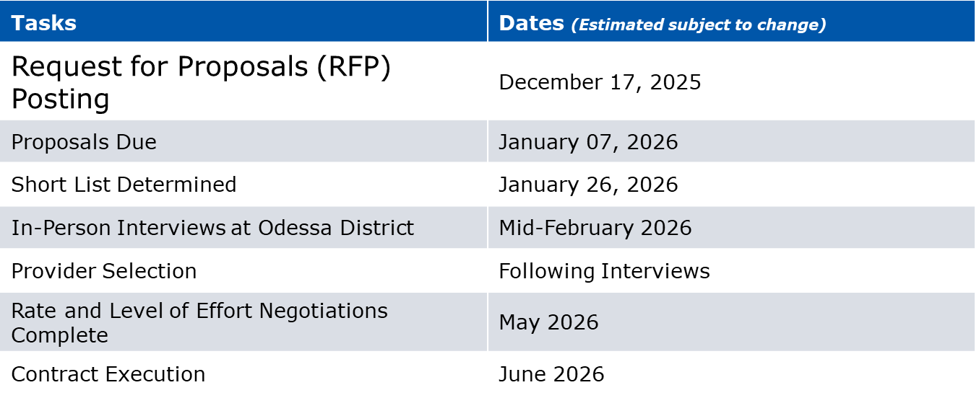
Contract Selection – Procurement Timeline
Figure 3 – Procurement Timeline
Please note this information is subject to change

Slide 16
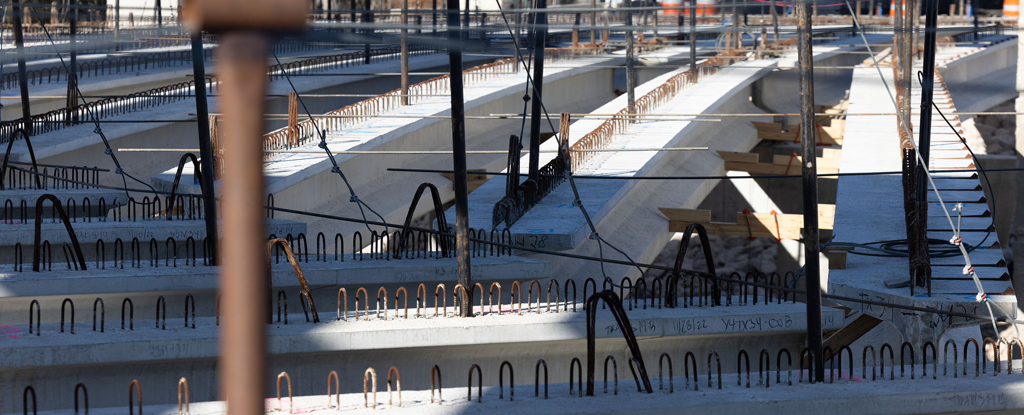
IH 20 Segment 4 Project Overview
CSJ 0005-14-092
Odessa District – Valerie Alvarado, P.E. – Construction Engineer

Slide 17
Table of Contents – Project Overview
18-19 | Project Overview
20| Project Purpose
21-22 | Typical Sections
8 | Organizational Chart & CEI Roles and Responsibilities
9| Basin 20 Initiative

Slide 18
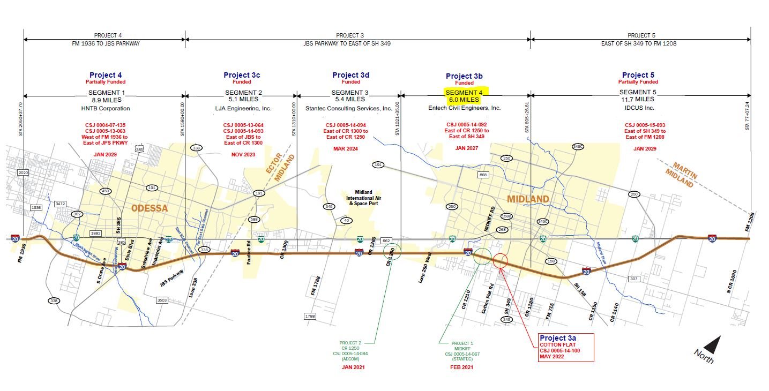
Project Overview – IH 20 Segment 4
Figure 4 – Project Line Diagram
Notes:
Cotton Flat and Midkiff bridges- stand alone bridges, built

Slide 19
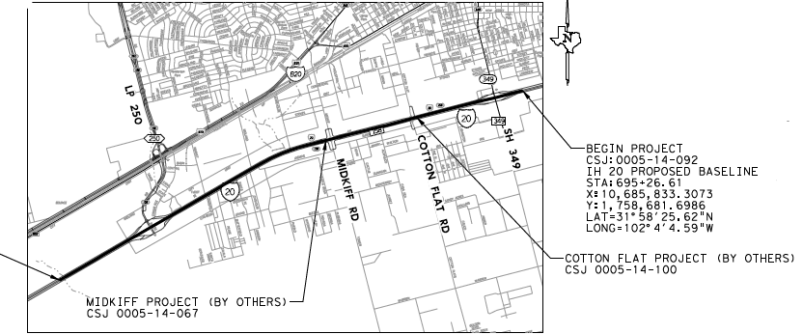
Project Overview – IH 20 Segment 4 Project 3
CCSJ : 0005-14-092
Highway : IH 20
Limit From : FROM EAST OF CR 1250 TO
Limit To : EAST OF SH 349
Est. Let Date : 1/1/2027
Project length : 6.2 Miles
Roadway : 6.07 Miles
Bridge : .13 Miles
Description : Reconstruction of frontage roads, ramps, U- turns, interchanges, convert frontage roads to 1 way, widen from 4 to 6 lanes
Avg Daily Traffic : 60,875 (2021)
: 96,050 (2041)
Design Speed : Main Lanes: 70 MPH
Ramps: 50 MPH
FR, SH 349, Cotton Flat: 45 MPH
LP 250: 55 MPH
Figure 5 – Project Location Limits
Notes:
Bridges: LP 250 (stack flip) and SH 349(reconstruct/widen) bridges. 1 new bridge class culvert,
Latest construction bid item estimate $177M
A+B bidding, incentives/disincentives will apply, 1 Milestone at LP 250 closure/phases, 6 days workweek on milestones
A milestone was created for the Loop 250 construction since that crossing is being flipped from underpass to overpass requiring lots of fill and will also require the use of a Detour to maintain traffic movement during TCP.
SH 349 is able to be constructed in sections to reconstruct/widen (inside, RT, and LT) avoiding a Detour.
Max working days 957- 48 months
Min working days 757
Risks: Heavy truck traffic around 40%,urbanized area of ODA, No RR coordination, No environmental issues- some lead paint on bridges, numerous utilities, acquired some ROW for detention ponds, corner clips, along ditch to fit 15’ berm border width

Slide 20
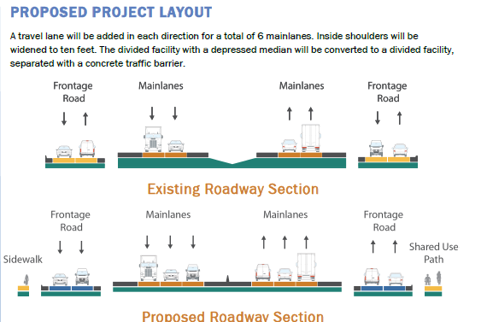
Purpose
The purpose of the proposed project is to enhance operation and safety, reduce traffic congestion, and improve roadway connectivity along the Interstate 20 corridor
Main Improvements Include:
Upgrade to latest freeway standards
Widen ML’s from 4 lanes to 6 lanes
Concrete ML’s & ramps, asphalt FR
Flip stack/IH 20 over- freight clearance
Reconfigure ramps- X configuration
Convert frontage roads to 1 way
Drainage improvements
Aesthetics
Traffic Signals
Illumination
ITS elements
SUP/sidewalk
Figure 6 – Proposed Project Layout
Notes:
ITS elements (cctv ,wireless hubs,fiber in conduit installed for future fiber network use in district, VIVDs,DMS),
Signals at 349, LP 250

Slide 21
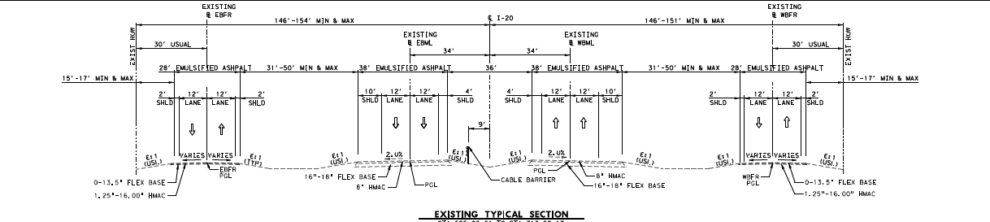
IH 20 Roadway – Existing Typical Section
Figure 7 – Existing Typical Section

Slide 22
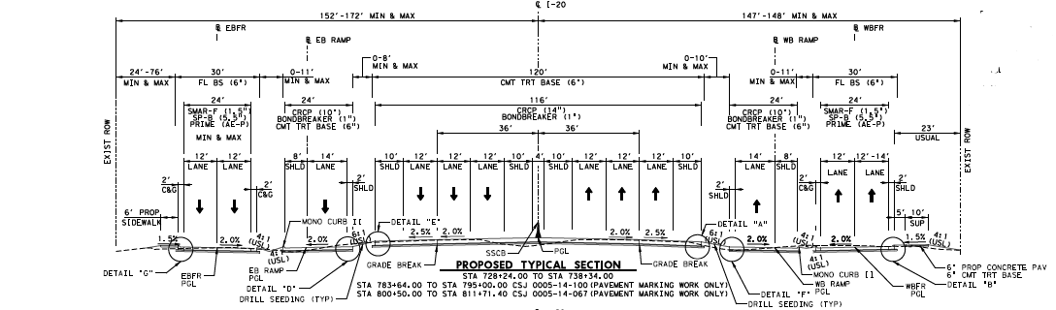
IH 20 Roadway – Proposed Typical Section
Figure 8 – Proposed Typical Section
Notes:
Mainlanes and ramps ,CTB, CRCP
Frontage roads asphalt- SP B/SMARF
Intersections fast track CRCP 13”
Phasing, construct frontage road 3 lane section, to shift ML to FR
Shift ML to FR
Reconstruct LP 250/ Work mainlanes
Reconstruct 349/Work mainlanes
Shift traffic back

Slide 23

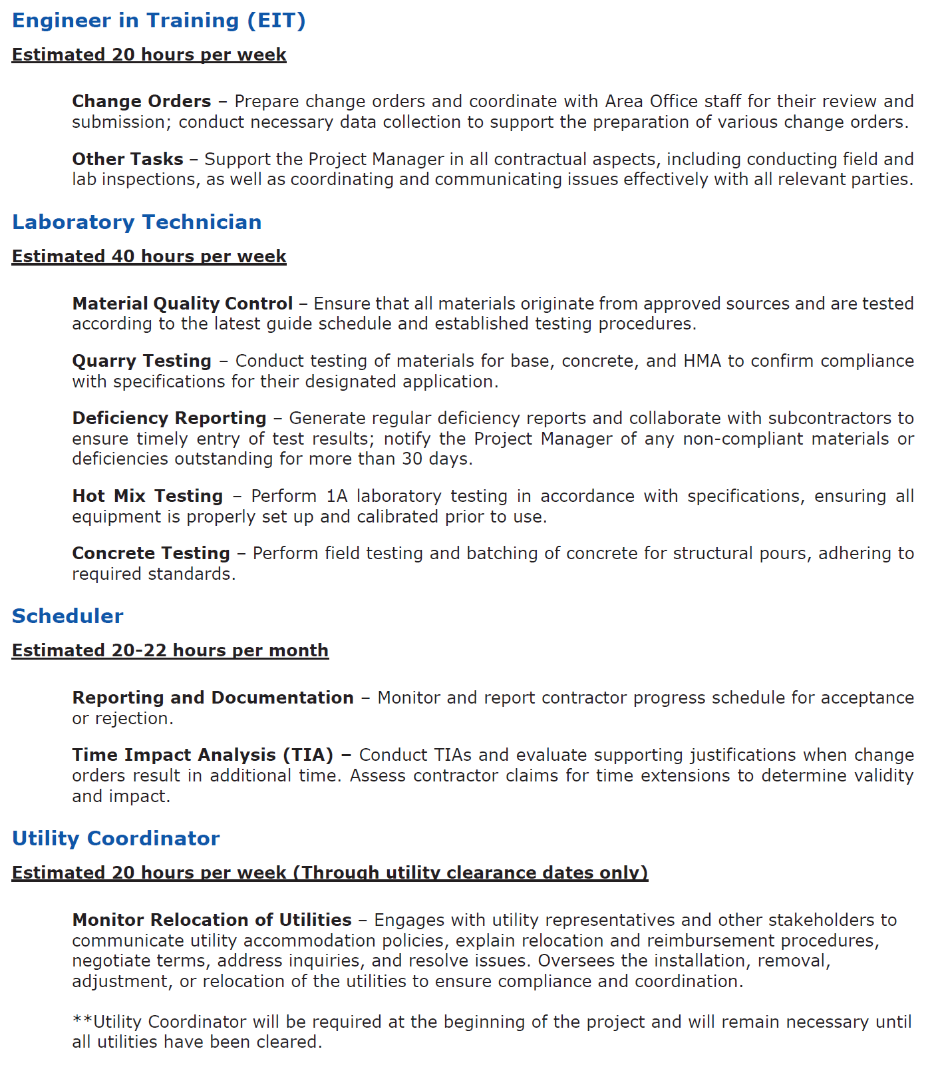
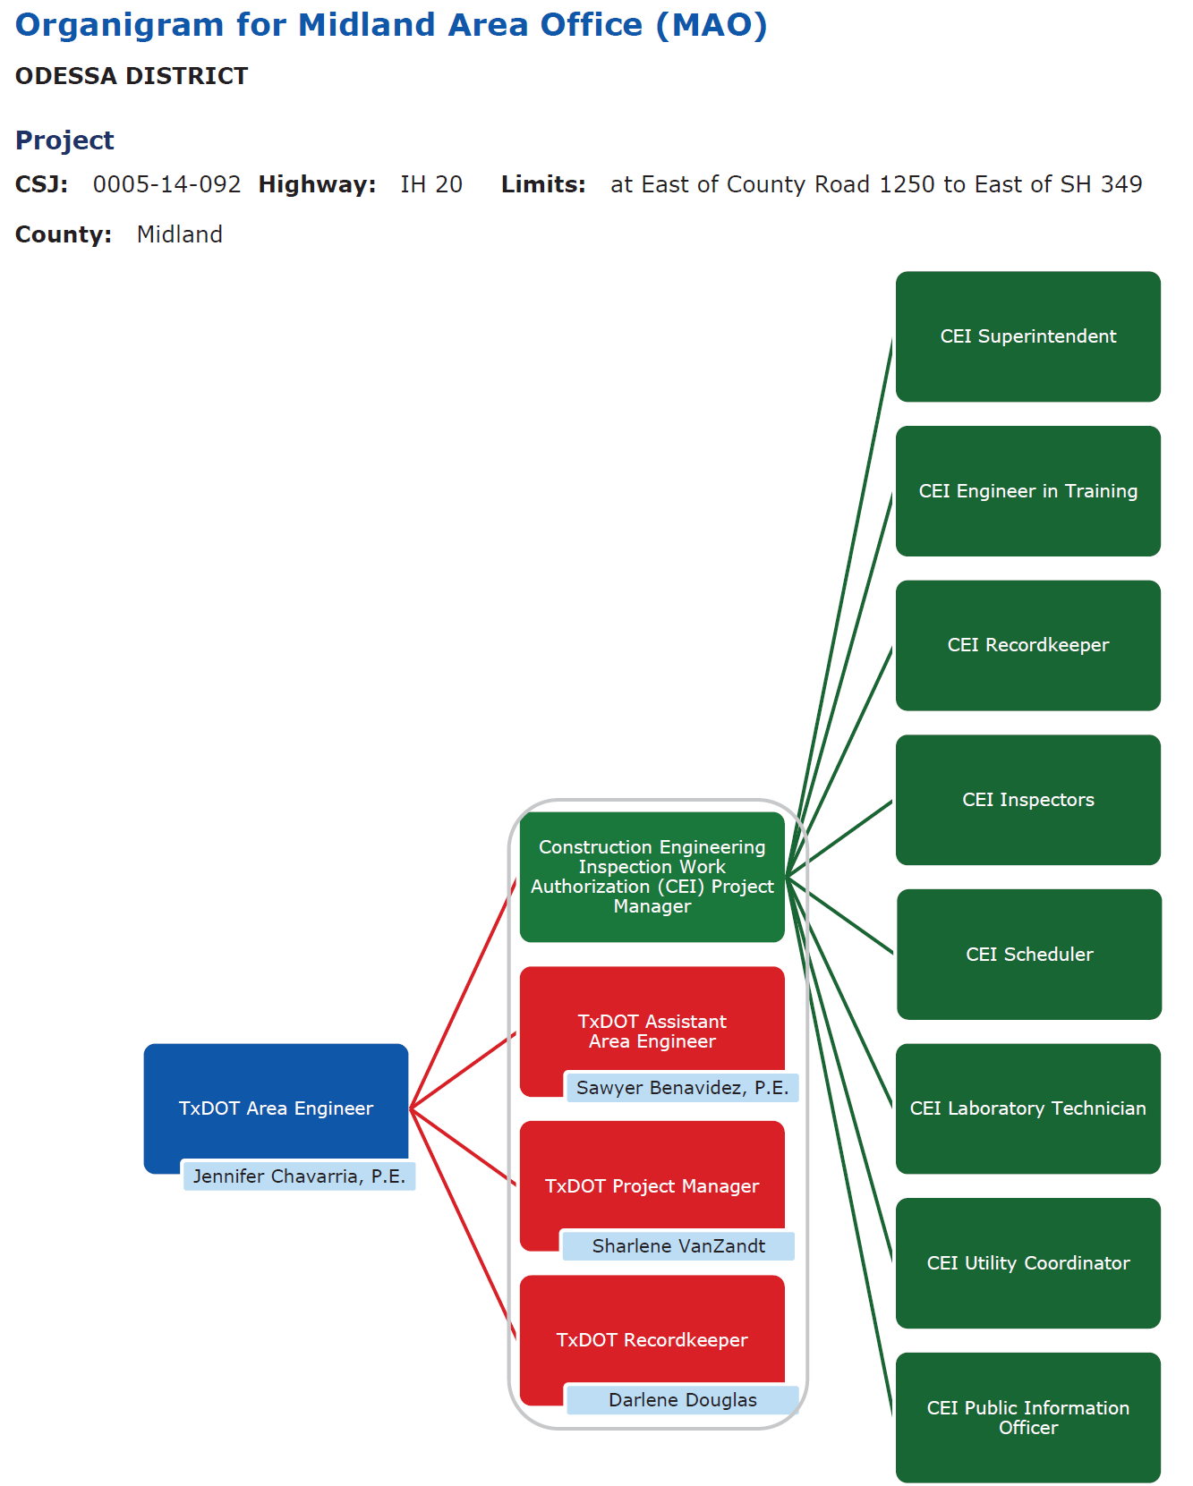
Organizational Chart & CEI Roles and Responsibilities
Figure 9 – Roles and Responsibilities
Information shown subject to change

Slide 24
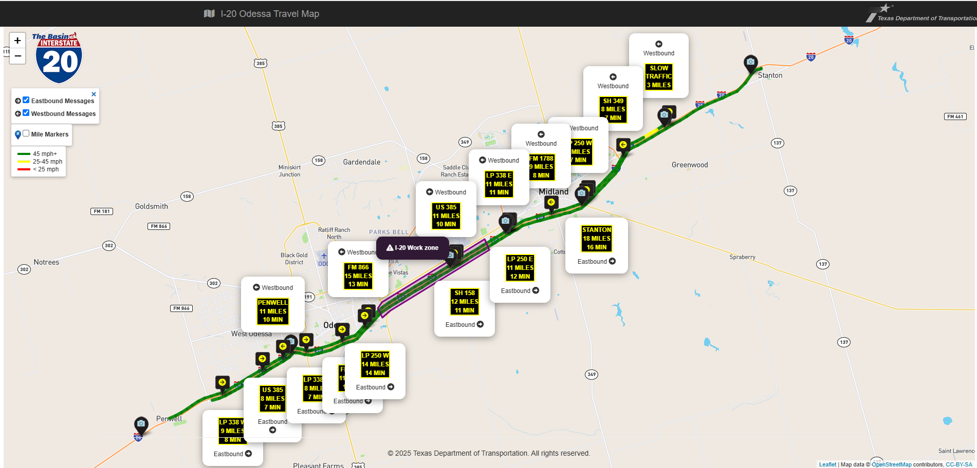
Basin20 Initiative
Link: www.basin20.org
Figure 10 – Basin20
Notes:
The Basin20 is an initiative that allows motorist to “Know Before You Go.” This initiative builds on what was learned from the I-35 project in Waco with traffic queuing and travel times and utilizes inrix data w TTI.
We have created a www.txdot.gov/basin20 to assist motorists with travel time information. The goal is to increase traveler safety with timely information.

Slide 25
Thank you for attending!

