Slide 1
Pre-Request for Proposal (RFP) Meeting: US 59 Construction Engineering Inspection (CEI) Procurement for Central Service Center
Thank you for dialing in.
Phones will be muted.
We will begin shortly.
Solicitation Number 601CT0000006432
RFP 13-6SDP5001
FY 2026 - Wave 3
Yvonne Colmenero, P.E.

Slide 2
Housekeeping
  Please note that all correspondence will be muted throughout this presentation.
  There will not be an opportunity to ask questions during the Pre-RFP presentation.
  You will be given an opportunity to ask questions after the presentation via email.

Slide 3
Agenda
Contract Selection Team (CST) & Professional Engineering Professional Services (PEPS) Team
Procurement Information
Avoid Disqualification
Post Award
Tentative Procurement Schedule
US 59 Segment 3 Project Overview
Closing Remarks

Slide 4
Consultant Selection Team (CST)
Consultant Selection Team (CST)
Consists of three personnel, there is one licensed Professional Engineer.
Please do not attempt to contact these individuals.
  Please note, CST members’ names will no longer be provided in the Advertisement, and PEPS will not share this information for future waves.

Slide 5
Professional Engineering Procurement Services Team
Table 1: PEPS Central Service Center
Procurement Support | Title
Jaime Vela Jr., P.E. | Section Director, PEPS Central Center
Yvonne Colmenero, P.E. | Procurement Engineer, PEPS Service Center for El Paso and Odessa Districts
Esther Cisneros | Contract Administrator, PEPS Service Center for El Paso and Odessa Districts
  You will be given an opportunity to ask questions after the presentation via email.
  If questions arise after the meeting, please submit to: Yvonne Colmenero, P.E. at yvonne.colmenero@txdot.gov by: Monday, March 9th, 2026, at 1 PM, CST
  All relevant questions and responses will be posted by Thursday, March 12th, 2026.

Slide 6
Standard Work Categories (Part 1)
Table 2: Standard work categories and corresponding percentages
Category | Category Name | Percentages (%)
1.8.1 | Public Involvement | 1.00%
4.5.1 | Constructability Review | 4.00%
11.1.1 | Roadway Construction Management And Inspection | 35.00%
11.2.1 | Bridge Construction Management And Inspection | 15.00%
11.3.1 | Construction Superintendent | 10.00%
11.4.1 | Environmental Inspections | 3.00%
11.5.1 | Construction Scheduling Project Manager | 1.00%
11.6.1 | Construction Schedule Support- General | 3.00%
11.9.1 | Railroad Coordination Management During Construction | 0.50%
11.10.1 | Construction Record Keeper | 7.00%
*Work Categories and Percentages Subject to Change Prior to RFP Posting.
Link to Become Pre-Certified

Slide 7
Standard Work Categories(Part 2)
Table 2 (continuation): Standard work categories and corresponding percentages
Category | Category Name | Percentages (%)
12.1.1 | Asphaltic Concrete Production | 3.00%
12.1.2 | Portland Cement Concrete | 3.00%
12.1.3 | Materials Engineering | 1.00%
12.1.4 | Asphaltic Concrete Placement | 2.00%
12.1.5 | Portland Cement Concrete Placement | 1.50%
12.1.6 | Embankment/Subgrade/Backfill/Base Production | 1.00%
12.1.7 | Embankment/Subgrade/Backfill/Base Placement | 1.00%
12.2.1 | Concrete Plant Inspection And Testing | 0.50%
12.2.5 | Hot Mix Asphalt (HMA) Plant Inspection and Testing | 1.00%
14.1.1 | Soil Exploration | 0.50%
*Work Categories and Percentages Subject to Change Prior to RFP Posting.

Slide 8
Standard Work Categories (Part 3)
Table 2 (continuation): Standard work categories and corresponding percentages
Category | Category Name | Percentages (%)
15.2.1 | Design Survey | 0.50%
15.2.2 | Construction Survey | 0.50%
18.2.1 | Subsurface Utility Engineering (Utility Eng. Investigation) | 1.00%
18.3.1 | Utility Adjustment Coordination | 1.00%
18.4.1 | Utility Engineering | 1.00%
18.5.1 | Utility Construction Management and Verification | 1.00%
18.6.1 | Utility Management & Coordination Oversight | 1.00%
*Work Categories and Percentages Subject to Change Prior to RFP Posting.

Slide 9
Contract Information- Potential Preclusion List
A final list of precluded firms will be available at the time of the solicitation opening in TxDOT Euna Procurement Portal.
Preclusions are based on the work that was done under the following contracts:
  13-0SDP5002- TRANSYSTEMS CORPORATION DBA TRANSYSTEMS CORPORATION CONSULTANTS, BLANTON & ASSOCIATES, INC, DALLAS AERIAL SURVEYS, INC., GEOTEST ENGINEERING, INC., GFT Infrastructure, Inc., HALFF ASSOCIATES, INC., SHINE & ASSOCIATES, INC., THE RIOS GROUP, INC
  36-2IDP5017- AECOM TECHNICAL SERVICES, INC
Please note this information is subject to change

Slide 10
Procurement Information (Project Manager Requirements)
Project Manager (PM) Requirements:
The prime provider’s PM is required to be a registered Professional Engineer in Texas.

Slide 11
Contract Selection Process –Federal with Interview (Disadvantaged Business Enterprise) (DBE)
Proposal Evaluation
➢Short Listed Providers move to the Interview Phase
Interview Evaluation
➢ Interview and Contract Guide (ICG) provides instructions
Selection
➢Top provider is selected for contract

Slide 12
Proposal Content
  The proposal will cover “proposal content” in a written format
  CST determines weightings and number of pages allowed for the proposal
Table 3: Evaluation criteria and weightings
Evaluation Criteria | Description | Weight
Technical Approach | Project understanding, innovative concepts or alternatives | XX
Project Manager’s Relevant Experience | Similar or related projects, project management experience | XX
Project Planning & Management | Project staffing and resource management (who, how, and why), communication plan, and quality control procedures. The prime firm’s past experience with utilizing subproviders and meeting program goals (Historically Underutilized Business (HUB) or Disadvantaged Business Enterprise (DBE)) and/or how it plans to utilize subproviders to meet the goals on this contract. | XX

Slide 13
Table 3: Evaluation criteria and weightings
Evaluation Criteria | Description | Weight
Key Staff’s Relevant Experience | Experience with similar projects | XX
Past Performance Score |  | 5 to 15

Slide 14
Avoid Disqualifications
Include all mandatory attachments in your package
PEPS Fireside Chat – New process and updated Project Team Composition (PTC) Form - Link Below
Check Task Leaders’ precertifications in standard work categories
Task Leader in the PTC form must match the Task Leader mentioned in the proposal
PM must meet RFP requirements
Link to PEPS Fireside Chat

Slide 15
Avoid Disqualifications Continued
QR Codes and Hyperlinks
  QR codes and hyperlinks are considered additional information. Do not include in your proposal.
Administrative Qualifications
  Ensure subs for Engineering and Design (E&D) related services are administratively qualified.
Task Leads
  Ensure Task Leads match on PTC and Proposal.
Proposal Cover Sheets
  Do not include extra sheets, such as a cover sheet, in your proposal.
Legal Firm Name
  Use legal firm name and ensure that it matches across all proposal documents.
Read the Cover Page Questionnaire
  Ensure that you are answering the questions in the Cover Page questionnaire truthfully.

Slide 16
Post Award (Negotiations Process)
Contract Award
Job Classification Negotiation with Procurement Engineer (~3 days duration)
  Include firm representative negotiating rates
  Include Subs in the process
  Provide reasoning for additional classification requests
  Provide concurrence with final classifications from prime and subs
  Indicate if classification is in your rate portfolio
Rate Negotiation with PEPS Negotiations Engineer
*If there are issues with legal firm names, Secretary of State, or Comptroller registration for any firm on the contract, negotiations will be delayed

Slide 17
Information Technology (IT) Security Requirements
Understand IT Security Requirements for this Contract
  Review Draft Attachment C, Section 1.7, Draft Contract Template, Attachment I, and TxDOT Security Questionnaire (TSQ)
  Review and understand Cybersecurity Requirements associated with the Contract
    TxDOT Cybersecurity Resources Webpage: TxDOT Cybersecurity Resources
    TxDOT Data Classification Policy: TxDOT Data Classification Policy
    TxDOT Security Questionnaire: TxDOT Security Questionnaire
  Utilize the question-and-answer period

Slide 18
Tentative Procurement Schedule
Table 4: Tentative procurement schedule
Tentative Procurement | Schedule
Pre-RFP Meeting | 2/26/2026
Request for Proposal (RFP) Posting | 3/19/2026
Proposal Due | Mid April 2026
Selection Notification | Late May 2026
Negotiations Complete | Early June
Contract Execution | Late September

Slide 19
Reminders
  Always refer to the RFP
  Use the Proposal Screening Checklist: Proposal Screening Checklist
  Review the Attachments before submitting in Procurement Portal
  Your submittal/proposal can be pulled back for a correction or revision before RFP closes
  If you have questions, follow RFP instructions and ask
  Check for Addenda and questions and answers

Slide 20
Kyle Trichel
Project Coordinator
Yoakum District

Slide 21
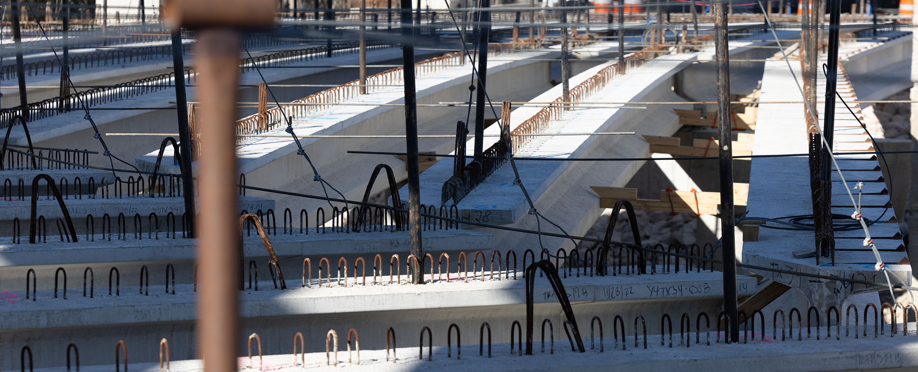
US 59 Segment 3 Project Overview
CSJ 0089-07-166
Yoakum District

Slide 22
Table of Contents
Project Overview
Project Purpose
Existing Typical Sections
Proposed Typical Sections

Slide 23
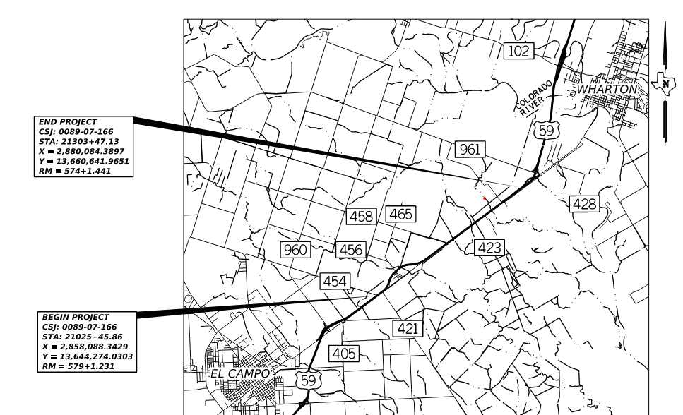
Project Overview – US 59 Segment 3
CCSJ: 0089-07-166
Highway: US 59
Limit From: FROM SOUTH OF FARM TO MARKET (FM) 961 TO
Limit To: SOUTH OF COUNTY ROAD (CR) 454
Estimated Let Date: 11/1/2026
Project length: 5.20 Miles
Roadway: 4.87 Miles
Bridge: 0.33 Miles
Figure 1: Project Limits of US 59

Slide 24
Project Overview – US 59 Segment 3 (Description)
Description:
Upgrade to rural freeway with 6 main lanes and frontage road consisting of proposed interchanges, widening, grading, base, pavement, drainage and structures.
Avg Daily Traffic :29,100 (2028)
: 38,850 (2048)
Design Speed: Main Lanes: 75 MPH
Ramps: 60 MPH
Frontage Road: 60 MPH
CR456/(James St.), Old HWY 59/(Loop 526), Robert Vonderau Dr. :30 MPH
Figure 2: Project Limits of US 59

Slide 25
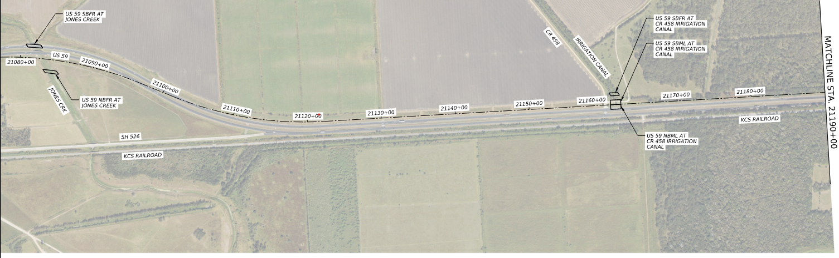
Project Overview – US 59 Segment 3 (STA 21025+45.86 to 21190+00.00)
Figure 3: Centerline Alignment of US 59

Slide 26
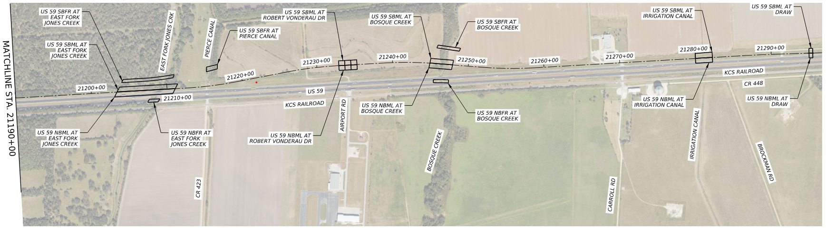
Project Overview – US 59 Segment 3 (STA 21190+00.00 to 21303+47.13)
Figure 4: Centerline Alignment of US 59

Slide 27
Purpose
The purpose of the proposed project is to enhance operation and safety, reduce traffic congestion, and improve roadway connectivity along the US 59 corridor
Main Improvements Include:
Upgrade to latest freeway standards
Widen Main Lanes (ML’s) from 4 lanes to 6 lanes
Concrete ML’s & ramps
Build new frontage roads
Drainage improvements
Aesthetics
Traffic Signage
Illumination
ITS elements

Slide 28
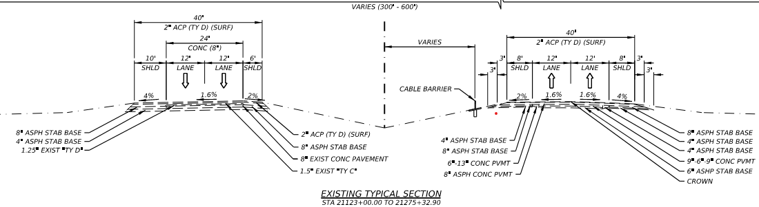
US 59 Roadway – Existing Typical Section
Figure 5: Existing Typical Section of US 59

Slide 29
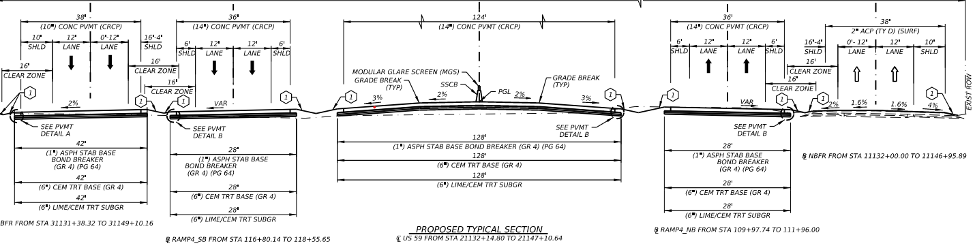
US 59 Roadway – Proposed Typical Section
Figure 6: Proposed Typical Section of US 59

Slide 30
Closing Remarks
This presentation will be posted on TxDOT.gov no later than Monday, March 2nd, 2026.
Questions regarding this Pre-RFP meeting should be submitted to:
Yvonne Colmenero, P.E. at yvonne.colmenero@txdot.gov
by 1 pm, CST, Monday, March 9th, 2026.
Relevant questions received and their responses will be posted on TxDOT.gov by Thursday, March 12th, 2026.

