Slide 1
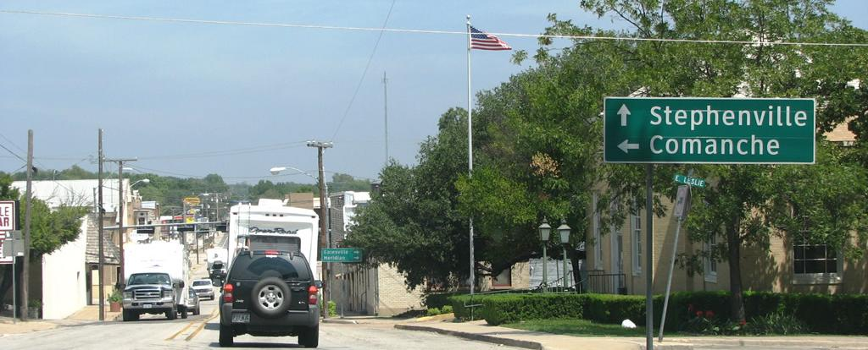
US 281 Hamilton Truck / Relief Route PS&E Information Session

Slide 2

Drive like a Texan English

Slide 3

Welcome and Introduction

Slide 4
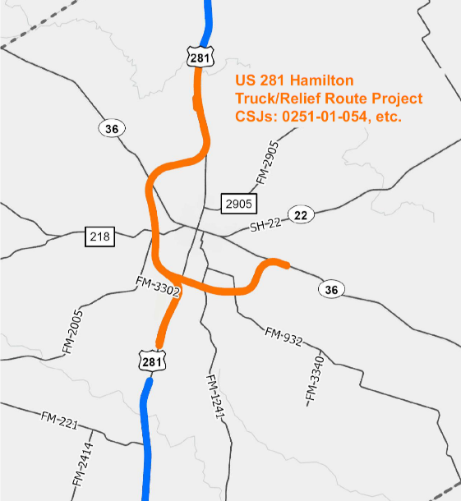
Project Overview
US 281 Hamilton Truck / Relief Route:
~ 15 miles of new location relief route
First of three projects to widen US 281 to four lanes throughout Hamilton County
Key Connectivity Corridor
Fully funded (Cats 4 and 12)
Single PS&E contract

Slide 5
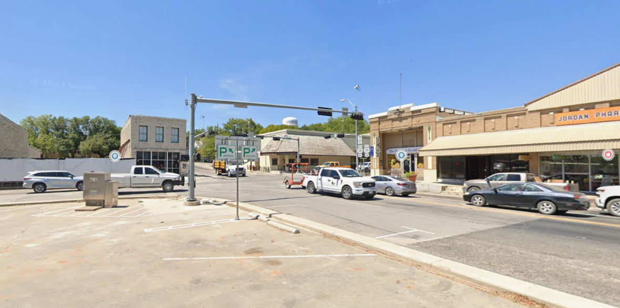


Project Context – Downtown Hamilton (1)
Oilfield and Oversize / Overweight traffic
Alternate Route to I-35

Slide 6
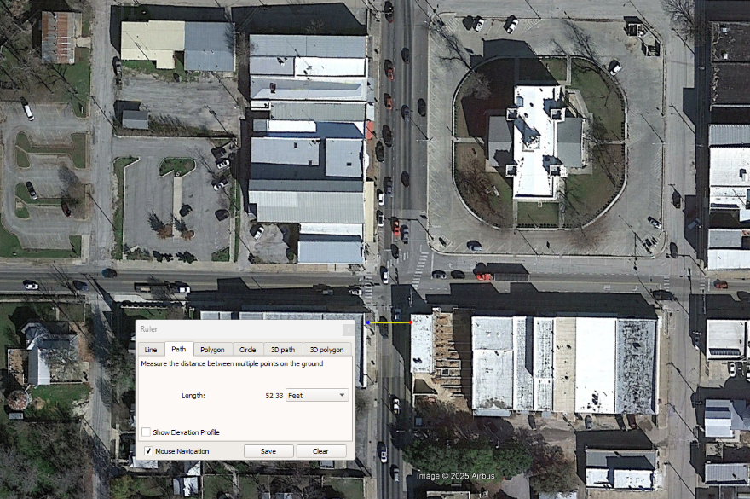
Project Context – Downtown Hamilton (2)
Streets entering Hamilton Courthouse Square measure less than 60 feet from building face to building face

Slide 7
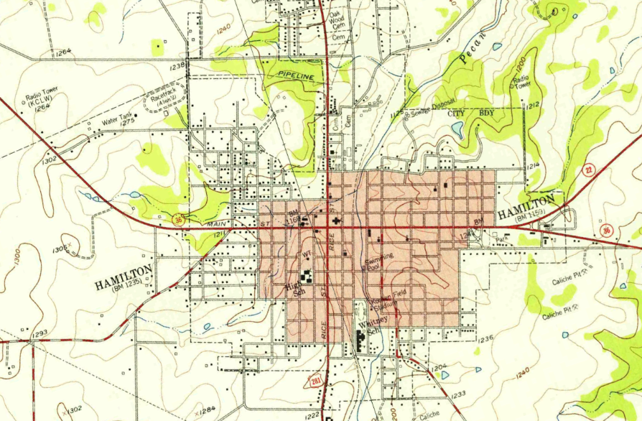
Project Context – Downtown Hamilton (3)
Topography of Downtown Hamilton precludes easy dissipation of spills

Slide 8
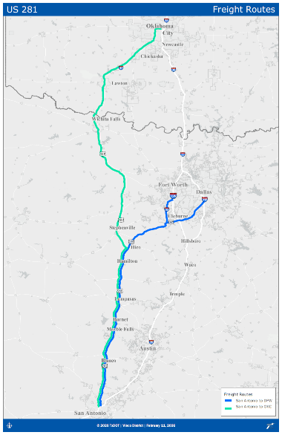
Project Context – Regional and Statewide Mobility
One in six cars traveling through the Hamilton Courthouse Square shows up on US 67 around Cleburne, bound for DFW
Simultaneous development of relief routes in Hamilton, Lampasas, Blanco, Marble Falls
Freight alternative to I-35
Intermediate term – San Antonio to DFW
Long term – San Antonio to OKC

Slide 9
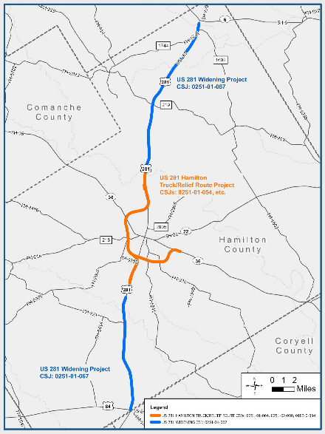
Project Context – Future Proof Design
Design Approach: Future Freeway
Widened sections: Non-access control with wide median to allow for future mainlanes
Relief route: New mainlanes with full control of access; ROW is sufficient to allow for future frontage roads by others
“Interstate Grade” vertical profile (avoid excessive crest and sag curves)

Slide 10
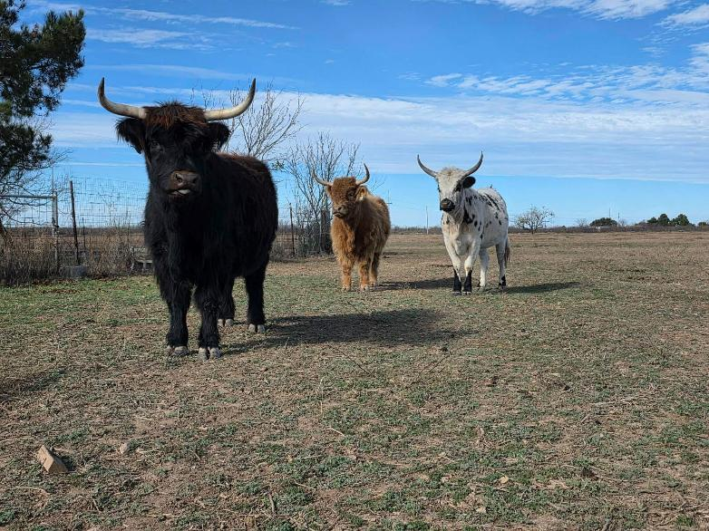
Project Context – Active Ranching Operations
Proposed alignment bisects active ranches
Overpasses and large culverts for stock and equipment movement
Post-schematic coordination with property owners

Slide 11
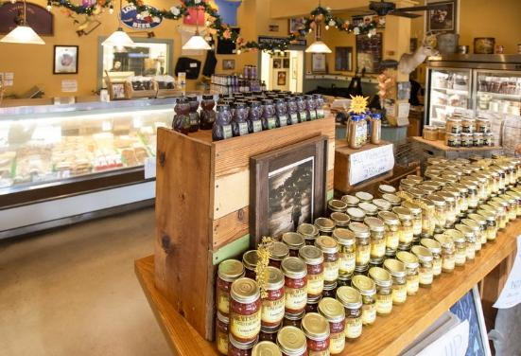
Project Context – Economic Development
50 mph DCs onto business routes enable easy return access from Downtown
Potential for streetscape improvements after relief route opens (not part of this project)

Slide 12
Detailed Project Overview
Google Earth walkthrough of 2/12 public meeting alignment and project features

