Slide 1
IH-10 project
San Antonio District
Construction Engineering and Inspection (CEI) Services
Solicitation No. 601CT0000006556
PRE-REQUEST FOR PROPOSAL (RFP) PRESENTATION

Slide 2

Drive like a Texan English
Notes:
Kind. Courteous. Safe. Next time you get behind the wheel, remember that a little kindness and courtesy go a long way to make our roads safer for everyone.

Slide 3

Thank you for your attendance!
This meeting will not be recorded, and attendees may not use any form of audio or video recording, photography, automated transcription services, or artificial intelligence (AI)-based analysis tools.
  In-Person Attendees:
  Be sure you signed in using the sign-in sheet.
  Please ensure your cellphones are muted.
  You may ask questions after this presentation.
  Virtual Attendees:
  Be sure your full name is showing up correctly.
  Please stay muted.
  You may submit your questions to all or just presenters using Microsoft-Teams.
Pre-RFP information will be posted by close of business day (COB) Friday, May 30, 2025.
This presentation is for INFORMATIONAL PURPOSES ONLY.
Notes:
Some housekeeping rules: if you are attending in person, please sign-in on the sign-in sheets AND turn off or silence your cell phones.
If you are attending virtually, make sure your full name is showing up so that it shows up on the “attendance list”.
Please do not put your name in the chat.
Also, you will stay muted throughout the presentation. You may submit your questions in MS-Teams. We’ll answer questions at the end of the presentation.

Slide 4
Agenda
1 | Introductions
2 | Project Information
3 | Procurement Information
4 | Questions & Answers (QA)
Notes:
During this presentation, we’ll provide project information as well as information about the procurement. The draft preclusion list has been established and will be shared here with this presentation. We’ll also discuss the debrief process. Questions will be answered at the end of this presentation.

Slide 5
Introduction
PEPS San Antonio Service Center:
  Philip Howlett, P.E., Lead PEPS Engineer
  Clara Carbajal-Sanchez, P.E., PEPS Metro Procure Section Director
  Wanda Williams, Contract Specialist

Slide 6
Questions prior to RFP Posting?
Project Information:
  Jeb Smith, P.E.
  Area Engineer, New Braunfels – San Antonio District
  Jeb.Smith@txdot.gov
Procurement Information:
  Clara Carbajal-Sanchez, P.E.
  PEPS Metro Procurement Section Director
  Clara.CarbajalSanchez@txdot.gov

Slide 7
Project Information

Slide 8
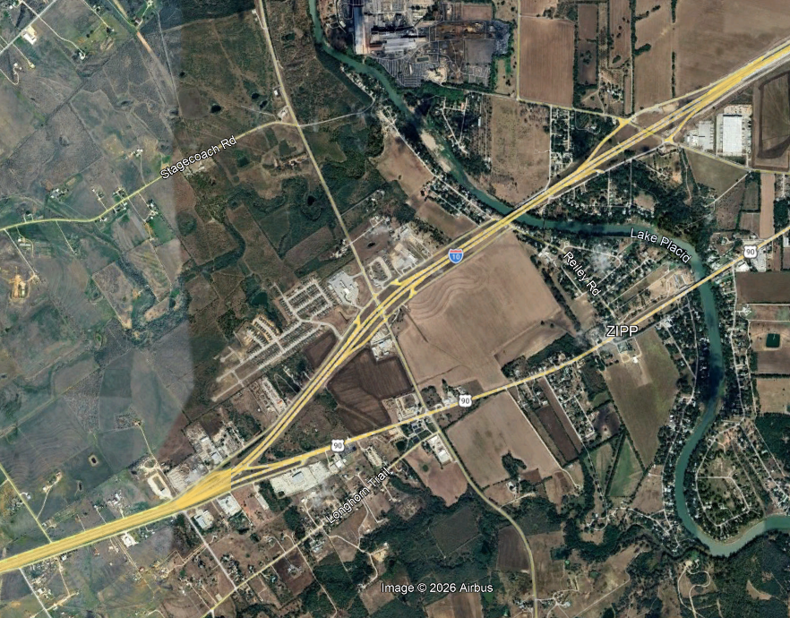
Project Location
FM 464
Highway: IH-10
Limits:
Pioneer Road to Farmer Market (FM) 464
Length: ~3.5 miles
County: Guadalupe
Pioneer Road

Slide 9
Project Information
Current Let Date: 9/2029
Anticipated Let Date: ~ 5/2027
Begin Work: 9/2027
Duration: 65 months
Estimated project completion based on barricades: 1/2033
Anticipated end work date: 5/2033

Slide 10
Project Information
Estimated Construction Cost: ~$345m
Project Includes: Widen Freeway
  Expand from 4 main lanes to 6 main lanes & Maintain Frontage Road capacity.
  Frontage Road – conversion from 2-way to 1-way.
  Ramp and Intersection Improvements.
Working days will be computed and charged in accordance with Article 8.3.1.2: Six-Day Work Week.
Nighttime inspection allowed as needed.

Slide 11
Project Information
The project is in the plans, specifications and estimate (PS&E) phase (~90%).
  A selection of Design information will be made available in the RFP.
  Construction management plan is in place to clear utilities.

Slide 12
Notable Project Challenges
Traffic control sequencing
Bridge over major waterway
Retaining walls / Bridges
Joint Bid utilities
Environmentally sensitive project
Adjacent project coordination

Slide 13
Estimated Projected Staffing Information
Position | Fulltime (FT)/Part-time (PT) | Primary Responsibilities
Construction Engineering and Inspection (CEI) Project Manager | PT - 15% | Contract administration and staffing coordination; Project planning and scheduling; Budget and cost management;
Resident Engineer | FT | Overall CEI management; leads weekly project meetings; primary coordination with TxDOT; addressing (Request for Information's) RFI’s; Project planning and scheduling; Quality control and assurance; Safety oversight; Assists with staff coordination and oversight
Chief Inspector / Construction Superintendent | FT | Site supervision & Coordination; Safety oversight; Scheduling & productivity; Quality control; Communication & reporting; Resource management; Problem solving & decision making; Regulatory compliance; Mentoring & leadership, inspection coverage, and testing;
Inspector (6) | FT | Daily inspection; TxDOT plan & specification compliance; Quality assurance; Recordkeeping & reporting; Coordination with contractor; Safety Oversight; Compliance documentation.
Record Keeper | PT - 30% | Document control & recordkeeping; Daily report managing; Estimates; Material testing records; Communication support; Audit preparation.
Project Control Specialist | PT -5% | Deficiency tracking, Quality Assurance Program (QAP) support, administrative assistance
Scheduler | PT - 20% | Time Impact Analysis (TIA) Support; Schedule development; Schedule updates and progress monitoring; Critical path & risk analysis; Coordination with stakeholders; Reporting & Documentation; Contract & Specification requirements.
Level 1B Tester (Asphalt) | As needed | Materials testing via qualified subcontracted laboratories
Soils and Base (SB) 102 Tester (Soils) | As needed | Materials testing via qualified subcontracted laboratories
Public Involvement | As needed | Public meeting coordination and presentation support

Slide 14
Procurement Information

Slide 15
Solicitation Process
Federal Process With Interviews
Federal regulations (23 CFR Part 172)
Specific Deliverable Contract
One Specific Deliverable contract without Work Authorizations
Four criteria for each step
Two step process
Request for Proposals & Interviews
Federal funds
Related scopes, Schedule, and LOE identified at the contract level
Disadvantaged Business Enterprise (DBE) goal: 0.00% - refer to RFP
District must provide formal notice to proceed to begin work

Slide 16
Solicitation Process - Euna Procurement electronic submittal platform
PEPS procurements are posted in the Euna (formerly Bonfire) each wave.
  Ask questions regarding the procurement during the Q&A period.
  Submit responses to PEPS solicitations.
Follow RFP instructions and submit all applicable documents required.
  Proposals submitted by other means will not be considered.
Resources:
  Euna Procurement frequently asked questions (updated 6/4/2025)
  Electronic Submittals Presentation
Euna related questions must be submitted to: PEPS_COE_Process@txdot.gov
Google Chrome is the recommended browser.
Whoever submits in Euna will be the one who receives correspondence.

Slide 17
2-Step Solicitation Process
Step 1: Request for Proposals (RFP)
Read RFP Carefully
Screening
Step 2: Interviews
Interview & Contract Guide (ICG)
Evaluation
Contract Negotiation & Execution
Submit Proposal Package via EUNA
Evaluation
Shortlist Selection
Final Selection
Notes:
This Solicitation will follow the Federal Process, which is a two-step process.
The RFP has a lot of information and guidance to help you with your proposal submittal.
First step is the Request for Proposal and second step is the Interview.
The top 3 teams that scored the highest will be shortlisted and interviewed: most qualified providers, as indicated by the proposal scores.
Invitation to present their experience as it pertains to the project.
The final selection will be based on interview scores.

Slide 18
Evaluation Process
Proposal Content and Interview Presentation
- Based on Evaluation Criteria and Included Elements
What we are looking for
- The most qualified team for the job.
- Information that is detailed, specific, demonstrated, and relevant.
- Quality over Quantity.
- Based on paragraphs provided in the RFP and ICG (if shortlisted).
Notes:
We are interested in meeting the contract goals and consultant characteristics – The proposal and interview contents are created based on the needs for this project. So, tailor your proposal/RFP response to answer each content.
The importance of criteria is indicated by the weight or % applied to them.
Tell us about your experience– Provide detailed examples and include challenges/lessons learned and innovation
Quality over quantity – One or two great examples are better than several good/average ones
Thoughtful relevant responses– No key-word search; this is about your capabilities, experience, knowledge, and thought process

Slide 19
Solicitation Process - Proposal
 | Evaluation Criteria | Included Elements: | Weighting for Evaluation of Proposal
1 | Technical Approach | Project understanding, project approach, innovative concepts or alternatives | XX%
2 | Project Manager’s Relevant Experience | Experience with similar or related projects, including both technical and management experience | XX%
3 | Project Planning and Management | Project staffing and resource management (who, how, and why), communication plan, and quality control procedures. Includes the prime firm’s past experience with utilizing sub-providers and meeting program goals (HUB or DBE) and/or how it plans to utilize sub-providers to meet the goals on this contract. Also, may include project scheduling or phasing for SD projects | XX%
4 | Key Staff’s Relevant Experience | Experience with similar projects | XX%
 | Past Performance Score |  | 5% - 15%
 |  | TOTAL: | 100 %
Notes:
The contents are developed with focus on the needs for this project/contract.
Proposals evaluated and scored based on four criteria: Technical Approach, PM Relevant Experience, Project planning & management , and Key staff relevant experience.
Prime Provider Past Performance will be captured at the RFP phase. The prime provider’s Evaluation Score Average (ESA) in the provider evaluation database (PS-CAMS) will be used to determine the prime provider’s past performance score at the Proposal stage according to the table shown on this slide.

Slide 20
Solicitation Process - Interview
 | Interview Evaluation Criteria -Federal Process |  | Weighting for Evaluation of Presentations
1 | Technical Approach | Project understanding, project approach, innovative concepts or alternatives | XX%
2 | Project Manager’s Relevant Experience | Experience with similar or related projects, including both technical and management experience | XX%
3 | Project Planning and Management | Project staffing and resource management (who, how, and why), communication plan, and quality control procedures. Includes the prime firm’s past experience with utilizing subproviders and meeting program goals (HUB or DBE) and/or how it plans to utilize subproviders to meet the goals on this contract. Also, may include project scheduling or phasing for SD projects | XX%
4 | Key Staff’s Relevant Experience | Experience with similar projects | XX%
 |  | TOTAL: | 100%
Notes:
Once you are shortlisted, you will be invited to present your experience, knowledge and ideas for the project.
Your presentation at the interview will be evaluated and scored based on the same four criteria but different weights: Technical Approach, PM Relevant Experience, Project management planning, and Key staff relevant experience.
The CST members will independently score presentations based on the criteria and relative importance factors (weightings).

Slide 21
Solicitation Timeline (Anticipated)
Task | Date
RFP Posting in Euna | Week of 9/7/2026
Proposal Due Date | Week of 9/27/2026
Shortlist Determination / ICG | Week of 10/26/2026
Interviews | Weeks of 11/9 or 11/16
Provider Selection | Week of 11/23/26
Contract Execution | 4/2027

Slide 22
RFP Information – Work Categories (DRAFT)
Work Categories and percentages are subject to change.

Slide 23
“DRAFT” - Preclusions
CONSOR North America, Inc.
HVJ South Central Texas M&J, Inc.
LJA Engineering, Inc.
CivilCorp, LLC
Rodriguez Transportation Group, Inc.
Core Team Restrictions
  None anticipated
Preclusion list is subject to change.

Slide 24
Appeals Process / Restrictions
Preclusion Appeals Process
  Prior to RFP Posting:
    Email PEPS Division Director: Martin L. Rodin, P.E.
    Include this Solicitation No. 601CT0000006556
    Explain rationale for removal from preclusion list
  After RFP Posted:
    Follow formal appeal outlined in Title 43 TAC § 9.7
    Deliver letter to TxDOT Executive Director: Marc Williams, P.E. and include above information
    Procurement process is not paused
Notes:
If your firms’ name is on the preclusion document, you may appeal by sending an email to Mr. Martin Rodin.
Once RFP is posted, appeals must be communicated with Mr. Marc Williams by delivering a letter of appeal to his attention.

Slide 25
RFP Information – Project Team Composition (PTC)
PTC Form - Online form in Consultant Certification Information System (CCIS).
  CCIS is a web–based system accessed through Salesforce.
Work Categories automatically pulled from Professional Services Contract Administration Management System (PS-CAMS).
Data is live up to closing. PTC forms will be available in CCIS between the solicitation posting and closing dates.
Portable Document Format (PDF) of the PTC form must be uploaded into Euna with the rest of the proposal package.
CCIS Precertification in Salesforce External Dashboard User Guidance CCIS job aid for vendors.
Notes:
Follow Instructions
Ensure Firm name is consistent throughout PTC form.
Prime provider shall perform at least 30% of the contracted work using its own work force.
After populating the PTC, print “ENTIRE” workbook (Parts 1, 2, and 3 ).
DBE goal is 13.0%
The Project Team Composition (PTC) form indicates the categories that are engineering and design related services. Refer to the Administrative Qualification Requirements section to ensure that all requirements are met for applicable firms.

Slide 26
Avoiding Disqualification
Don’t wait for the last minute.
Follow RFP instructions and submit all applicable documents required. (things change)
Check your team’s DBE status and NAICS certification
Check your team’s Administrative Qualification (AQ) status.
Meet assigned DBE goal.
Task Leads identified in your PTC must match those in your proposal.
Do not use precluded firms.
Make sure you sign everything that needs to be signed.
Utilize the Screening Checklist: Federal Process.
Notes:
Attach the right document for each attachment - bonfire does not recognize types of attachments.
Submit on time. Bonfire will not accept submittals after 1pm on the due date
Upload everything early and check/upload revised docs.
Calling someone a TL in proposal and in PTC; make it clear who is doing the task.

Slide 27

Questions & Answers

Slide 28
Thank You for your attendance!
May e-mail questions by 8/27/26 to: Philip.Howlett@TxDOT.gov
Pre-RFP info to be posted on-line under Consultant Information Meetings by COB on 9/1/26.
  Presentation slides
  Sign-in sheets
  All relevant questions received and responses

