Slide 1
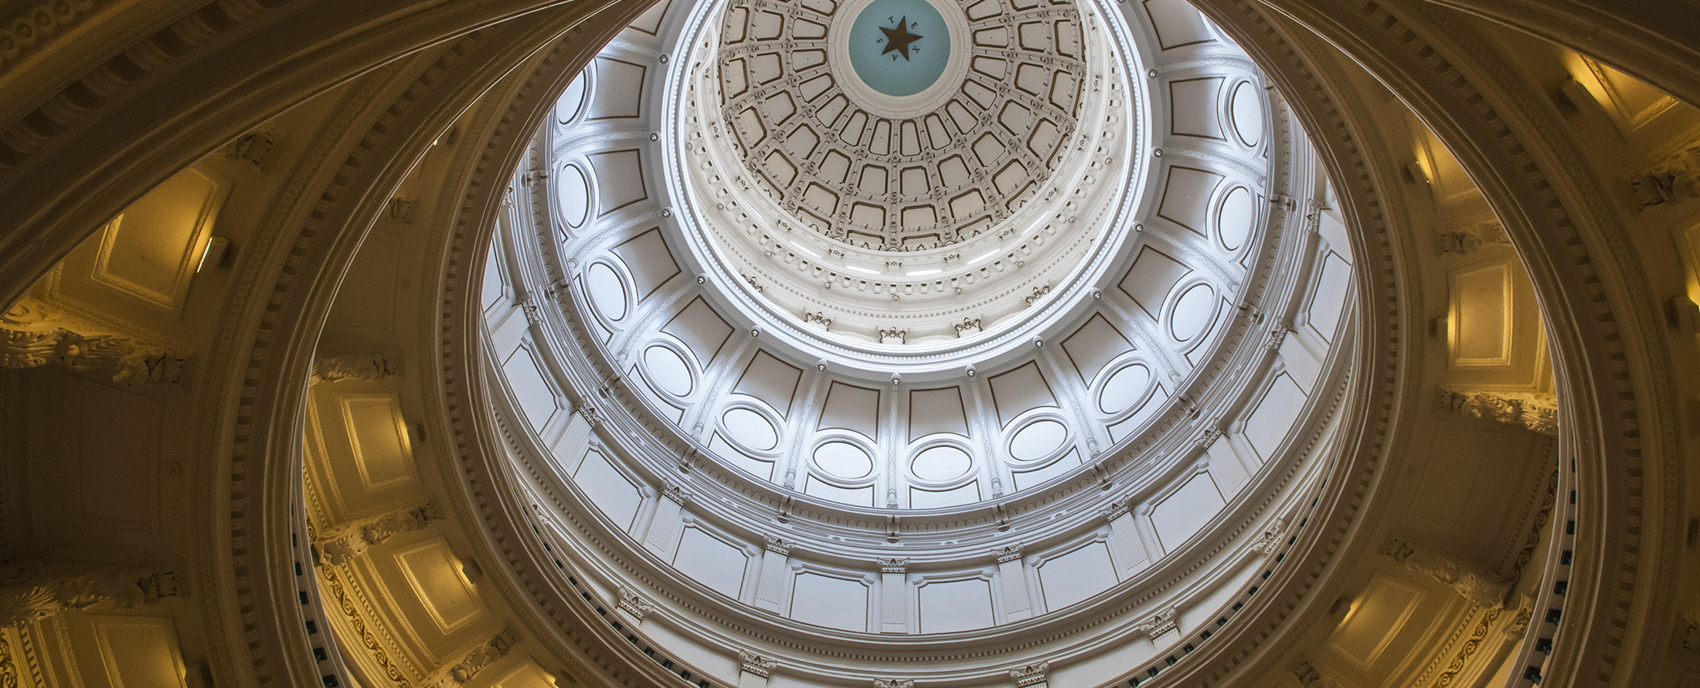
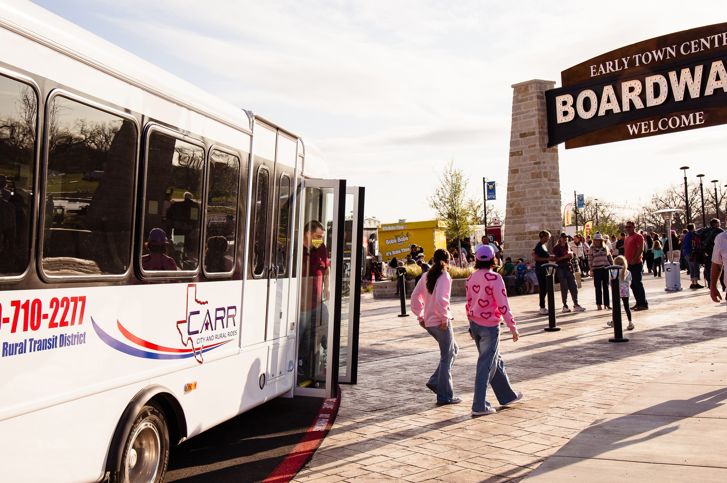
Semiannual Transit Operator’s Business Meeting
Settling in 8:30AM – 8:40AM
Welcome

Slide 2
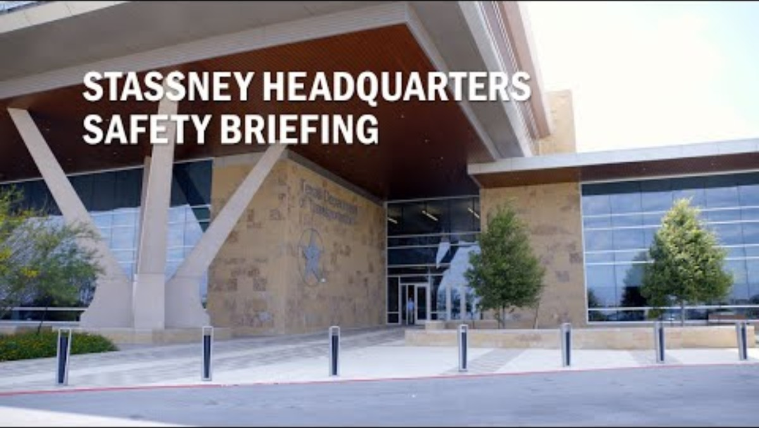
Stassney Safety Briefing
Before we begin
1
Please give the video your full attention.
2
The recording includes open captions.
Safety starts with awareness.

Slide 3
Agenda
8:30AM – 8:40AM | Settling In
 | Welcome/Safety Brief
 | Director’s Report
 | Compliance Program Update
 | Statewide Multimodal Transit Plan (SMTP) Implementation Transit Peer Exchange (TPE) Planning for Service Expansion Funding
 | BREAK – Where in the World
 | Statewide Multimodal Transit Plan (SMTP) Implementation Statewide Transit Priority Network Universal Trip Planning and Fare Payment
Figure 1– Sample image.

Slide 4
Agenda continued
11:45 AM – 1:15PM | Lunch
 | Transit Panel Discussion – Emergency Response Coordination
 | BREAK
 | Transportation Alternatives Program: Integrating Transit and Active Transportation in the FY27 Call for Projects
 | The Route Ahead – Closing remarks
3:30PM – 3:45PM | General Q&A / Adjourn

Slide 5
Director’s Report

Slide 6
TGEMS Challenges
User login challenges
Data migration
Signature authority review
Docusign adjustments
Delayed release of MGA & C&A
Budget adjustments

Slide 7
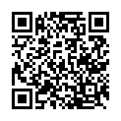
TGEMS Benefits
Submit your feedback
Docusign
Reduce the number of PGA’s
Subrecipient portal home page upgrade
Security – clearer role definition
In-house software solution
https://www.surveymonkey.com/r/KMXGGP9
Need help today?
Help desk available from 1:00PM – 2:00PM
Enchanted Rock conference room

Slide 8
What is the Texas Transit Tracker (“T3”)?
New version of PTN-128
Web-based reporting system designed to:
Collect uniform, consistent, and quality transit data from transit providers
Perform quality control
Provide queries and reports
Manage performance

Slide 9
T3 Objectives
Alignment with state and NTD reporting requirements
Reduce external data collection (ex: supplemental documents)
Reduce complexity and improve user experience

Slide 10
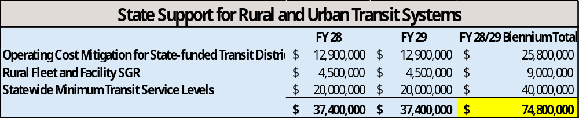
FY 28/29 Legislative Appropriations Request

Slide 11
FY 28/29 Legislative Appropriations Request
  Operating Cost Mitigation for State-funded Transit Districts requires $12.9 million each year for a biennium request of $25.8 million to bring current levels of state funding equivalent to 2010 levels based on increased operating costs per hour experienced by Texas rural and small urban transit districts.
  Rural Fleet and Facility SGR requires $4.5 million each year for a biennium request of $9 million. Funds would be used toward capital assets and would match federal discretionary funds when available. These funds represent 20% of the need for rural SGR through 2029.
  Statewide Minimum Transit Service Levels require $20 million each year for a biennium request of $40 million. This amount would make incremental progress toward a standard minimum level of service (16 hours weekday, 12 hours Saturday, 8 hours Sunday) in rural and small urban areas, making transit a more feasible mobility option.

Slide 12
Other Items
FY 2027 Transit Leadership Institute – Strategic Plan Development
Grant Balances
Communications – Holiday Season Charitable Activities
Digital Accessibility

Slide 13
Compliance Program Update

Slide 14
Equal Employment Opportunity (EEO)
On May 20, 2026, FTA published Federal Register Notice 2026-10103, withdrawing guidance for Circular 4704.1A.
Ending the requirement for full and/or abbreviated EEO plans.
Must still comply with all federal nondiscrimination requirements, such as Titles VI and VII of the Civil Rights Act.

Slide 15
Disadvantaged Business Enterprise (DBE)
On October 3, 2025, USDOT issued a DBE Interim Final Rule.
FY27 Resume DBE Reporting
  Period 1: October 1st – March 31st
    Due April 30th
  Period 2: April 1st – September 30th
    Due October 30th

Slide 16
PTN’s Internal Audit Review Sub-recipient Impacts
New Grant Applications will require a match documentation letter when local match is being used.
Current Program Grant Agreements (PGAs) with local match funds will require a letter from the agency identifying the match to be added.
If new or additional local match funds need to be added to the PGA:
  Budget must be updated to add the local match
  Local match documentation letter must be submitted with request

Slide 17
PTN’s Internal Audit Review Sub-recipient Impacts
Personally Identifiable Information (PII) from all source documentation submitted in TGEMS must be redacted.
Payroll documentation requirements for onsite reviews and/or desk reviews.
Conduct an annual review of Subrecipient user roles in TGEMS.

Slide 18
Statewide Multimodal Transit Plan
Transit Peer Exchange (TPE)
Planning for Services Expansion Funding
Statewide Priority Transit Network & Hub Plan
Universal Trip Planning and Fare Payment

Slide 19

Texas Transit Peer Exchange UPDATE
Semiannual Transit Operators’ Meeting
September 29, 2026
Holly Parker
Research Scientist
Notes:
508-compliant starter template. Font sizes should remain 18pt or larger because some of the foreground/background color combinations will fail contrast requirements at smaller sizes. (See https://webaim.org/resources/contrastchecker/ for a more detailed explanation of color contrast.)
Contact TTI Communications, https://my.tti.tamu.edu/com/, if you need further assistance with 508 compliance.

Slide 20
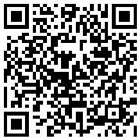
First, a poll…
PollEv.com/michaelwalk897
Which statement best describes you?
I attended both previous virtual Peer Exchanges.
I attended one virtual Peer Exchange.
I registered but have not attended any of the virtual Peer Exchanges.
I am interested but have not registered for the Texas Transit Peer Exchange.
This is my first time hearing about the Texas Transit Peer Exchange.

Slide 21
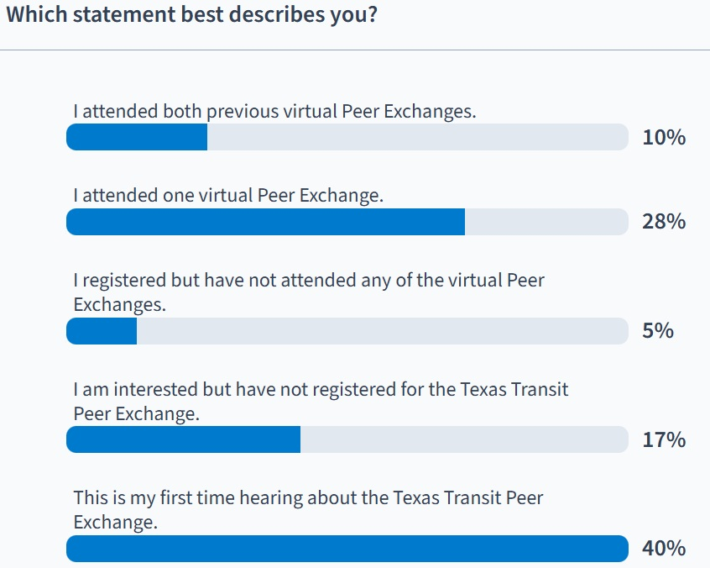
Poll Everywhere survey activity
Activity Title: Registration and Participation in the TPE
Slide 3
Notes:
Do not modify the notes in this section to avoid tampering with the Poll Everywhere activity.
More info at polleverywhere.com/support
Registration and Participation in the TPE
https://www.polleverywhere.com/surveys/F3hDNfvwqQMp2QaAmBoJO?flow=Default&onscreen=persist

Slide 22
AGENDA – TPE Update
    Debrief on the first two meetings
    Participation and awareness of the TPE
    Additional topics or resources that would be helpful
    Online platform update
The Texas Transit Peer Exchange is identified as a near term SMTP 2050 priority:
Establish a community of practice (CoP) to address small urban and rural transit challenges

Slide 23
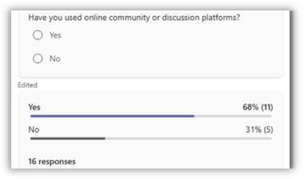
First Virtual TPE Meeting
The first meeting on June 30 included:
  Breakout groups on the topics of:
    Combined microtransit topics
    Cooperative procurement statewide
    Local match
    Insurance risk pools
  Live polling
Notes:
Let audience know that there will be an opportunity to scan a QR code on slide 6.

Slide 24

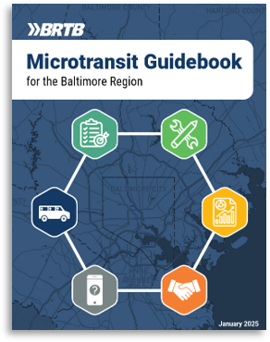
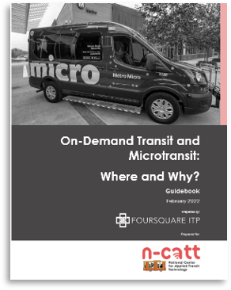
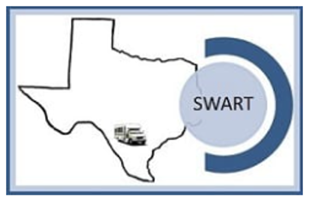





Virtual TPE Knowledge Exchange
The second meeting on September 9 included:
  Presentations from Microtransit SME Jessica Klion, and River Valley Transit in rural CT – an early adopter of microtransit
  TPE member agencies with microtransit systems
  Presenters and participants sharing experience and resources

Slide 25
Upcoming Knowledge Exchange Topics
    Local match (4 votes)
    Microtransit:
      marketing and outreach (3 votes)
      parameters for zone development and management (2 votes)
      performance indicators (2 votes)
    Cooperative procurement statewide -all things (3 votes)
    Sustainable funding strategies (2 votes)
    Measuring success at the passenger level (2 votes)
    Phasing in service expansion - navigating challenges (1 vote)
    Maintenance facility – all steps in the A&E, environmental review, contracting and compliance process (1 vote)
Notes:
Each of these topics received 2 votes in the survey at the end of the Microtransit Knowledge Exchange earlier this month – with the exception of Local Match – which received 4 votes. For those who did not attend the Knowledge Exchange – or didn’t take the survey, please do so now using the QR code on this slide so we have your feedback about topics of interest. The TPE is for you, and by you! Does anyone have ideas for speakers on any of these topics? If so, please raise your hand or catch me later. You will be more able to engage directly with your peers who share the same interests – and to find and share resources with the launch of the TPE Online Community Platform “Hivebrite” later this fall…

Slide 26
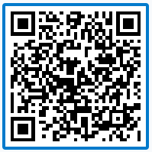
Topics: poll #2
PollEv.com/michaelwalk897
    Local match (4 votes)
    Microtransit:
      marketing and outreach (3 votes)
      parameters for zone development and management (2 votes)
      performance indicators (2 votes)
    Cooperative procurement statewide -all things (3 votes)
    Sustainable funding strategies (2 votes)
    Measuring success at the passenger level (2 votes)
    Phasing in service expansion - navigating challenges (1 vote)
    Maintenance facility – all steps in the A&E, environmental review, contracting and compliance process (1 vote)
Notes:
Each of these topics received 2 votes in the survey at the end of the Microtransit Knowledge Exchange earlier this month – with the exception of Local Match – which received 4 votes. For those who did not attend the Knowledge Exchange – or didn’t take the survey, please do so now using the QR code on this slide so we have your feedback about topics of interest. The TPE is for you, and by you! Does anyone have ideas for speakers on any of these topics? If so, please raise your hand or catch me later. You will be more able to engage directly with your peers who share the same interests – and to find and share resources with the launch of the TPE Online Community Platform “Hivebrite” later this fall…

Slide 27
Resources: poll #3
PollEv.com/michaelwalk897
What additional resources would be helpful?
Studies (Ex: Micromobility Feasibility)
Training Materials
Sample Agreements (Ex: Local Match)
Excel-based and other tools (Ex: cost-allocation tool)
Use the paper provided on your table to share specific resources and topics of interest – we’ll collect them.
  We have collected some general resources – from:
    NRTAP
    APTA
    TTA
  As well as Microtransit resources.
Notes:
TTI is populating the resource library with materials from YOUR AGENCIES to be used by YOUR PEERS.

Slide 28
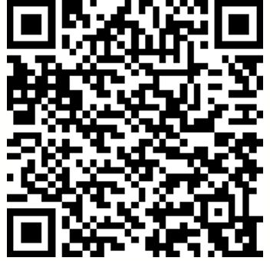
(If you haven’t already)… JOIN THE TPE!
  TPE membership is currently comprised of 50 individuals representing 33 agencies.
  Different agencies and agency representatives participate in meetings/ knowledge exchanges based on the discussion topic(s).
  Registration remains open!
If you AREN’T ALREADY a TPE member: register now!
Notes:
While you were able to register for the knowledge exchange without being an official TPE member, you will not have access to the new platform, discussions, or receive notifications about events and new resources in there without registering first. Registration is open to all staff at Texas transit agencies, regardless of title.

Slide 29
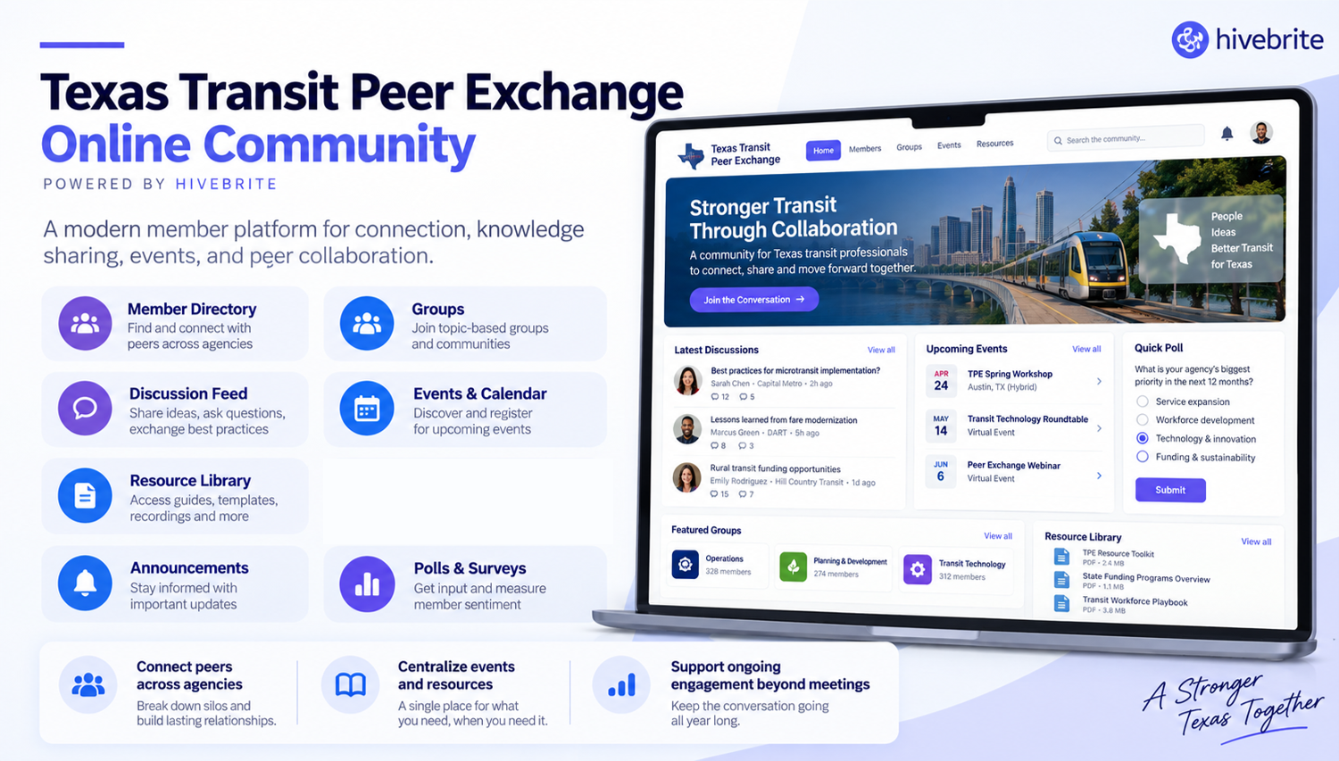
Texas Transit Peer Exchange Online Community

Slide 30
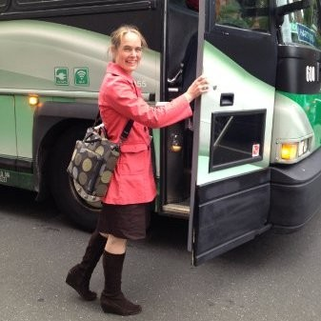
Thank you! Comments or Questions?
Holly Parker: h-parker@tti.tamu.edu
Carrie Diamond: c-diamond@tti.tamu.edu
Michael Walk: m-walk@tti.tamu.edu
Brigida Gonzalez: Brigida.Gonzalez@txdot.gov
Theo Kosub: theodore.kosub@txdot.gov
Notes:
Use this slide as an opportunity for people to share any ideas they have for speakers.

Slide 31
Transit Service Span Existing Conditions Analysis
SMTP Span Gap Analysis: Preliminary Results
September 29, 2026
PTN Semi-Annual Operators Meeting
Michael J. Walk
Research Scientist
Special thanks to:
Troyee Saha, Ph.D, &
Bhavana Tadavarthy
Notes:
508-compliant starter template. Font sizes should remain 18pt or larger because some of the foreground/background color combinations will fail contrast requirements at smaller sizes. (See https://webaim.org/resources/contrastchecker/ for a more detailed explanation of color contrast.)
Contact TTI Communications, https://my.tti.tamu.edu/com/, if you need further assistance with 508 compliance.

Slide 32

TTI Agenda
Analysis goal
Methods
Summarized results
What’s next?

Slide 33
Analysis Goal
Compare the current span of transit services at rural and small urban transit systems against the span target in the Statewide Multimodal Transit Plan (SMTP)
SMTP Span Target:
16 hours on weekdays
12 hours on Saturdays
8 hours on Sundays
Identify gaps in meeting the target to help obtain additional state funding for transit
Q: Why only rural and small urban?
A: This is an initial phase of the analysis. More gap analyses likely to follow in subsequent phases.

Slide 34
Methods
Inventory rural and small urban public transit services
  Fixed route from GTFS feeds
  Demand response (including microtransit) from Texas Transit Dashboard
  Exclude services not for general public (e.g., ADA, NEMT)
  Calculate average span per day for each agency’s
    Fixed route
    Demand response
    Microtransit
Calculate service span scores for each agency’s service
  0 – 0.75 = Below target
  0.76 – 0.90 = Partially meets target
  0.91 – 1.00 = Approaching target
Map services and populations served
For example, a span score of 0.80 means that the service’s span across a week is at about 80% of the SMTP weekly target, receiving a category of partially meets target.

Slide 35
Preliminary Results
Summarized

Slide 36
Results Tables
Transit Agency Type (number of services) | % Below the Target | % Partially Meeting the Target | % Approaching the Target
Rural (41) | 83% | 15% | 2%
Small Urban (15) | 47% | 40% | 13%
Rural & Urban (21) | 76% | 24% | 0%
Service (number of services) | % Below the Target | % Partially Meeting the Target | % Approaching the Target
Fixed-Route (33) | 61% | 33% | 6%
Demand Response (35) | 86% | 11% | 3%
Microtransit (9) | 78% | 22% | 0%

Slide 37
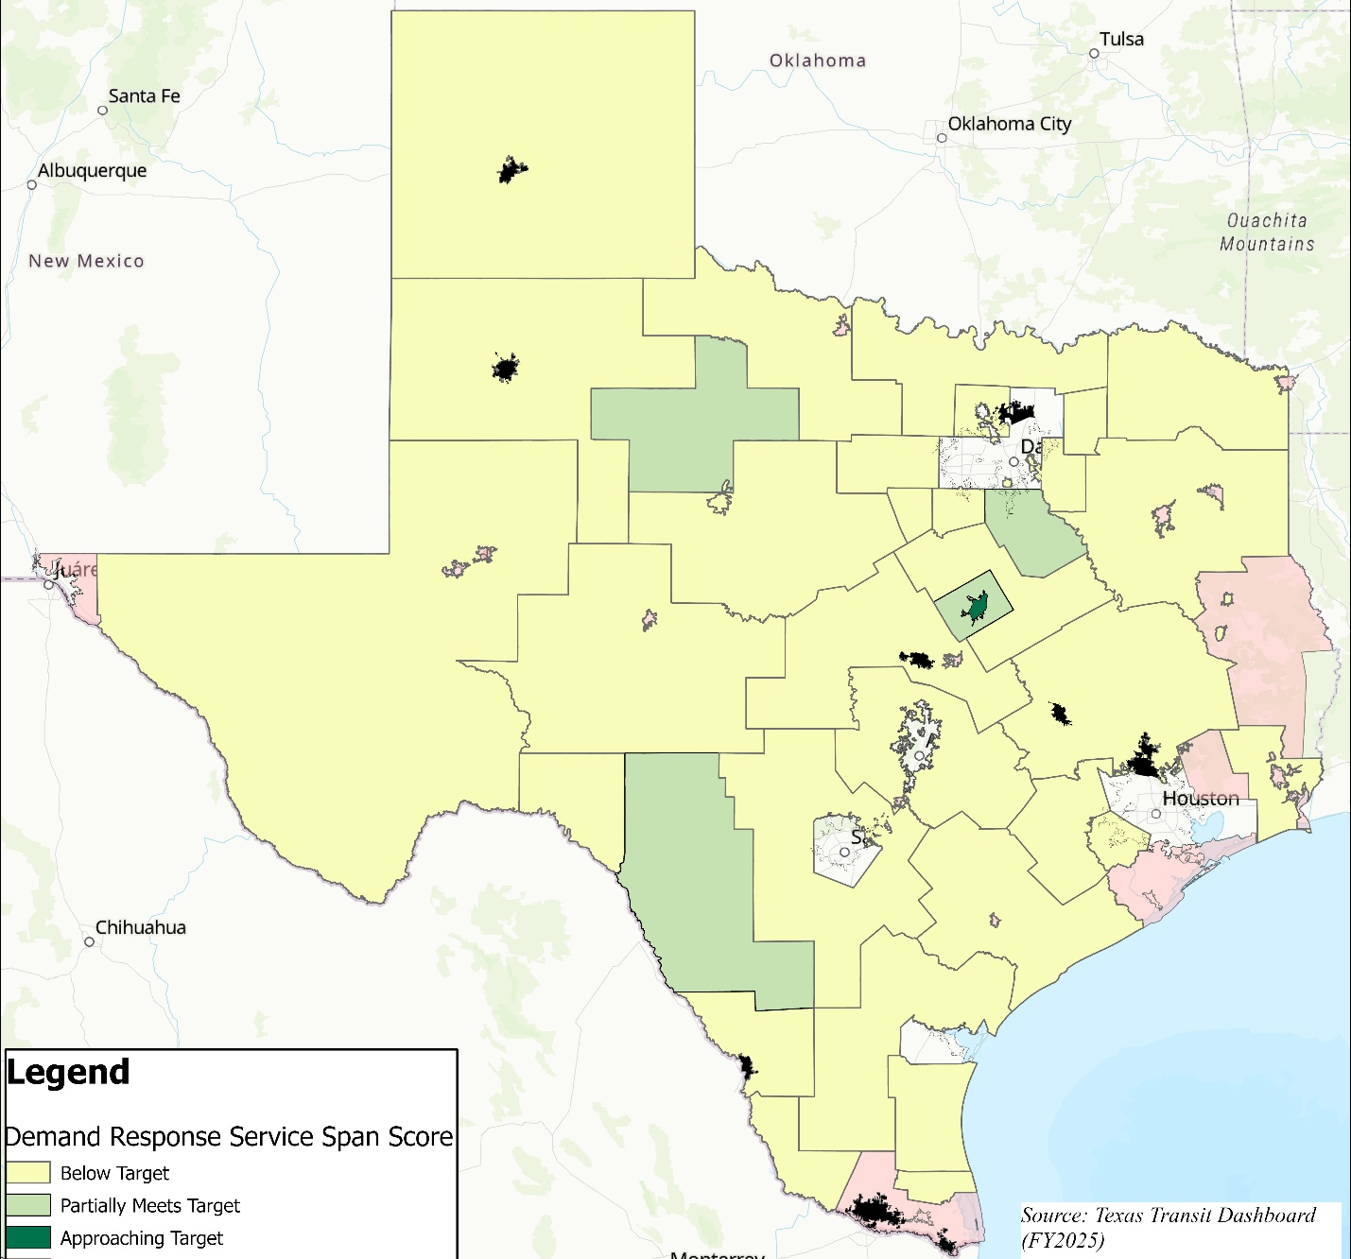

Demand Response Map
Most demand response service in Texas is below the SMTP target

Slide 38
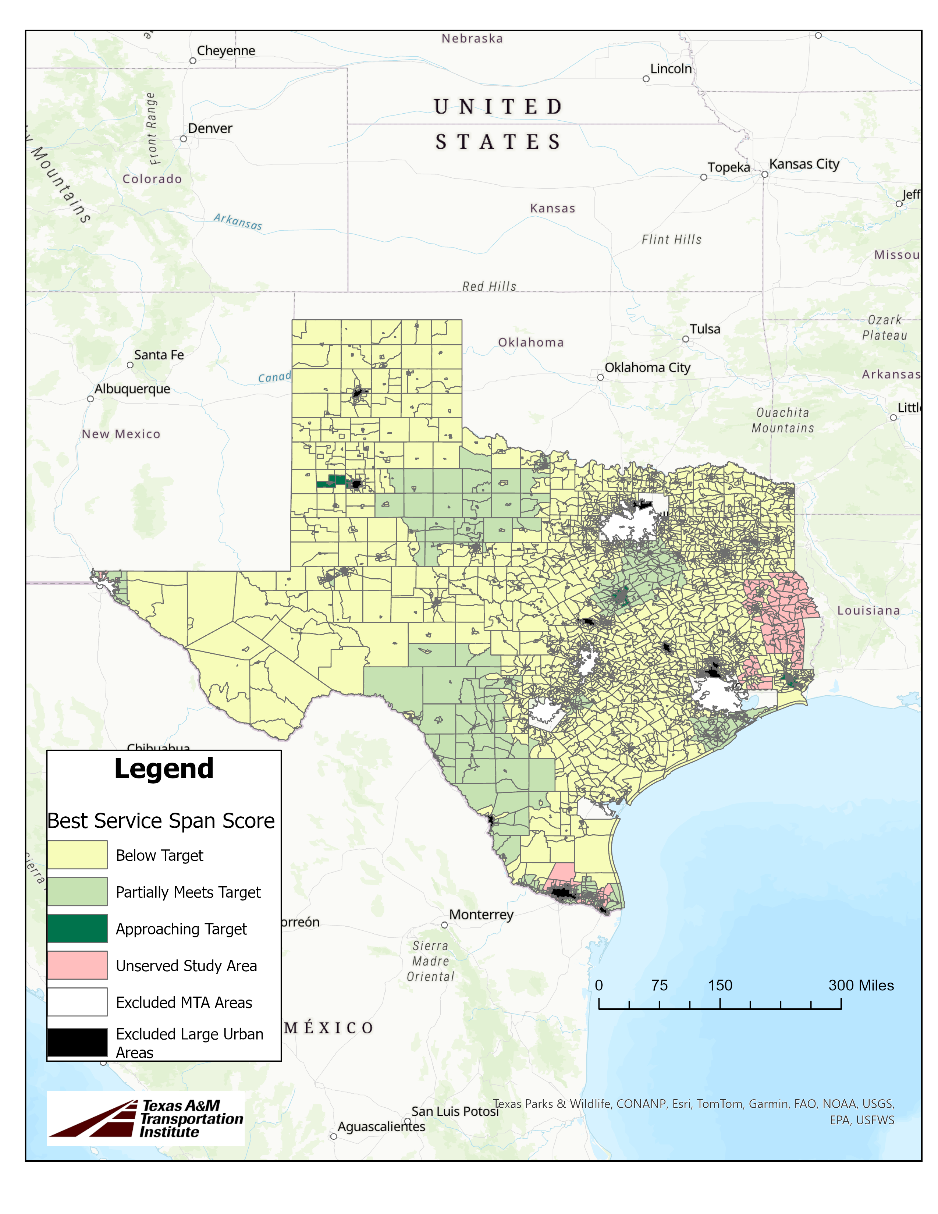
All Services Combined Map
When we map the best service span available in a Census block group (from fixed route, demand response, and microtransit), we still find most areas’ service is below the SMTP target

Slide 39
Key Findings
~10.9 million people live within the boundaries of rural and small urban transit districts, accounting for 36% of Texas's population
72% of the 10.9 million people live where the best available transit service is below the SMTP target
Demand response is typically below the target (86% of services)
Sundays had lowest performance (most Sunday service was below the target)

Slide 40
Next Steps
Prepare final gap analysis results
Outreach to rural and small urban transit agencies to understand how they would use the funds to meet the minimum service level
Prepare information for upcoming legislative session

Slide 41
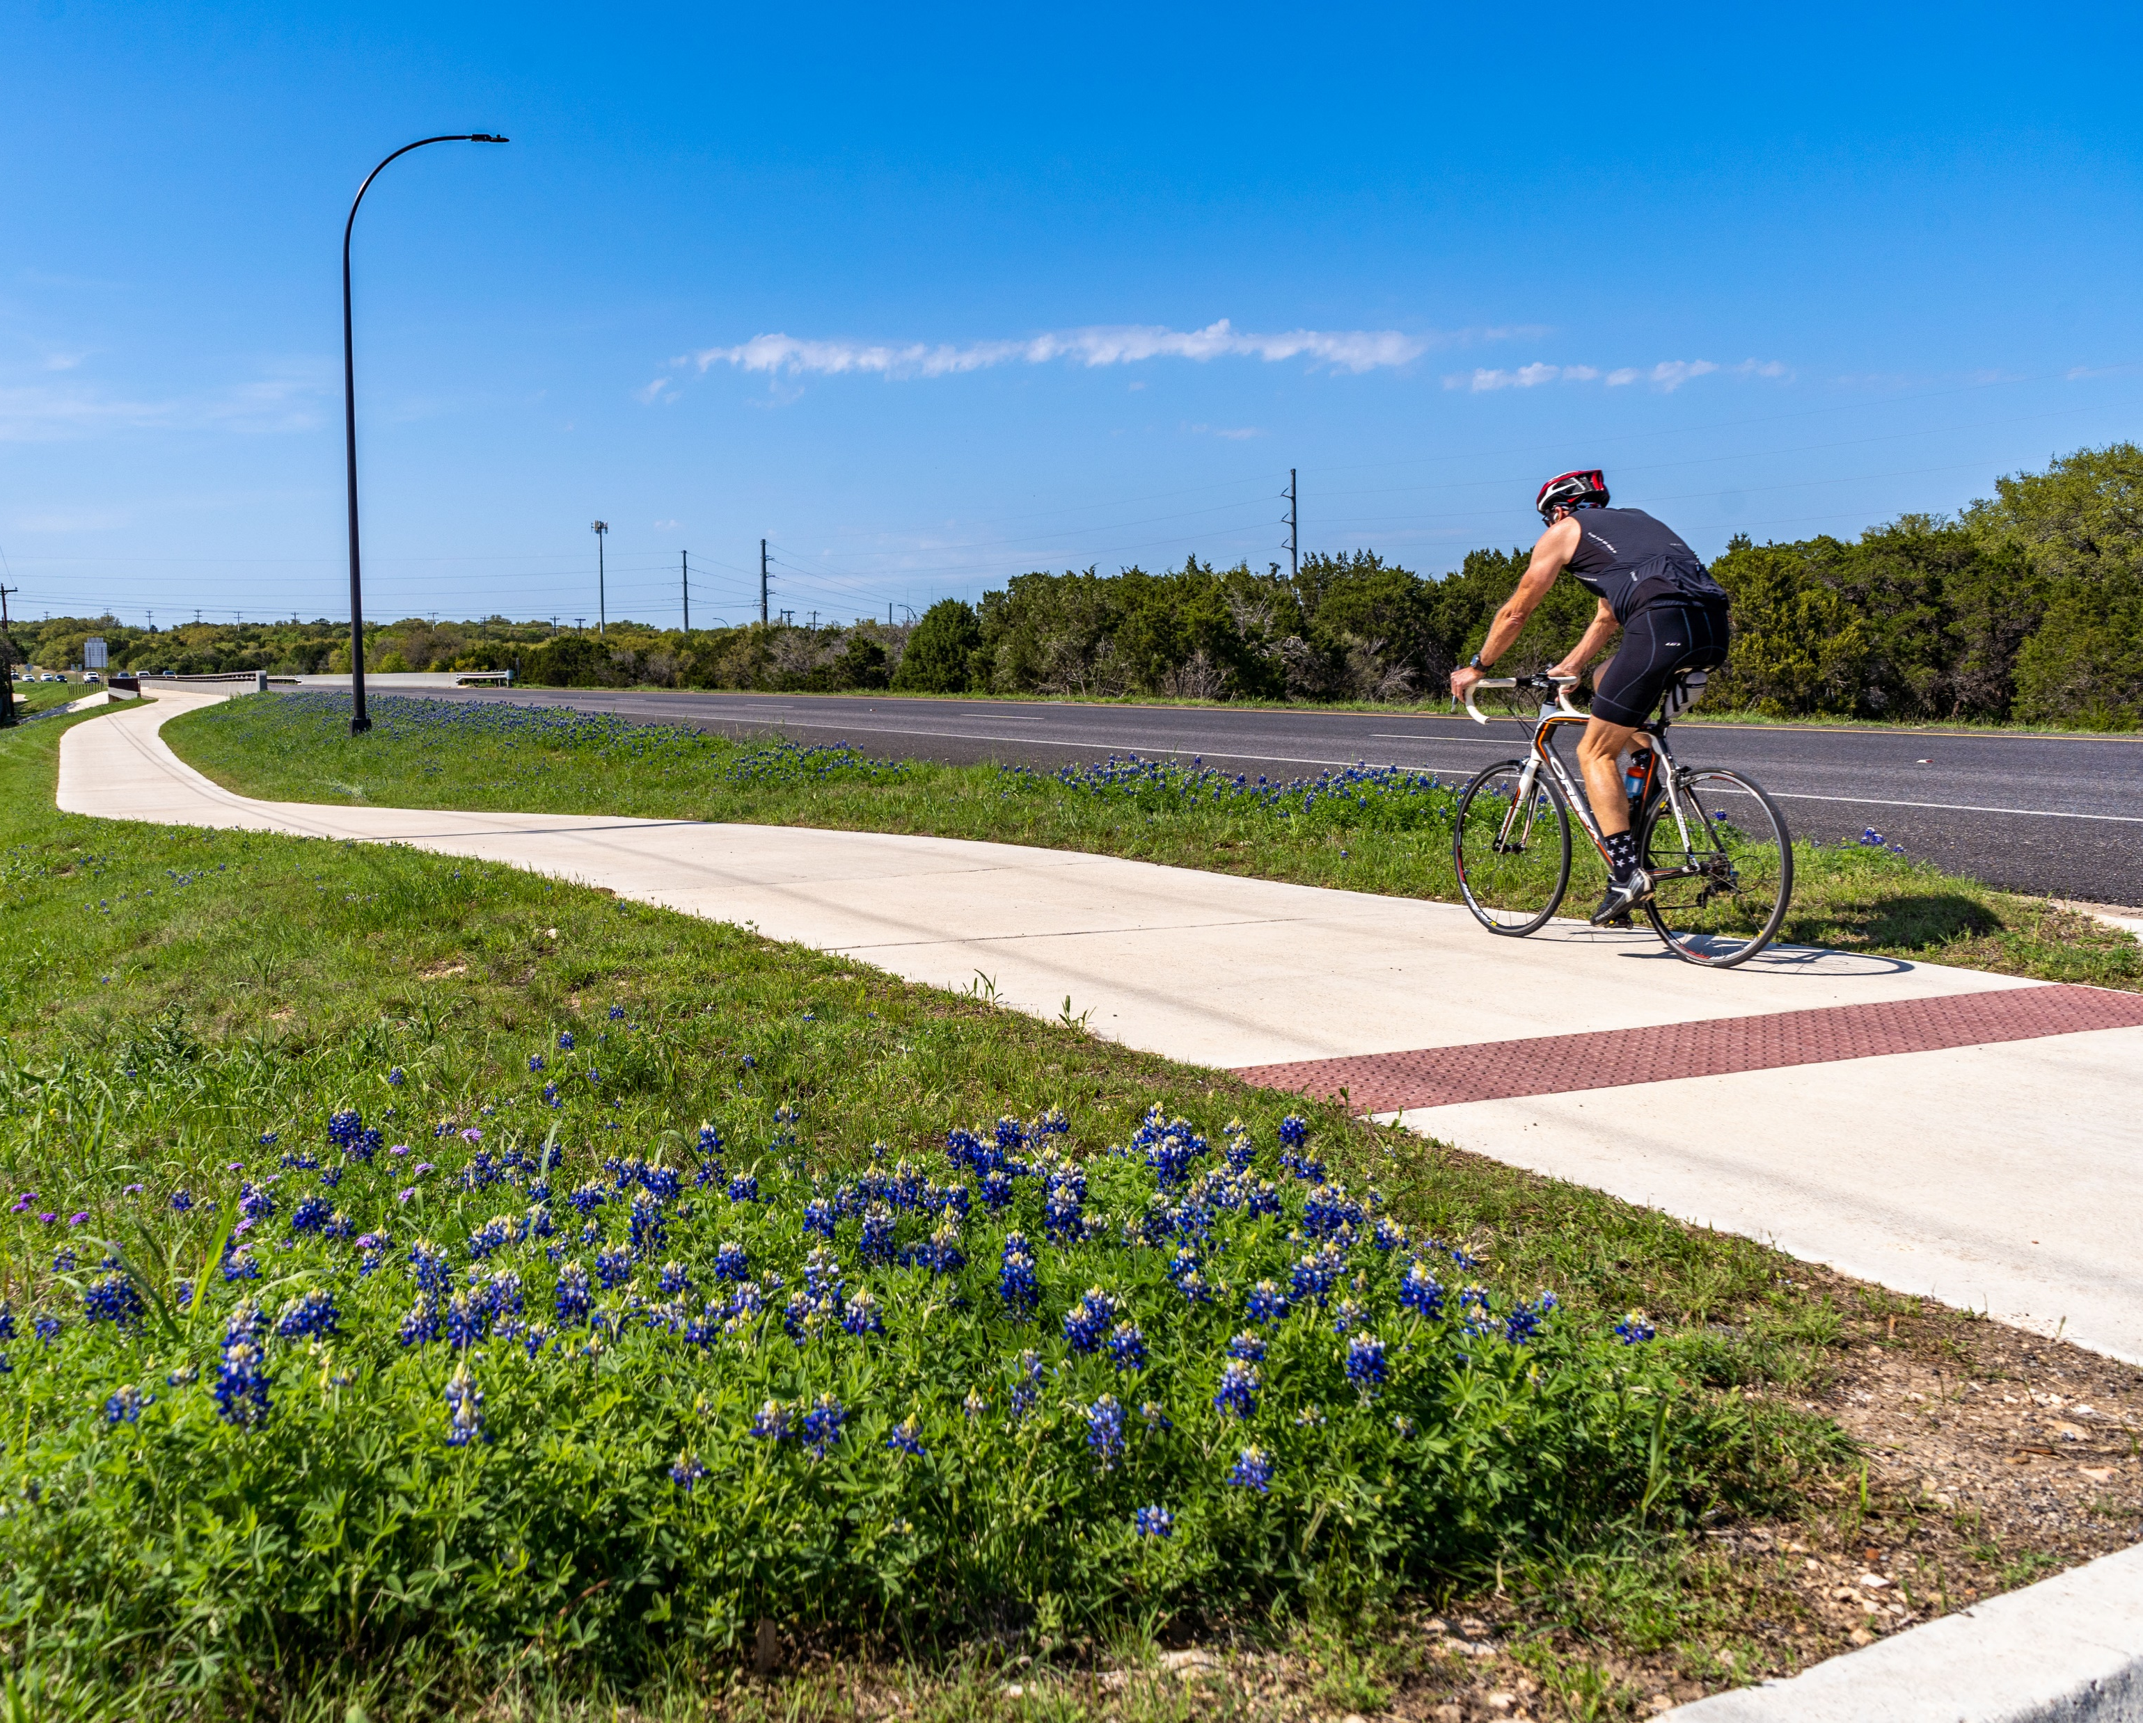
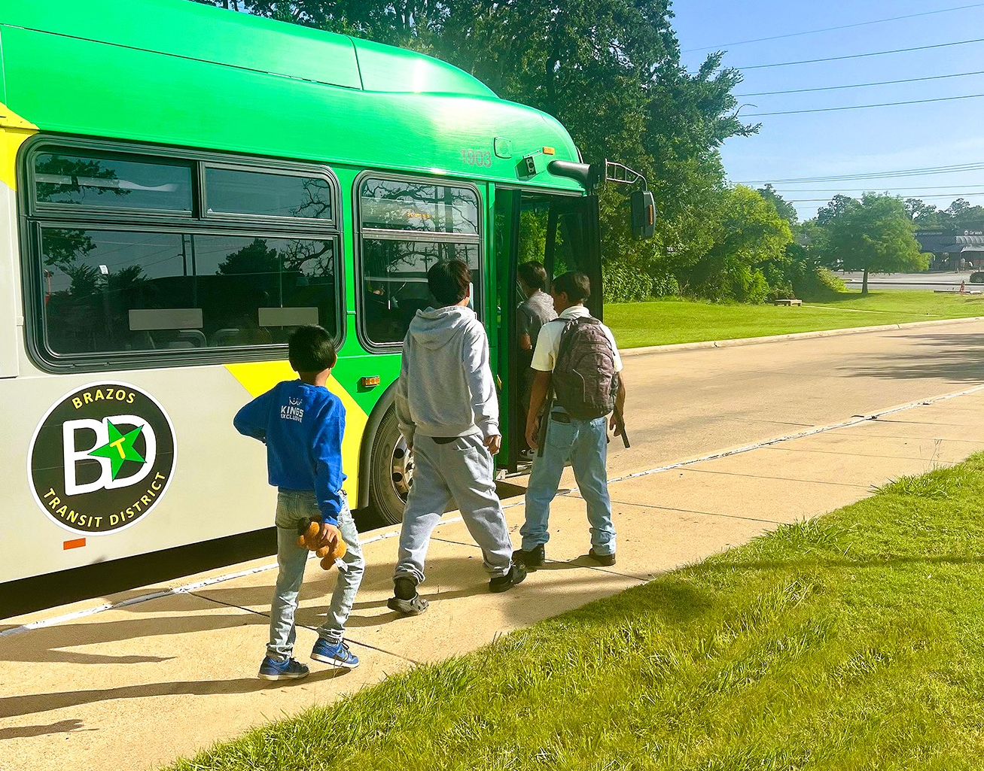
Statewide Priority Transit Network & Hub Plan
Semi-Annual Transit Operators Meeting

Slide 42
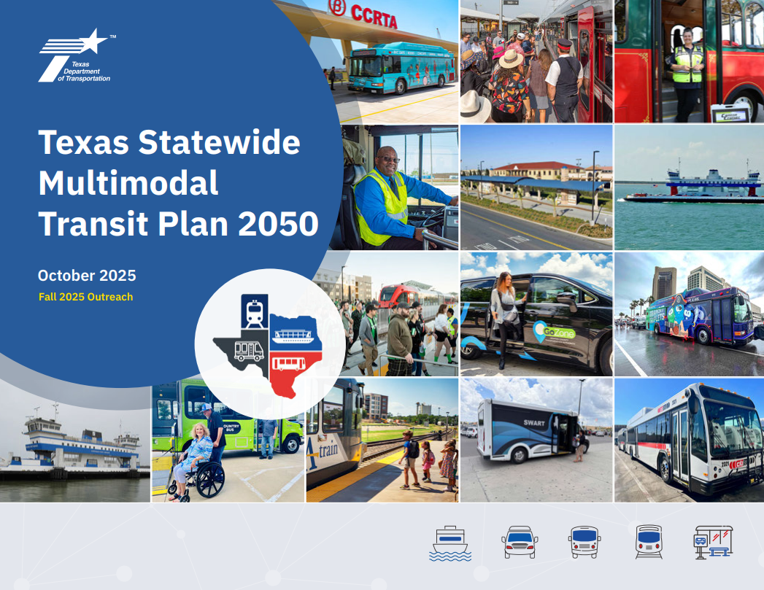
Initial Priority identified in the SMTP
The Network and Hub Plan will address a key strategy identified in the Statewide Multimodal Transit Plan
Components of a Network and Hub Plan are noted in the SMTP to include:
Key statewide transit corridors connecting major destinations across the state
Existing and future transit hubs
Network of urban or rural connecting corridors and hubs
Corridors within local transit agency service areas that are on state roadways

Slide 43
Expected Outcomes What the plan sets out to do
Facilitate Intermodal
Transfers
Expand Multimodal Options
Support Economic Development & Job Access
Expand User Access
to Services

Slide 44
Network & Hub Plan Development Process
Phase 1
Baseline
Phase 2
Network hierarchy
& priority corridors
Phase 3
Hubs & typologies
Phase 4
Final plan
Building off SMTP compile existing services network and facilities.
Evaluate service levels (rail, intercity bus, first-last mile), access points, fare structures and linkages, and identify priority networks/connections.
Develop hub typologies informed by connectivity, land use, service levels, and planning costs.
Assemble deliverables into a comprehensive final plan.
Regional Stakeholder Working Group Session 1 Discuss gaps in the network today.
Regional Stakeholder Working Group Session 2
Review identified network and connections, discuss to prioritized network
Regional Stakeholder Working Group Session 3 Feedback on draft hub typologies and amenities.
Regional Stakeholder Working Group Session 4 Review the draft recommendations and implementation plan.

Slide 45
Data Collection & Network Hierarchy Assessing the network to develop hub typologies
NETWORK HIERARCHY
DATA COLLECTION
Ridership
Best Practice Research
Bicycle & Sidewalk network
Tech-nology
Previous planning efforts
Ride sharing data
Demo-graphic Data
Active, Freight, and other plans
Gaps & key linkage opportunities
Assess rail, bus, first/last mile connections
Transit Emphasis Corridors
Prioritize & execute right-sized and context specific appropriate investments
Correlate Branding Hierarchy
Identify statewide branding opportunities
Notes:
Prioritize transit treatment upgrades in each region
NETWORK HIERARCHY
Identify Gaps & key linkage opportunities for:
Passenger rail
Intercity bus
Transit corridors
First last mile connections
Identify Transit Emphasis Corridors
Locations to prioritize transit treatment upgrades in each region
Correlating Branding Hierarchy
Statewide branding opportunities
Enhance customer experience

Slide 46
Hub Typologies & Recommendations
Mobility Hub Recommendations
State highway system
Surrounding land uses
First/last mile connectivity
Transit districts
High-capacity corridors
Regional/local focal points
Identify and deploy mobility hub best practices
Develop a methodology for identifying hub areas that will consider all elements shown in the graphic here
Typologies will be adaptable to metro, large and small urban, and rural transit district service areas
Hub and Priority Transit Network recommendations will be deployed within the context of the overall state highway system to inform investment decisions and use in high-capacity corridors

Slide 47
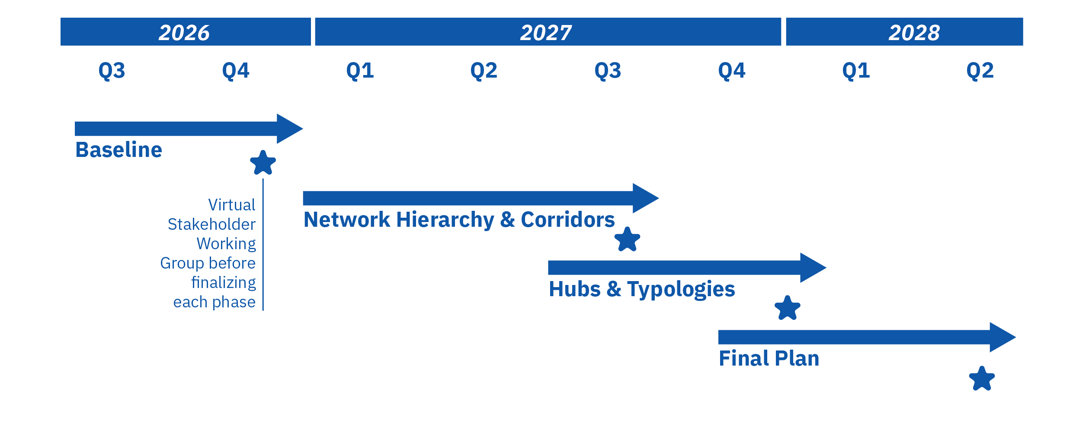
Timeline & Commitment

Slide 48
How Operators Are Involved
Four regional working group session will take place within Task 3 intermittently to gain consensus on key milestones
Discuss key strengths and opportunities
Gain insights from operators regarding how their systems work now and could work in the future
Provide input on potential solutions
Review proposed mobility hub location, treatments, policies, and design solutions, providing barriers and priorities
Collaborate with consultant to public to identify priority projects and treatments
Identify which solutions would be most beneficial and aligned with their system, and prioritize those solutions

Slide 49
Thank You
Contact Information
TxDOT Public Transportation Statewide Network & Hub Plan
Theodore Kosub, Project Manager theodore.kosub@txdot.gov
Jake Francis, HNTB
jfrancis@hntb.com

Slide 50
Universal Trip Planning and Fare Payment
Innovation Coordination Access and Mobility Grant Application
GTFS and GTFS-Flex Initiative

Slide 51
Statewide Multi-modal Transit Plan – 2050 Vision Statement
A safe, universally accessible, and integrated network of transit mobility options that connects people seamlessly, locally, and across the state, supporting an improved quality of life and a resilient and vibrant economy

Slide 52
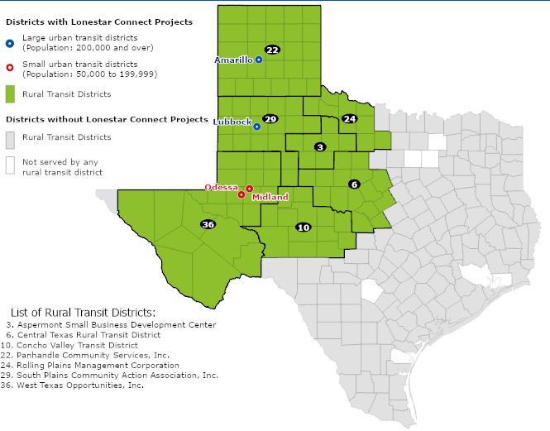
Proposed Project
ICAM request: $2,731,894
+ TxDOT match: $682,973
Total: $3,414,867
Uses GTFS and GTFS Flex
GoPass platform
7 Rural Transit Districts
3 Urban Transit Districts
Map 1 - Project Area.

Slide 53
Why West Texas
Identified as a need in regional coordination plans
Previous attempt to implement a coordinated mobility platform
History of coordination between agencies
Lubbock’s experience with GoPass

Slide 54
Proposed Project
Support innovative projects for transportation disadvantaged populations that will improve the coordination of transportation services and non-emergency medical transportation services
Uses the General Transit Feed Specification (GTFS)
GoPass is the platform

Slide 55
Project Timeline (approximate)
4 years to complete
Winter 2026/Spring 2027 – Federal Transit Administration (FTA) decision
3rd Quarter 2027 - Interlocal Agreements (ILAs) with transit agencies
3rd Quarter 2028 – Procurements for professional services complete
3rd Quarter 2029 – Launch of part 1, Lubbock and 2 agencies
3rd Quarter 2030 – Complete launch of remaining 7
2031 – Closeout

Slide 56
Branding Options
Vote for one:
Lonestar Connect
Go!Texas

Slide 57
Statewide GTFS & GTFS-Flex Initiative
Issues and opportunities

Slide 58
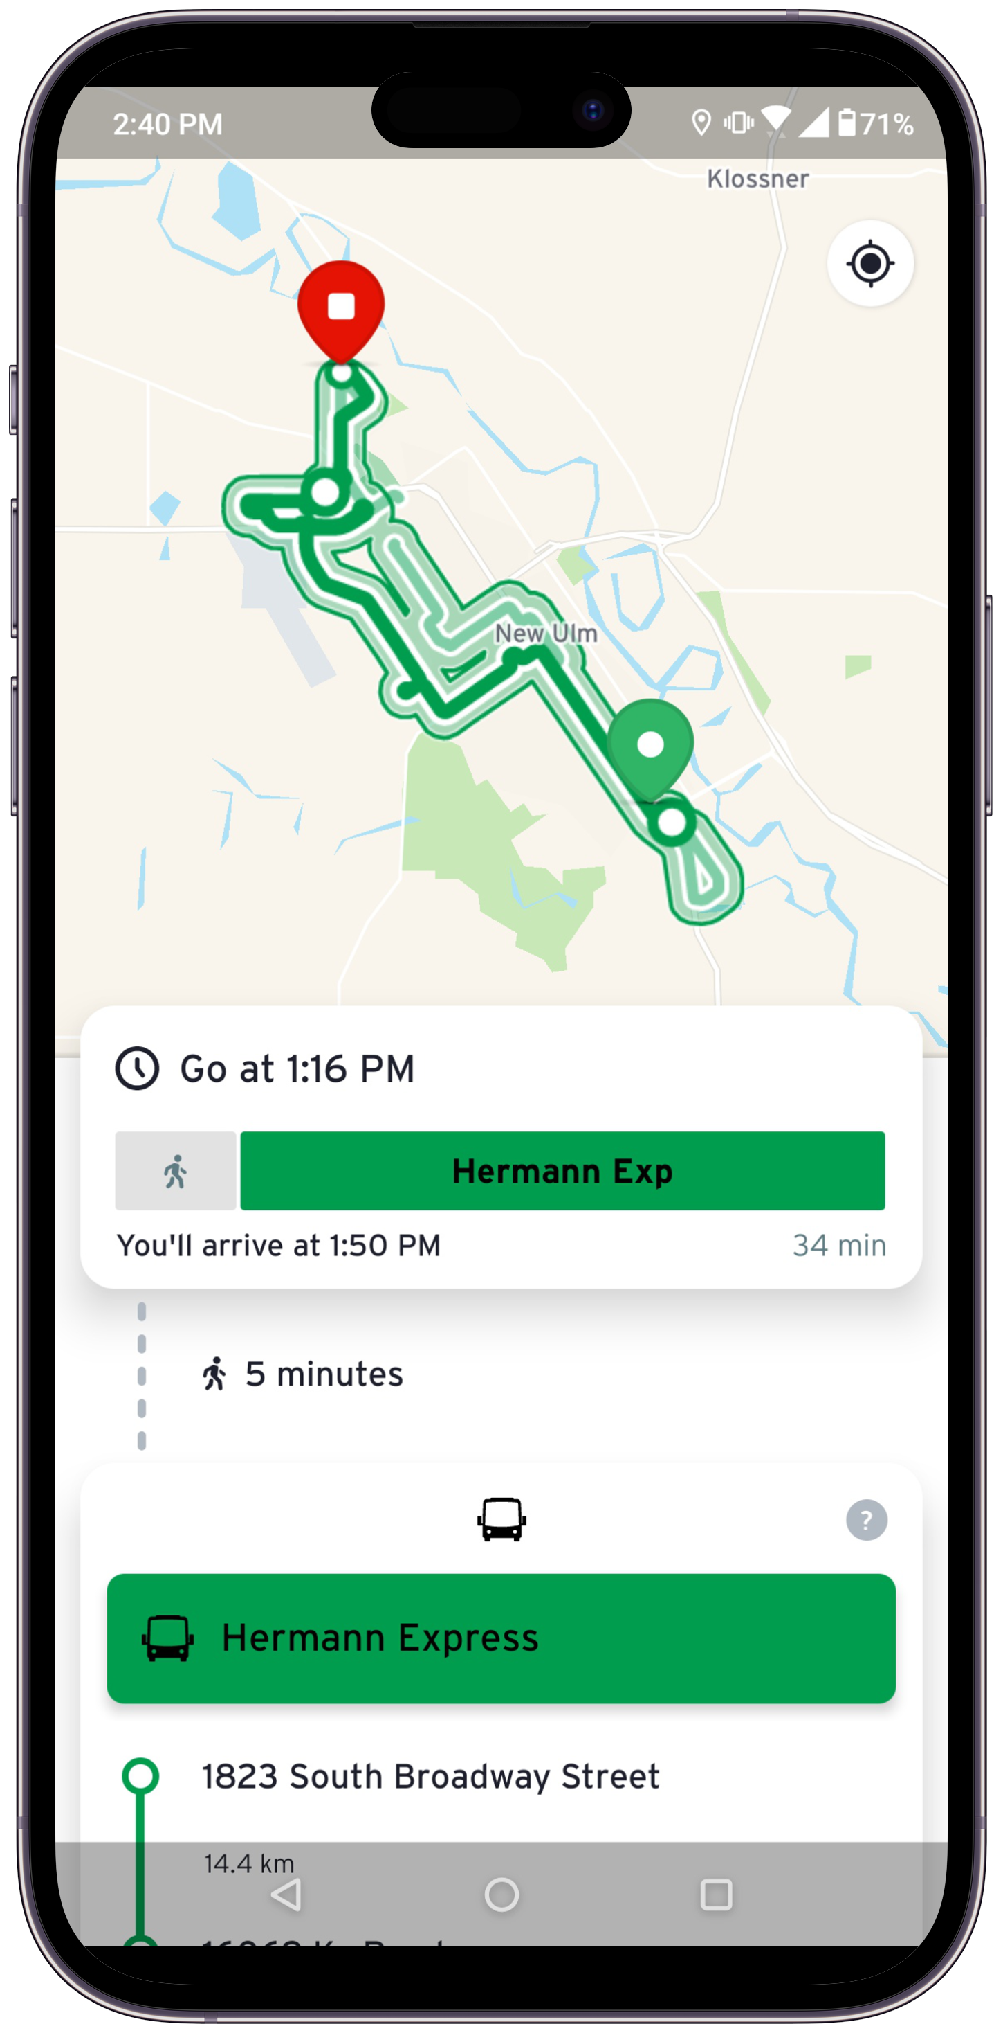
Beyond GTFS NTD Requirements
Published GTFS files should meet requirements for use in trip planning apps, not just NTD requirements
Makes effective use of TxDOT investment in GTFS
Provides the most benefit to agencies and riders

Slide 59
When GTFS is Not Updated
Inaccurate GTFS:
- Confuses the passenger
- Undermines confidence in your system
- Causes trip planning systems to fail

Slide 60
Common Issues in Texas GTFS Datasets
Validation
Expired calendars
Broken links
Schedules
Mismatched schedules
Missing trips
Route naming issues
Mapping
Stop location issues
Route alignment problems
Duplicate stops

Slide 61
Coming in FY27
Monthly Monitoring
Quarterly Reports
Agency Support
Better GTFS
Monthly monitoring focusing on outreach to agencies with non-valid datasets.
New TTI quarterly reports to facilitate better maintenance of datasets.
Workshop in November/ December to facilitate how TTI or your scheduling vendor can help you maintain your datasets
Better GTFS for riders and better data to share with trip planners.

Slide 62
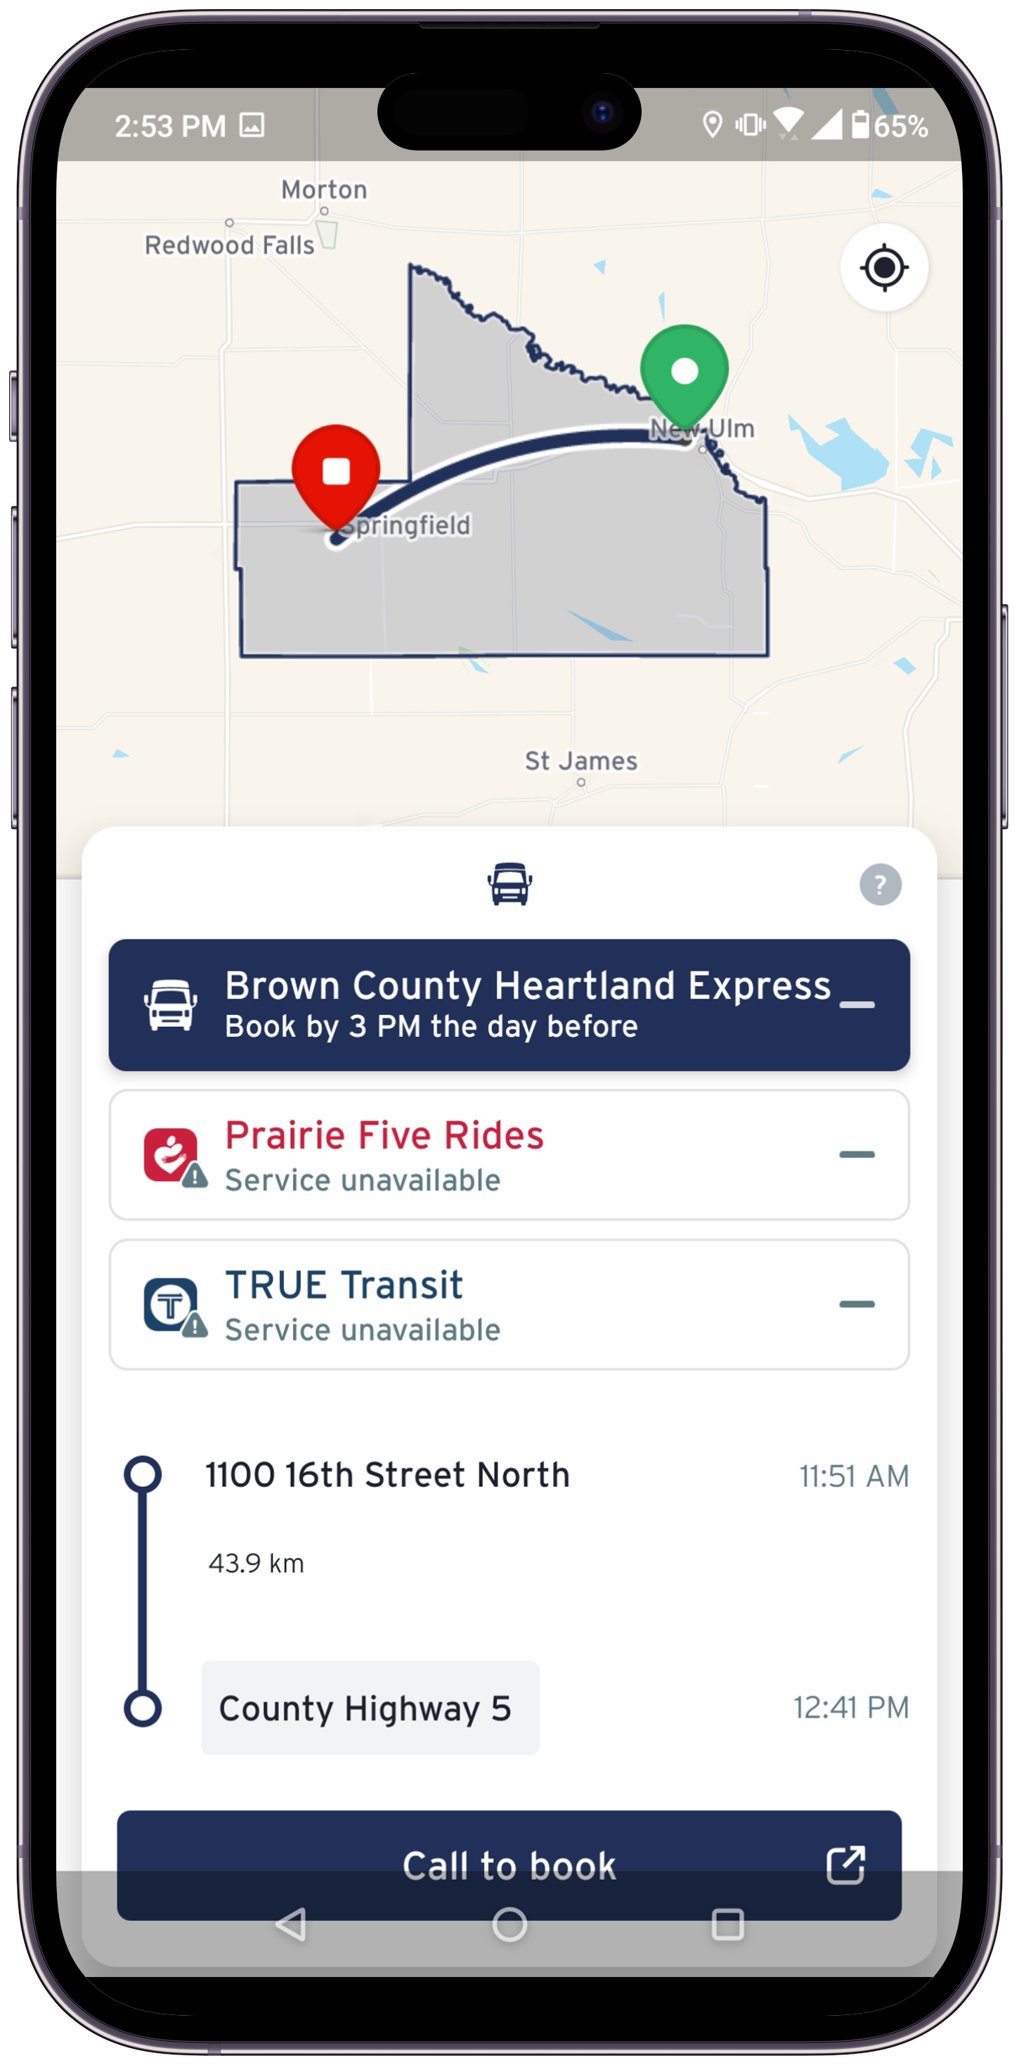
In Development: GTFS-Flex
Currently developing GTFS-Flex to support:
  Demand Response
  ADA Paratransit
  Microtransit
  Deviated Fixed Route

Slide 63
What Agencies Can Do Today
Identify who manages your GTFS
  Whether it is a vendor or staff member and who is responsible for updates.
Develop basic internal procedures to update and publish your GTFS at least with every schedule change
If you have a vendor: clarify with vendor on maintenance and who is responsible for edits and updates.

Slide 64
What Agencies Can Do Today (Cont.)
Publish/Maintain your GTFS
  Trip Planners: Google, Apple, GoPass, Transit App, Moovit, Bing
  GTFS Depositories: Mobility Data, Transitland
Need help? Have questions?
  Michael Walk | m-walk@tti.tamu.edu
  Jimmy Cardenas | j-cardenas@tti.tamu.edu

Slide 65
Lunch
11:45am-1:15pm

Slide 66
Break

Slide 67
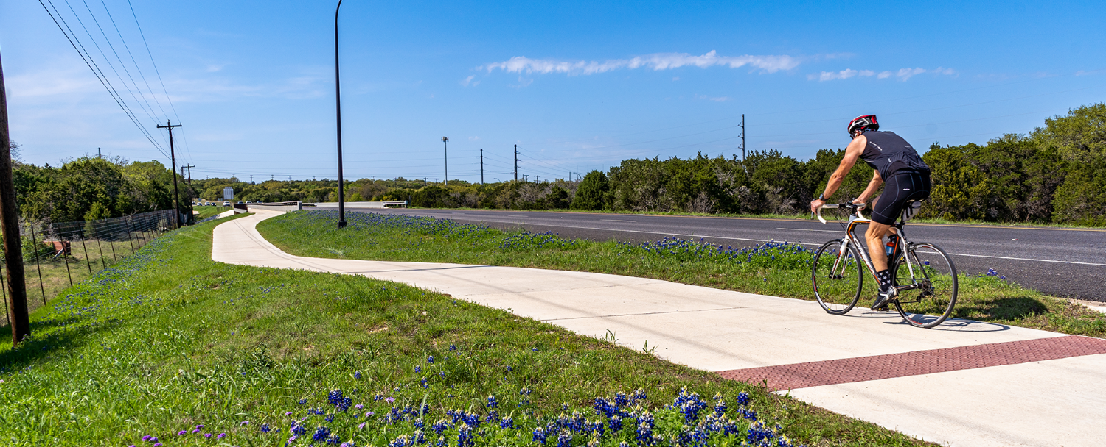
TxDOT’s 2027 Transportation Alternatives (TA) Call for Projects

Slide 68
Transportation Alternatives Agenda
1| Eligible Activities
2| Anticipated funding
3| Project & Sponsor eligibility
4| Example Projects
5| Application Process
5| Selection Criteria and Weights
7| Tentative Schedule
Notes:
Here is today’s training agenda.
There will be one 10-minute break during this 2-hour session.

Slide 69

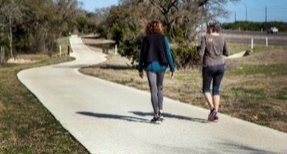
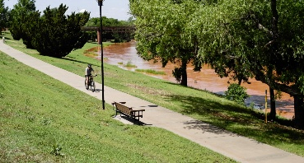


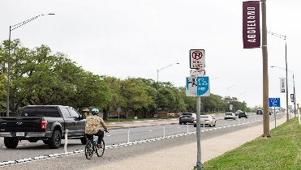
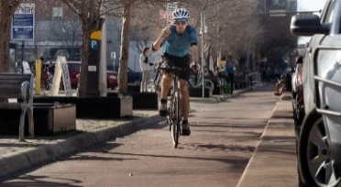
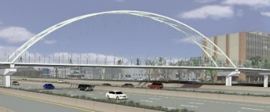

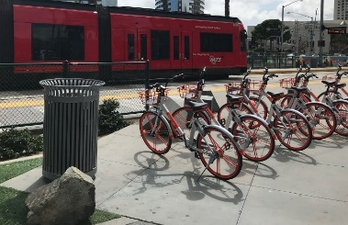
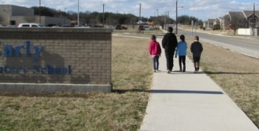
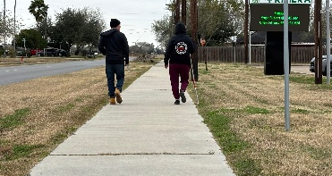
2027 Call for Projects
Construction
Planning
Small - Scale
Medium - Scale
Large Scale
Shared use paths
Shared use paths
Bicycle Tourism Trails
Bike/Ped bridges
Bike Lanes
Bike Lanes
Multimodal hubs
Sidewalks
Sidewalks
Planning
$250,000 - $1.5m
Sidewalks
Bike lanes
Shared use paths
$1.5M -$5M
Sidewalks
Bike lanes
Shared use paths
$5M - $20M
Bike/ped bridges
Regional trails
Multimodal hubs
SRTS Plans
Active Transportation Plans
Safety Action Plans
Notes:
TxDOT’s call for projects included four categories of projects:
Traditional Community-based sidewalk and bike lane projects in small and mid-sized communities (less than or equal to 200,000 in population)
Large-scale bike/ped projects around $5M - $25M in value that substantially improve biking and walking mobility options
Network Enhancements which are quick turnaround projects that improve the quality of existing facilities
Non-Infrastructure projects to help communities plan for building safe, connected networks

Slide 70
Planning for TxDOT’s 2027 Call for Projects Funding
TxDOT funds:
Population Area | Anticipated Funding Allocation (FY30-FY31)
Nonurban (<5,000) | $32.6 M
Small urban (5,000 to 49,999) | $14.3 M
Medium urban (50,000 to 200,000) | $15 M
Any Area | $139 M
Total | ~$200.9 M
TxDOT 2027 TA Call for Projects ~$200M to be made available (FY30 – FY31 funds)

Slide 71
Eligible Project Sponsors for TxDOT TA Call for Projects
  Local governments
  Regional transportation authorities
  Transit agencies
  Natural resource or public land agencies
  School districts, local education agencies, or schools
  Tribal governments
  Metropolitan Planning Organization (MPO)
  that serves an area with a population of 200,000 or less
  Nonprofit
  Other governmental entity responsible for oversight of transportation or recreational trails (other than an MPO that serves a population greater 200,000 or a state agency)
  A State (TxDOT), at the request of an entity listed above

Slide 72
TxDOT’s 2027 Call for Projects TA Program Focus Areas
Project sponsors are strongly encouraged to submit projects that:
Integrate and improve access to public transportation by investing in bicycling, wheelchair, and walking access. Specifically, projects that integrate multiple modes of transportation such as transit stops, carsharing, bikesharing, micromobility, or other shared-mobility services.
Improve safety, access, or mobility for people of all ages and abilities engaged in active transportation, especially on-system improvements (within TxDOT right-of-way) in support of TxDOT’s Americans with Disabilities Act (ADA) Transition Plan, TxDOT’s Vulnerable Road User Safety Assessment, and other bicycle or pedestrian safety initiatives.
Enhance bicycle and pedestrian access and safety to school-related destinations enabling and encouraging children, including those with disabilities, to use bicycle and pedestrian facilities to travel to school activities.
Construct segments identified as part of Texas Bicycle Tourism Trails network, TxDOT’s ACTIONetwork, or implement a locally-preferred alternate route.
Notes:
Types of projects that TxDOT is particularly interested in…..

Slide 73
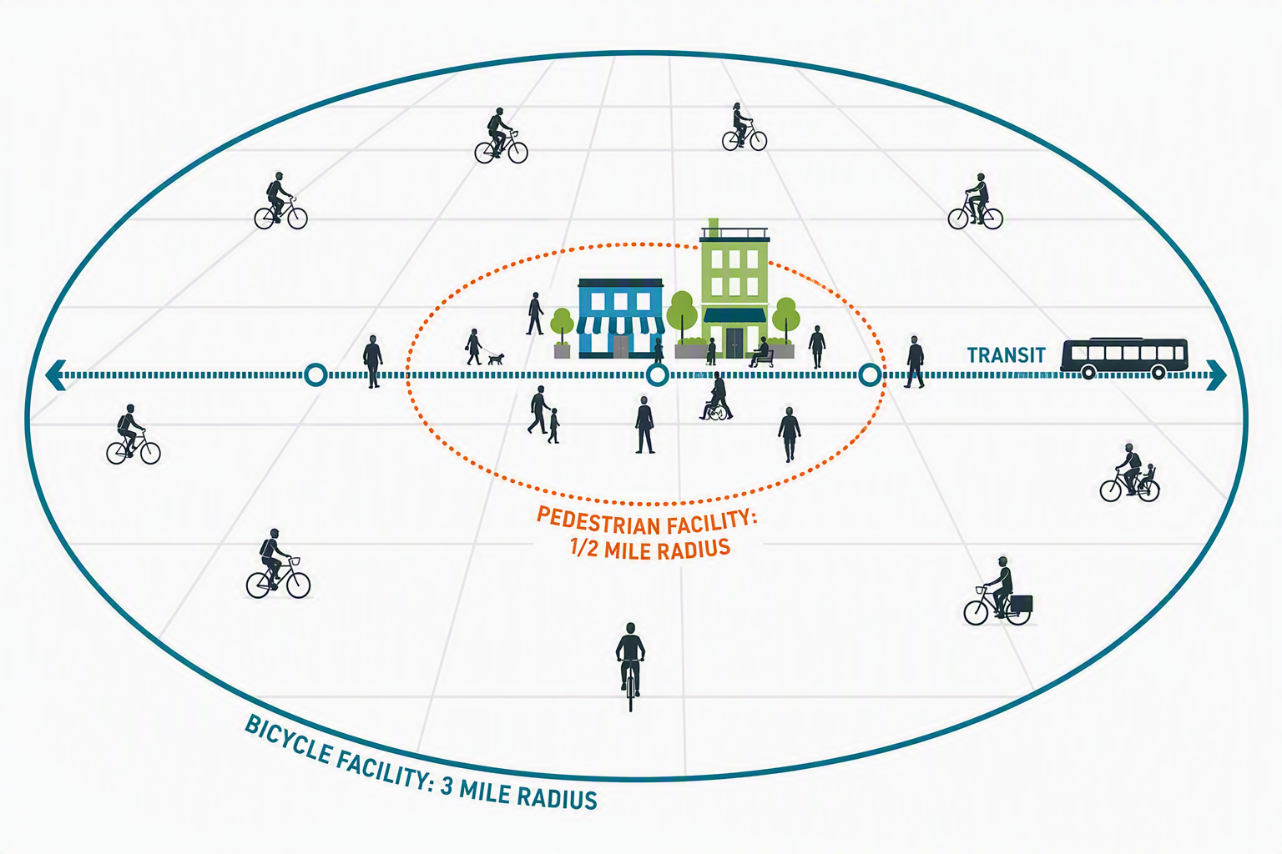
Transfer to FTA
  Projects with transit nexus (within 1/2-mi for pedestrian/3-mi for bicycle of transit stop)
  Agency must be eligible to receive FTA funds
  Project components must be eligible under FTA program rules

Slide 74
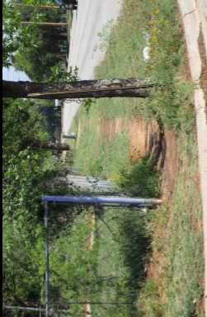
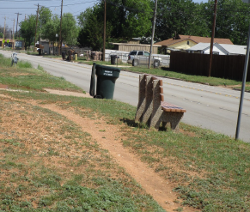
Examples of projects with transit nexus
Building new bus shelters with sidewalks (City of Abilene)
Bus shelters – 5 new bus shelters and benches
New sidewalks – 5,700 feet and 5-foot wide with 22 new curb ramps and guardrails
Pedestrian signal upgrades – new signal improvements feature audible ped crossings.
Before photo
Before photo

Slide 75
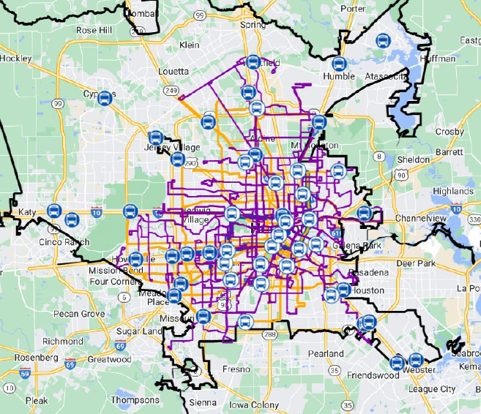
Examples of projects with transit nexus, part 1
Bike and Ride Access to Transit (METRO Transit Authority of Harris County)
Evaluate bicycle and pedestrian access to rail stations, park and ride, burs rapid transit, and BOOST Corridors.
Develop recommendations to improve bicycle and pedestrian access and connectivity to transit.

Slide 76
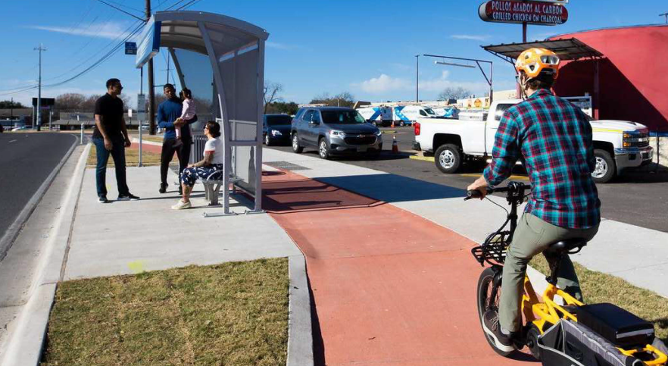
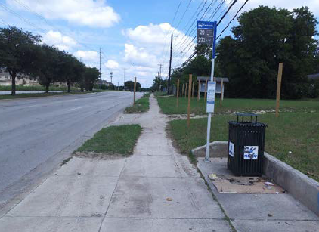
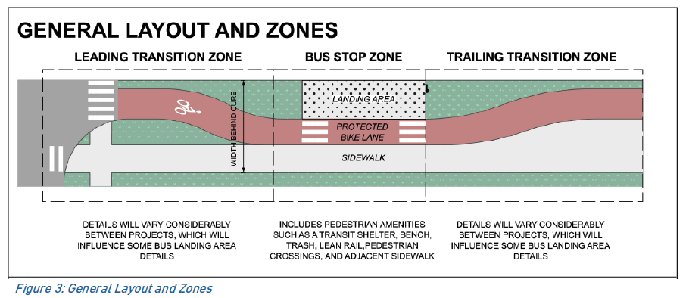
Examples of projects with transit nexus, part 2
CapMetro ADA Transition Plan Bus Stop Improvements
Implementing bus stop improvements which enhances pedestrian access and upgrade accessibility to accommodate individuals with mobility needs.

Slide 77
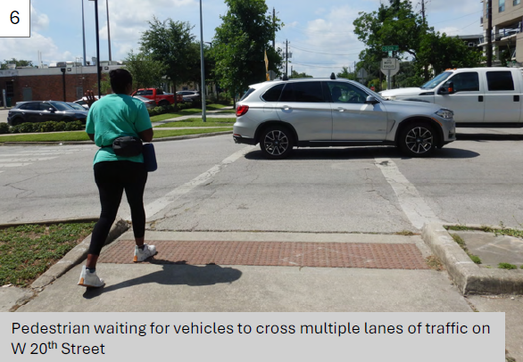
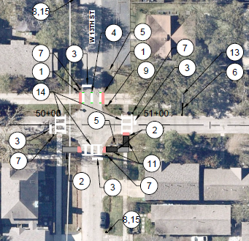
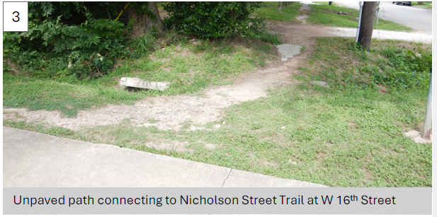
Examples of projects with transit nexus, part 3
Nicholson and MKT Trial Improvements (Memorial Heights Redevelopment Authority)
Improvements include: upgrade crosswalks, new or improved ADA ramps, limited sidewalk (gap filling), rectangular rapid flashing beacons, and improved lighting.

Slide 78
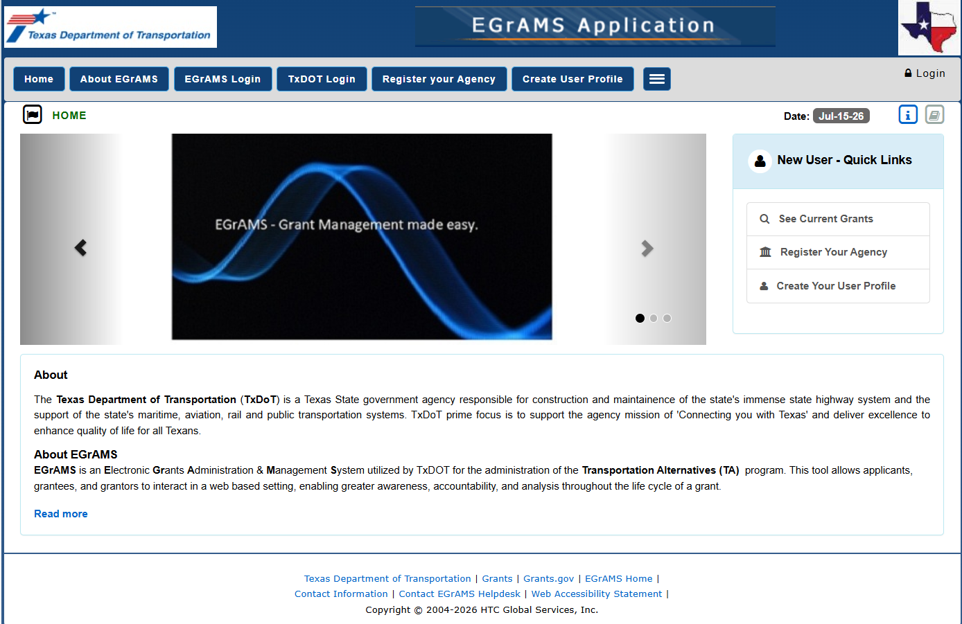
Web-based Application Process
TA-PATH

Slide 79
TxDOT TA evaluation criteria
  Bike & Pedestrian Crash Count/Rate
  Safety Hazards
  Countermeasures
  Design Elements
  Modal connectivity
  Destinations
  Barrier Elimination
  Bicycle Tourism Trails
  Employment & population density*
Safety
Connectivity & Accessibility
Geographic Balance, Community Support & Planning
Project Readiness
  Investing in areas
  with underserved populations
  Commitment,
  community support & planning
  Status of project development
  Project timeline
  Constructability
*Employment & population density are not evaluated on nonurban or small urban projects.

Slide 80
TxDOT’s 2027 TA Call for Projects Schedule (tentative)
October – December 2026 – Get the word out & roll out TA-PATH (new web app)
January 2027 – Call for Projects opens
February 2027 – Preliminary Applications due
April 2027 – Detailed Application available
June 2027 – Detailed Applications due
October 2027 – Anticipated Commission award

Slide 81
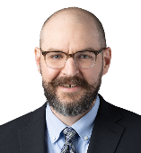
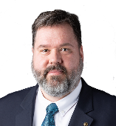
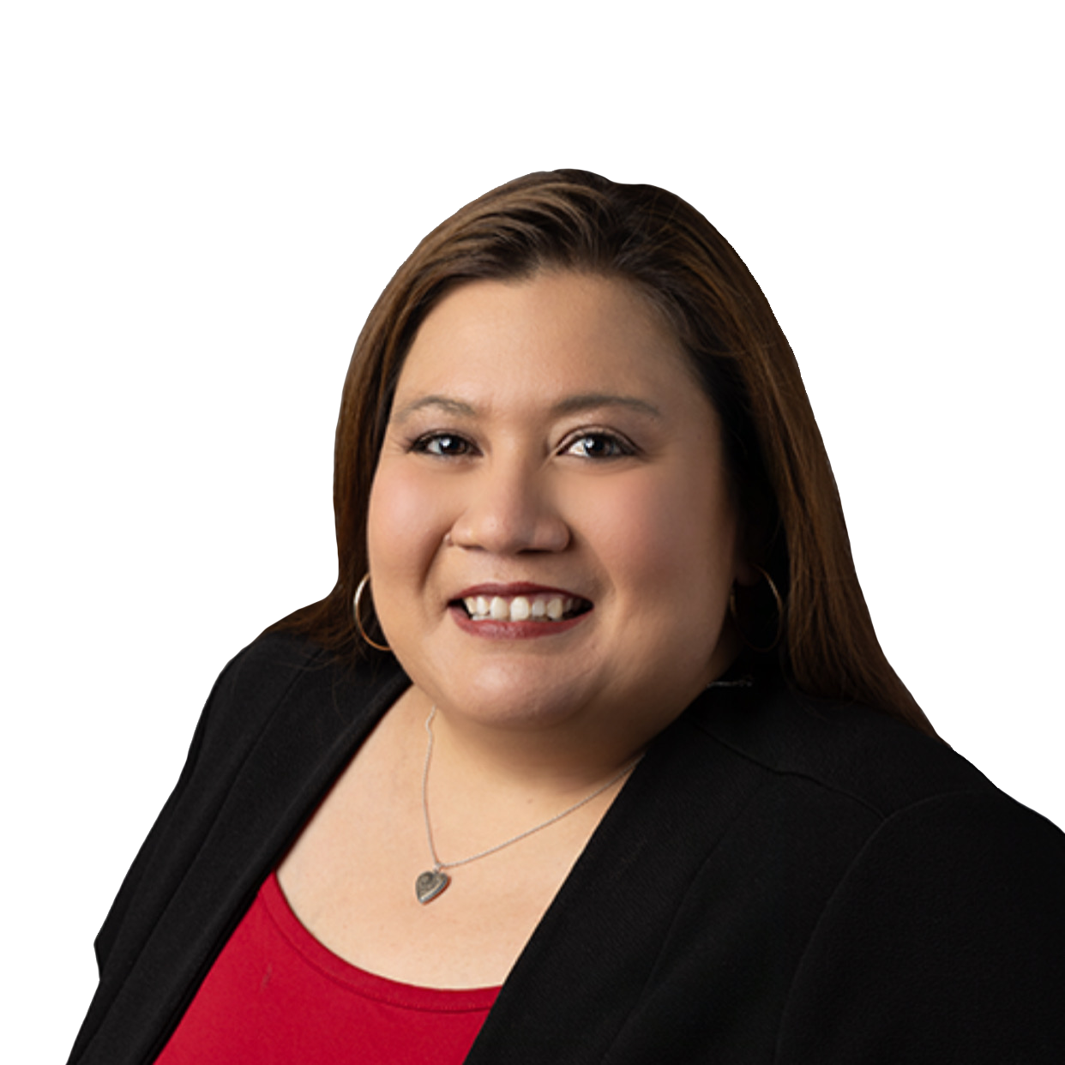
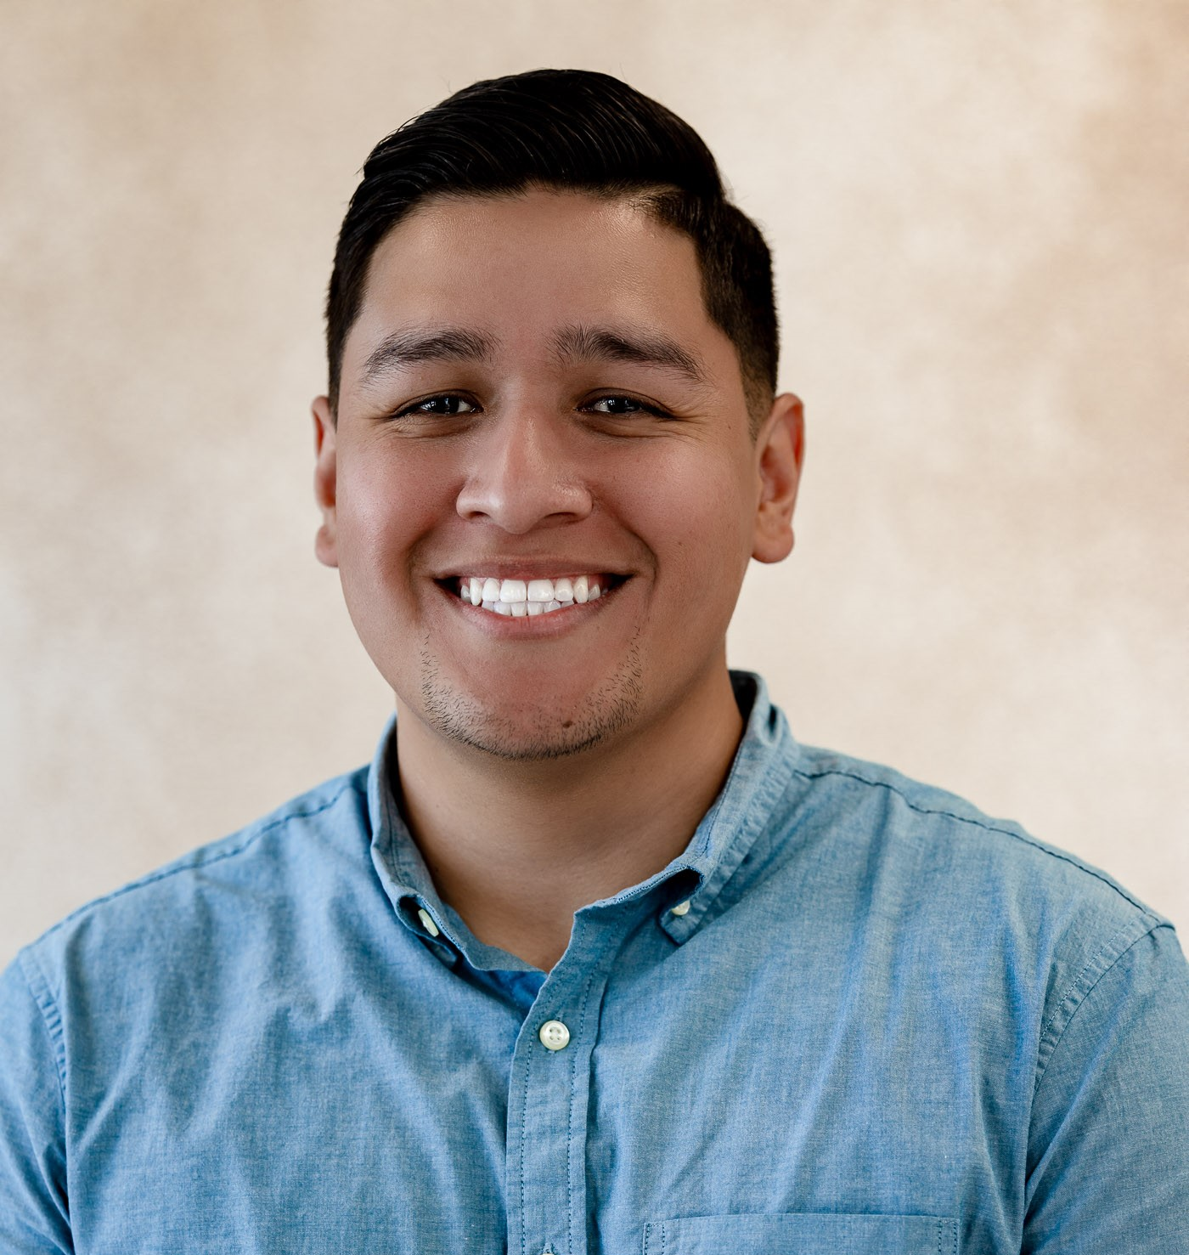
TxDOT’s Transportation Alternatives Program Team
Noah Heath, AICP
Transportation Alternatives (TA) Program Manager
noah.heath@txdot.gov
Matthew Volkmann, PE
Bicycle and Pedestrian Engineer
matthew.volkmann@txdot.gov
Daniel Davila
Transportation Planner
Daniel.Davila@txdot.gov
Veronica Cortez
Transportation Funding Specialist
veronica.cortez@txdot.gov

Slide 82
General Q&A / Adjourn

