Slide 1
Welcome
Community Connectors Meeting:
University and Downtown Access
Saturday, Jan. 31, 2026
Austin Community College Highland Campus
Why am I here today?
To learn about access along I-35 between US 290 East and Holly Street once construction is complete, as well as highlighting design improvements made since the Final Environmental Impact Statement (FEIS) as approved in 2023.
I-35 is the backbone of our local, regional and national transportation network. Improvements are needed to support the population and employment growth in our communities. The I-35 Capital Express Central project will enhance safety, improve mobility and reduce congestion through Austin.

Slide 2
What is Community Connectors?
Foster open dialogue between community members and project stakeholders regarding the I-35 Capital Express Central project.
Objectives:
  Informed community: Updates on progress, timelines and impacts. Providing contact information for neighbors.
  Transparency: Consistent, early, accurate and honest information.
  Mitigation Planning: Address disruptions proactively.

Slide 3
What we heard and the resulting design updates
WHAT WE HEARD
RESULTING DESIGN UPDATES
Urban feel to downtown
Creating boulevard-style configuration from Cesar Chavez to Dean Keeton: with deck plaza opportunities
Don’t build higher or wider
Removing upper decks and lowering mainlanes between Holly Street and Airport Boulevard
Provide more east-west crossings
Adding new and enhanced bridges, crossings and connectivity at 15 locations
More bike and pedestrian features
New bike and pedestrian crossings at 3rd St., 4th St., 15th St., MLK Blvd., 51st St.
Reduce impacts to homes and businesses
Reducing displacements by approximately 20 properties and over 100 single family units
Encourage transit
Managed lanes: grade separations accommodating the current Red Line and Project Connect lines

Slide 4
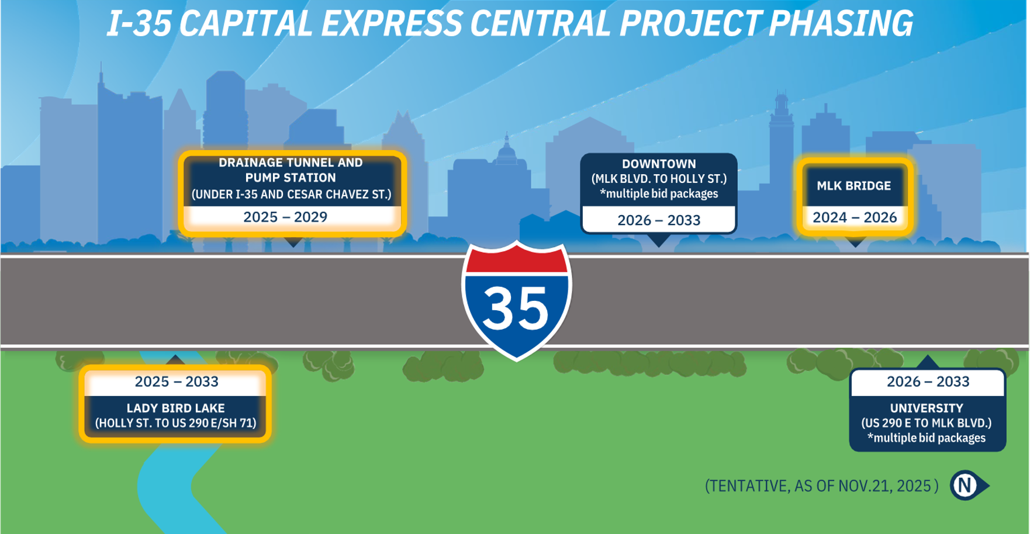
I-35 Capital Express Central: Project Phasing

Slide 5

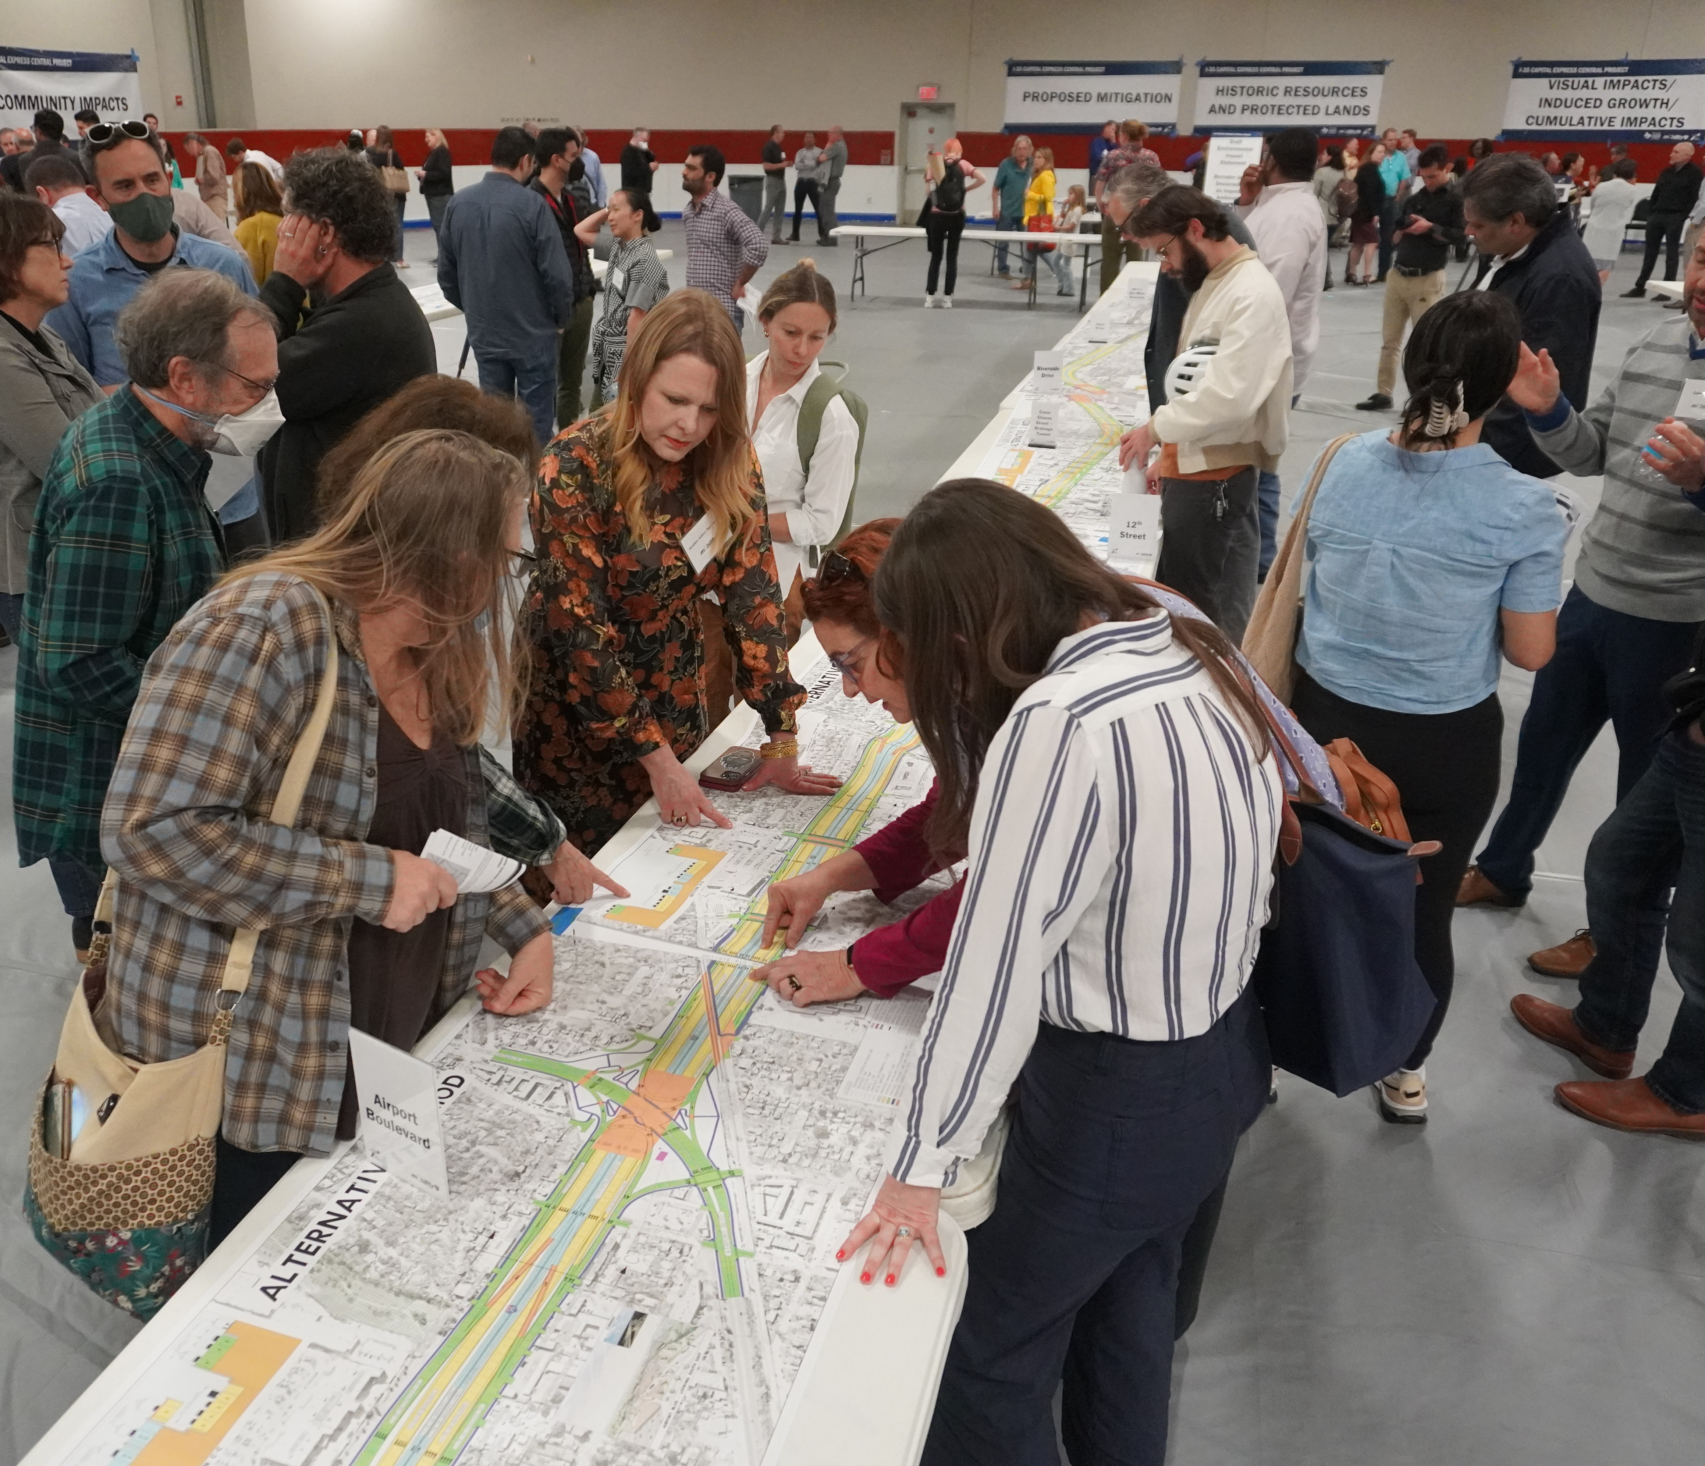
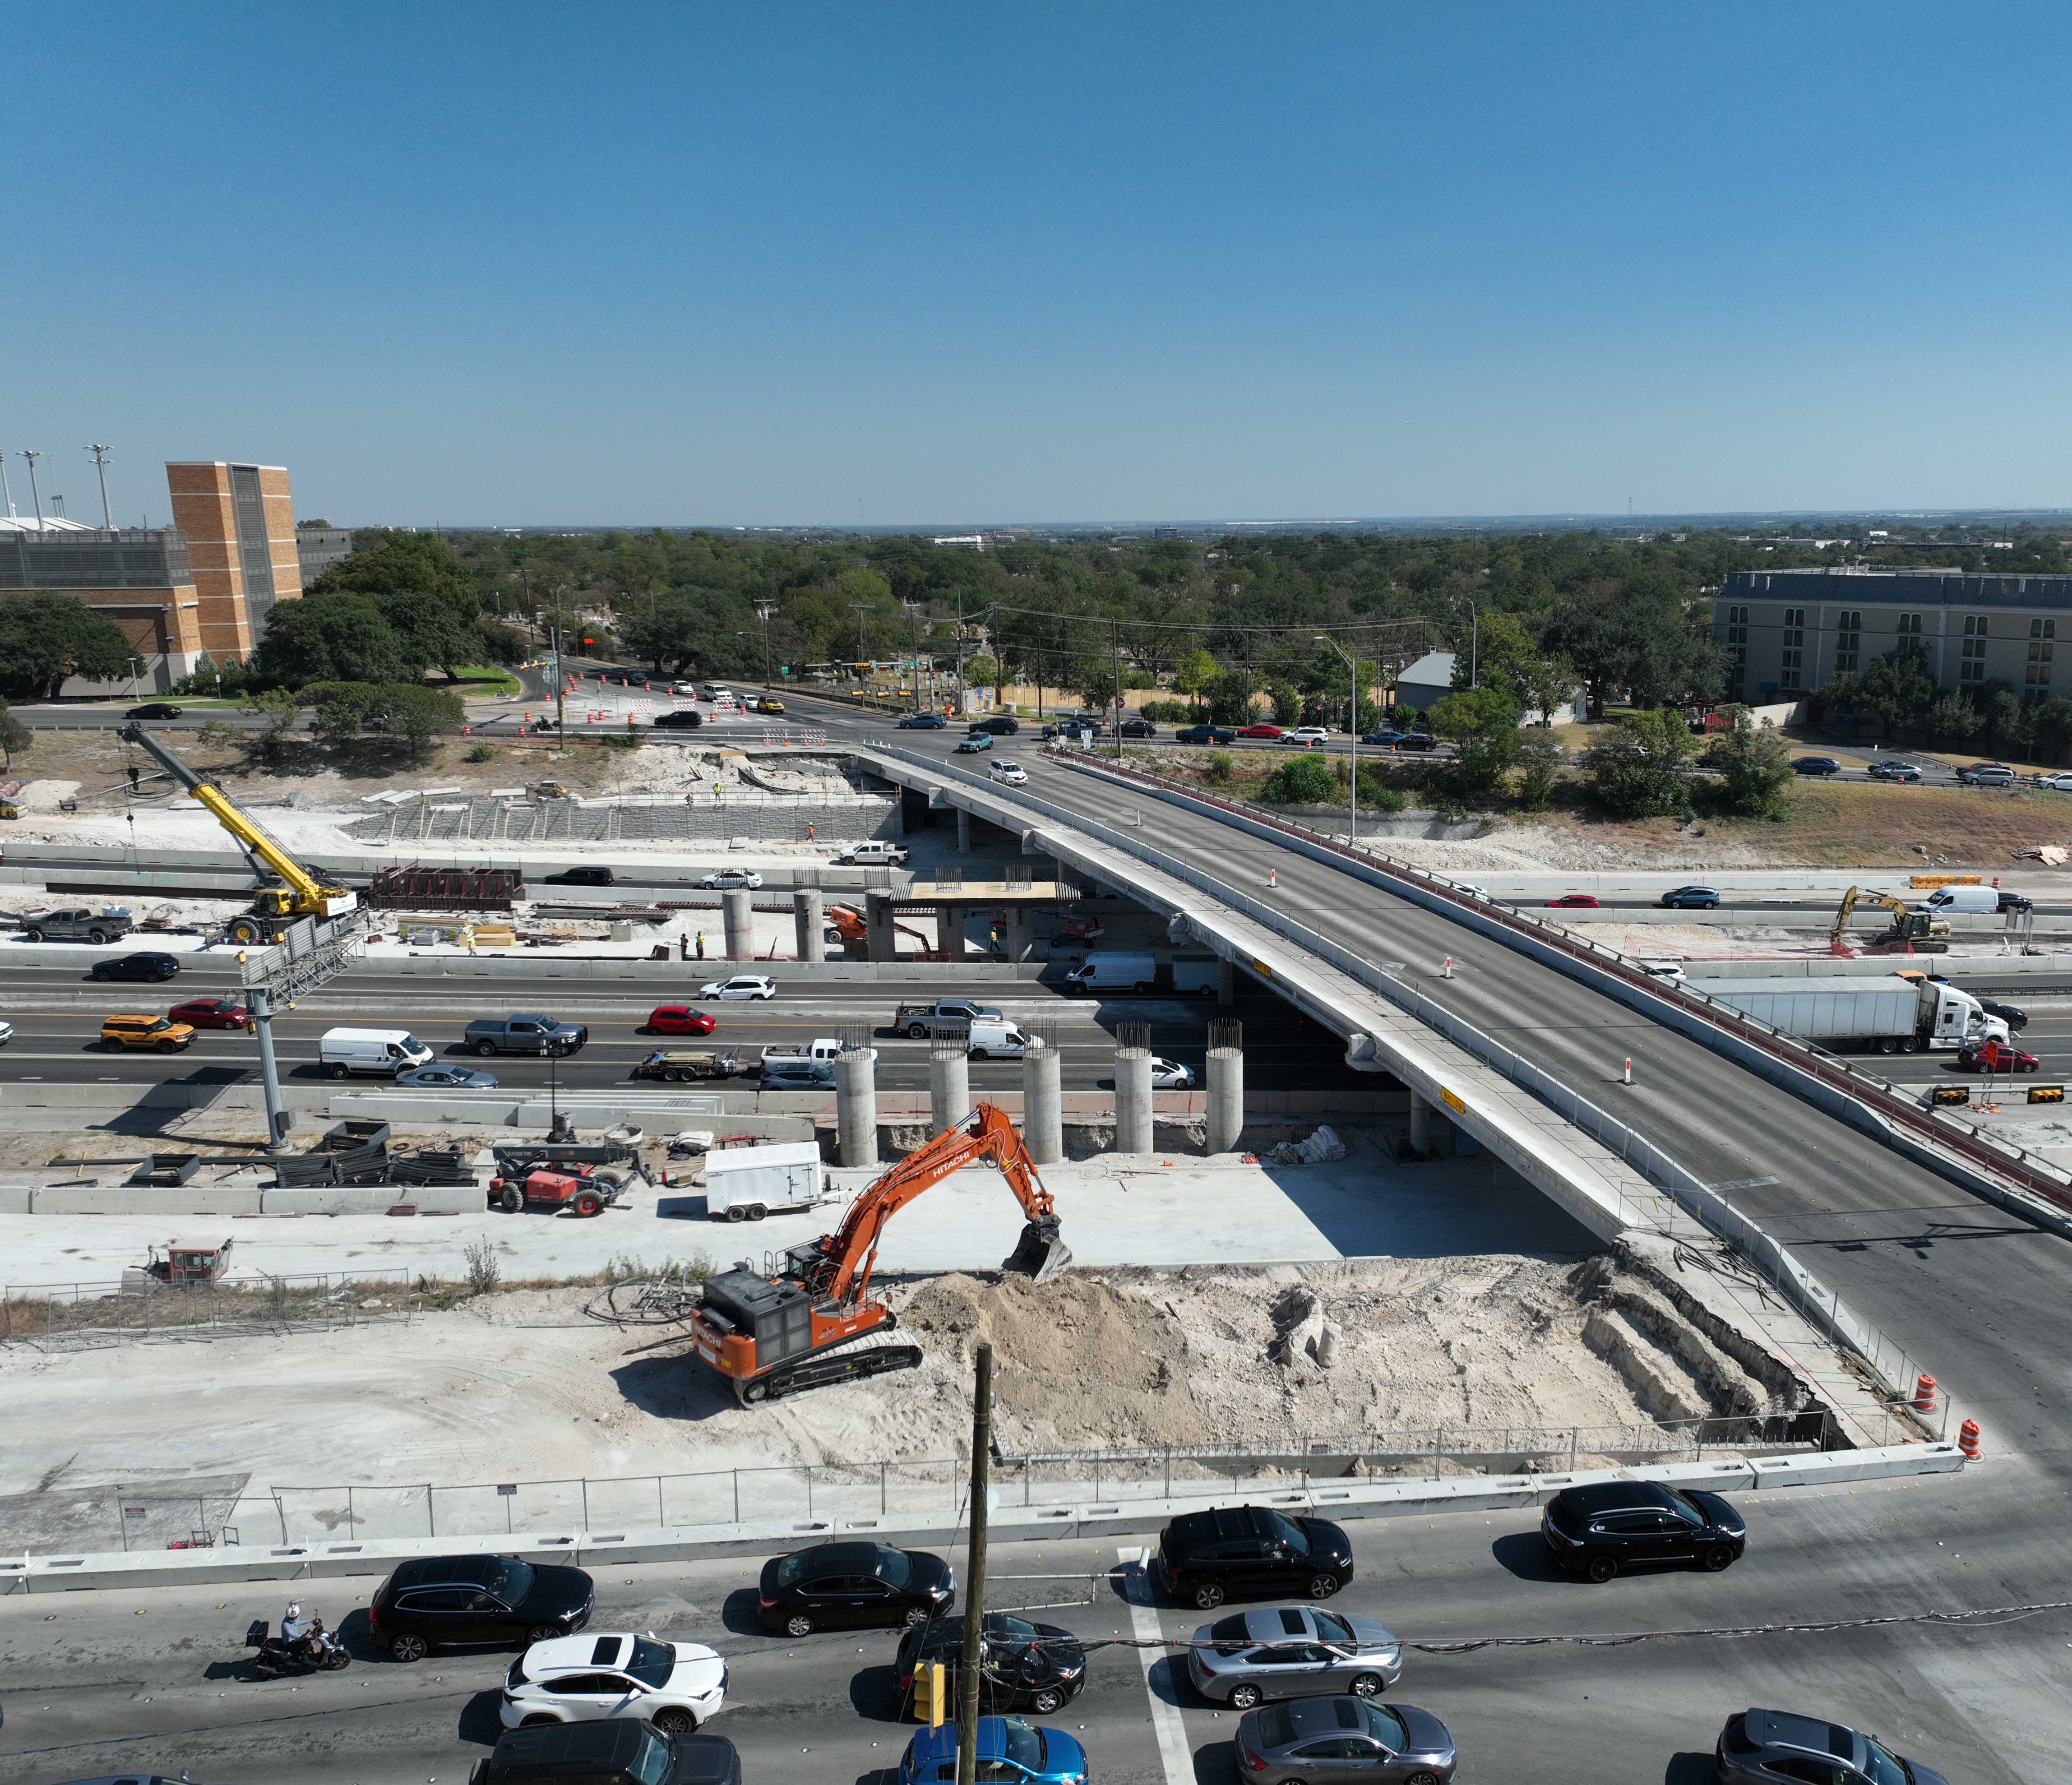
Project Update
WE ARE HERE
Project Development
Construction

Slide 6


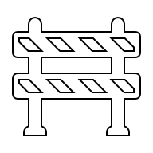
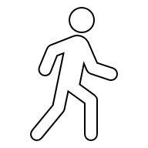
Community Driven Improvements
TxDOT reviewed feedback from the 2023 preliminary schematics and refined the design to reflect community priorities:
SAFETY
MULTI-MODAL
ACCESS
EAST - WEST
CROSSING
CONSTRUCTION
MITIGATION
Improve pedestrian/bicycle safety.
Widen bridges.
Reduce conflict points.
HOV/managed lanes.
Multi-modal transit improvements.
Pedestrian/bicycle paths.
Future connections to regional transit networks.
Improve east – west connection.
Community connection through caps and stitches.
Identify additional access points.
Noise mitigation.
Vibration monitoring.
Access issues.

Slide 7
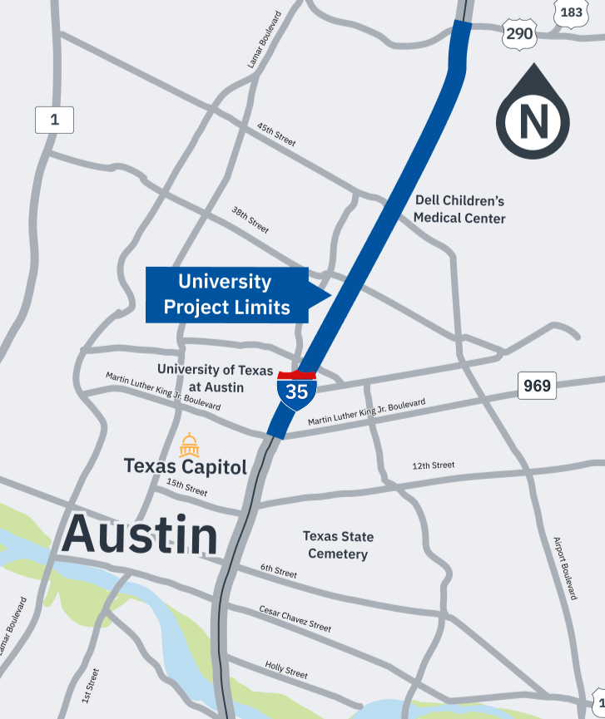
University Segment Overview
Limits: US 290 East to Martin Luther King Jr. Boulevard.
Project Details:
  Add two high-occupancy vehicle (HOV) managed lanes in each direction.
  Reconstruct east-west crossings to be widened bridges at 41st Street, 38th 1/2 Street, 32nd Street, Dean Keeton Street and Manor Road.
  Reconstruct the Airport Boulevard intersection.
  Construct pedestrian-only bridge at Capital Plaza, 21st Street and at the CapMetro Red Line rail bridge crossing at Airport Boulevard.
  Remove upper decks and lower I-35 mainlanes.
  Construct bicycle and pedestrian paths along the corridor.
Construction start: 2026
Map of University segment

Slide 8
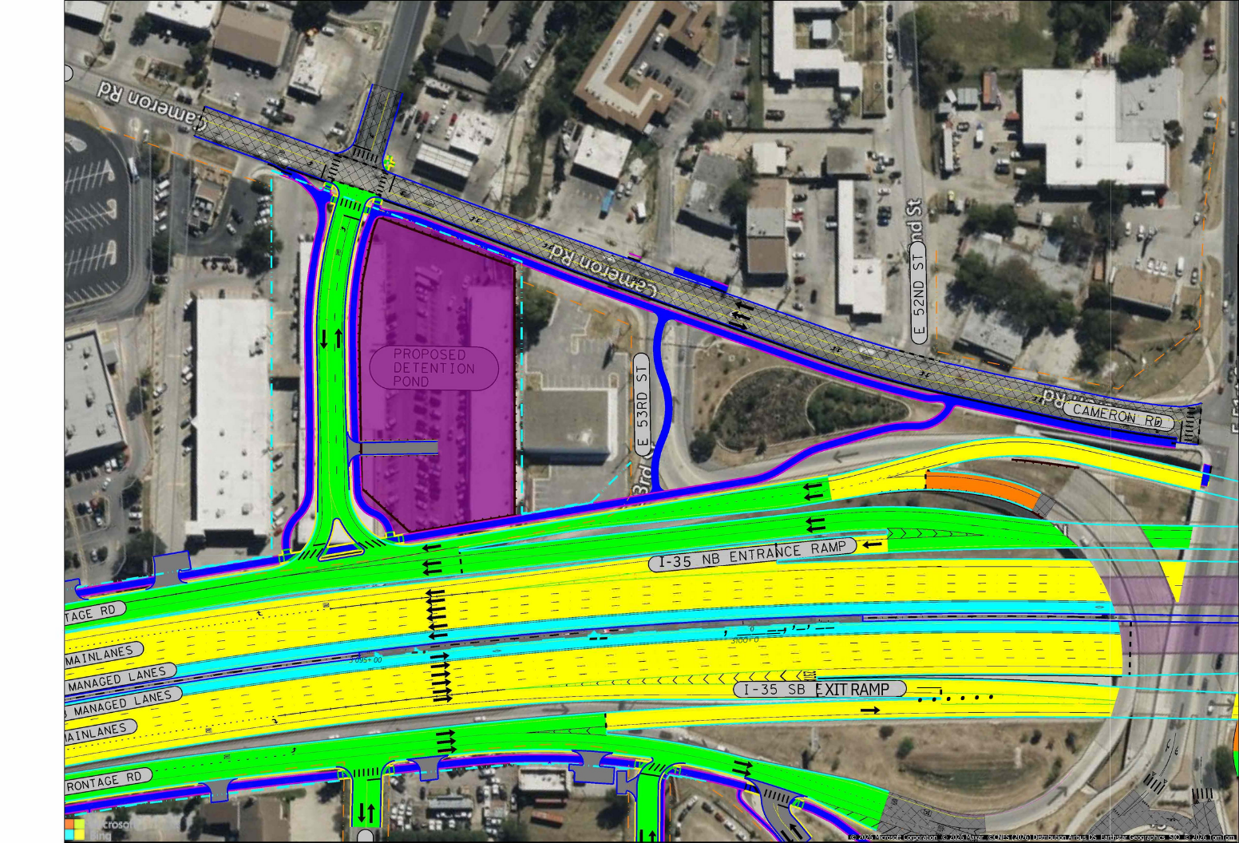
Broadmoor Drive Connection
What We Heard: The 2023 design did not provide a connection to Broadmoor Drive.
What We Did: The new design includes a connection from northbound I-35 frontage road from Broadmoor Drive.
Broadmoor Drive Connection Schematic

Slide 9
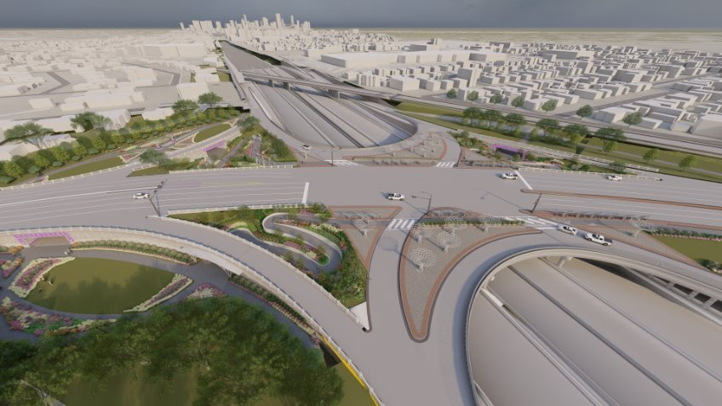
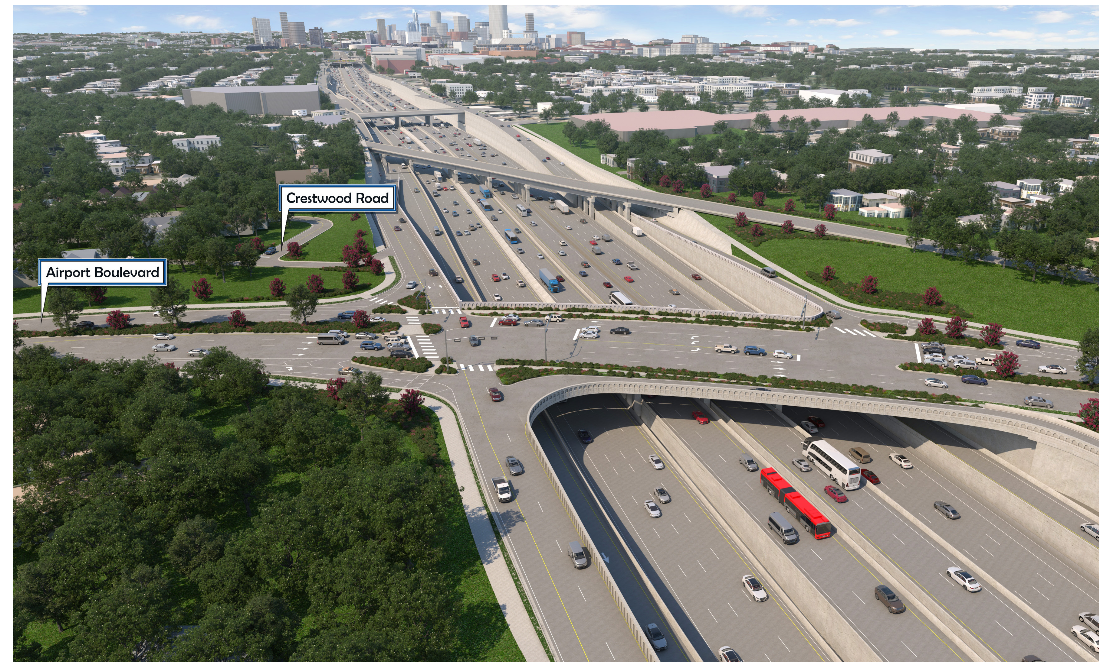
Airport Boulevard Intersection
What We Heard: The proposed Single-Point Urban Interchange (SPUI) design at the Airport Boulevard and I-35 intersection did not provide proper pedestrian safety or access across I-35.
What We Did: Replaced SPUI design with a traditional intersection to better prioritize pedestrian and cyclist safety and mobility, while maintaining vehicular access.
September 2023 design
New design

Slide 10
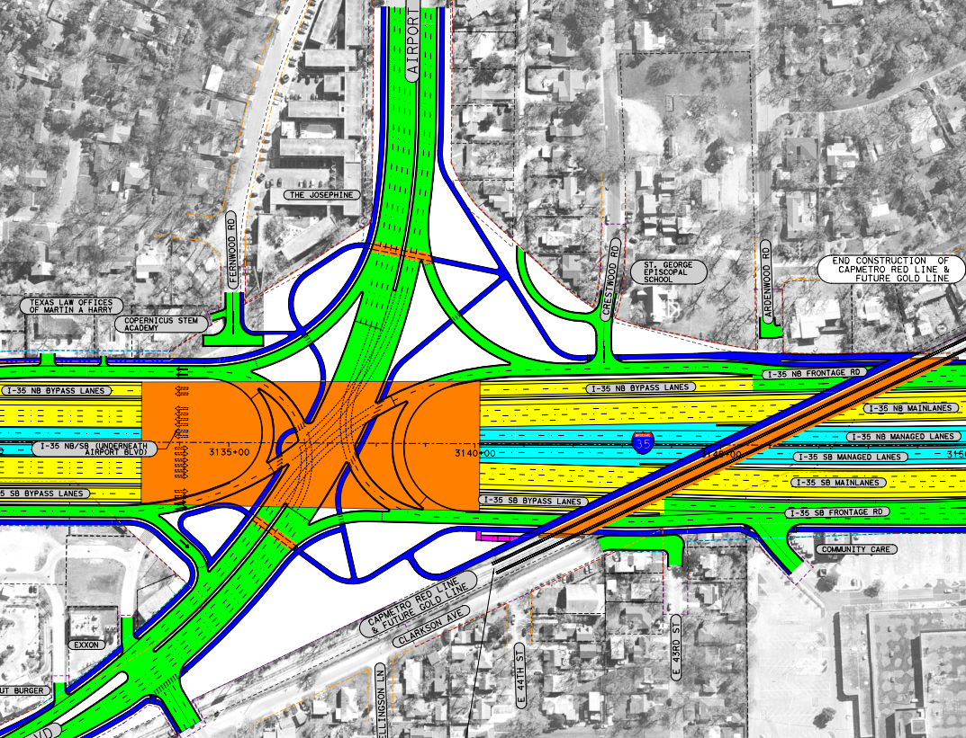
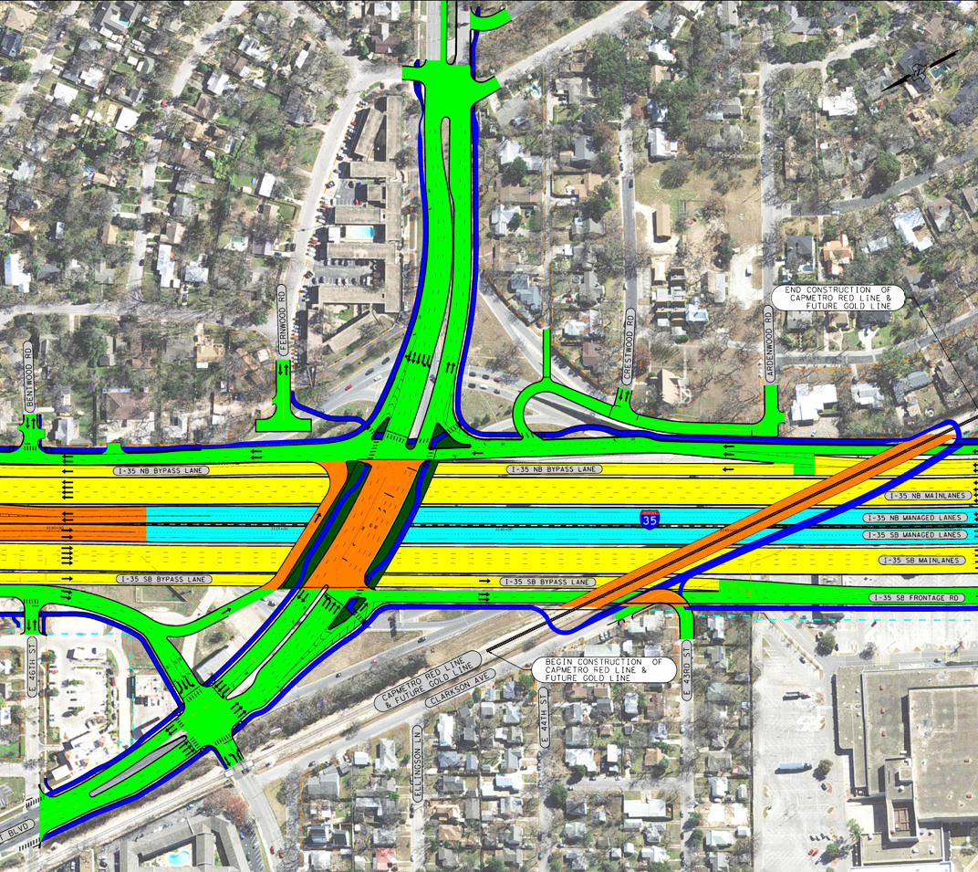
St. George Connection
What We Heard: The 2023 design limited access from the neighborhoods to the northbound I-35 frontage road, south of Airport Boulevard.
What We Did: The updated design provides two-way local access on the northbound I-35 frontage road to Ardenwood Road and Crestwood Road.
August 2023 design
New design

Slide 11
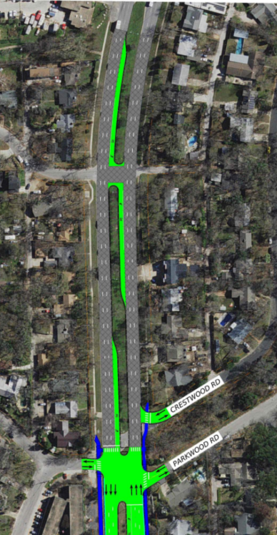
Parkwood Road Connection
What We Heard: Communities expressed a need for improved intersection access in the proposed 2023 design.
What We Did: The updated design includes a four-way traffic signal at Parkwood Road, providing safety improvements along the corridor.
August 2023 design
New design
New design focused on Parkwood Road

Slide 12
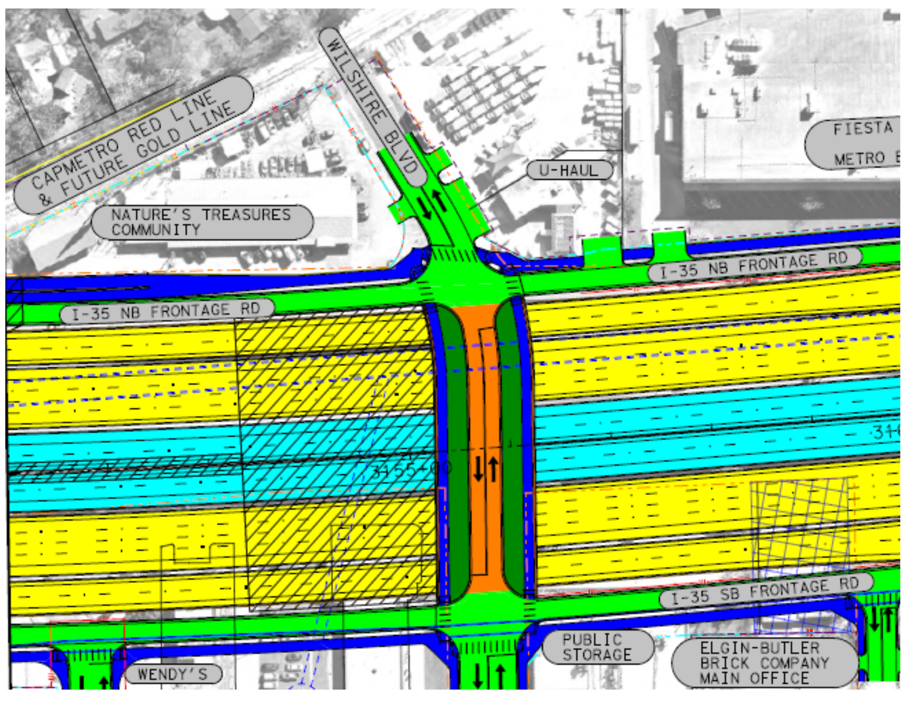
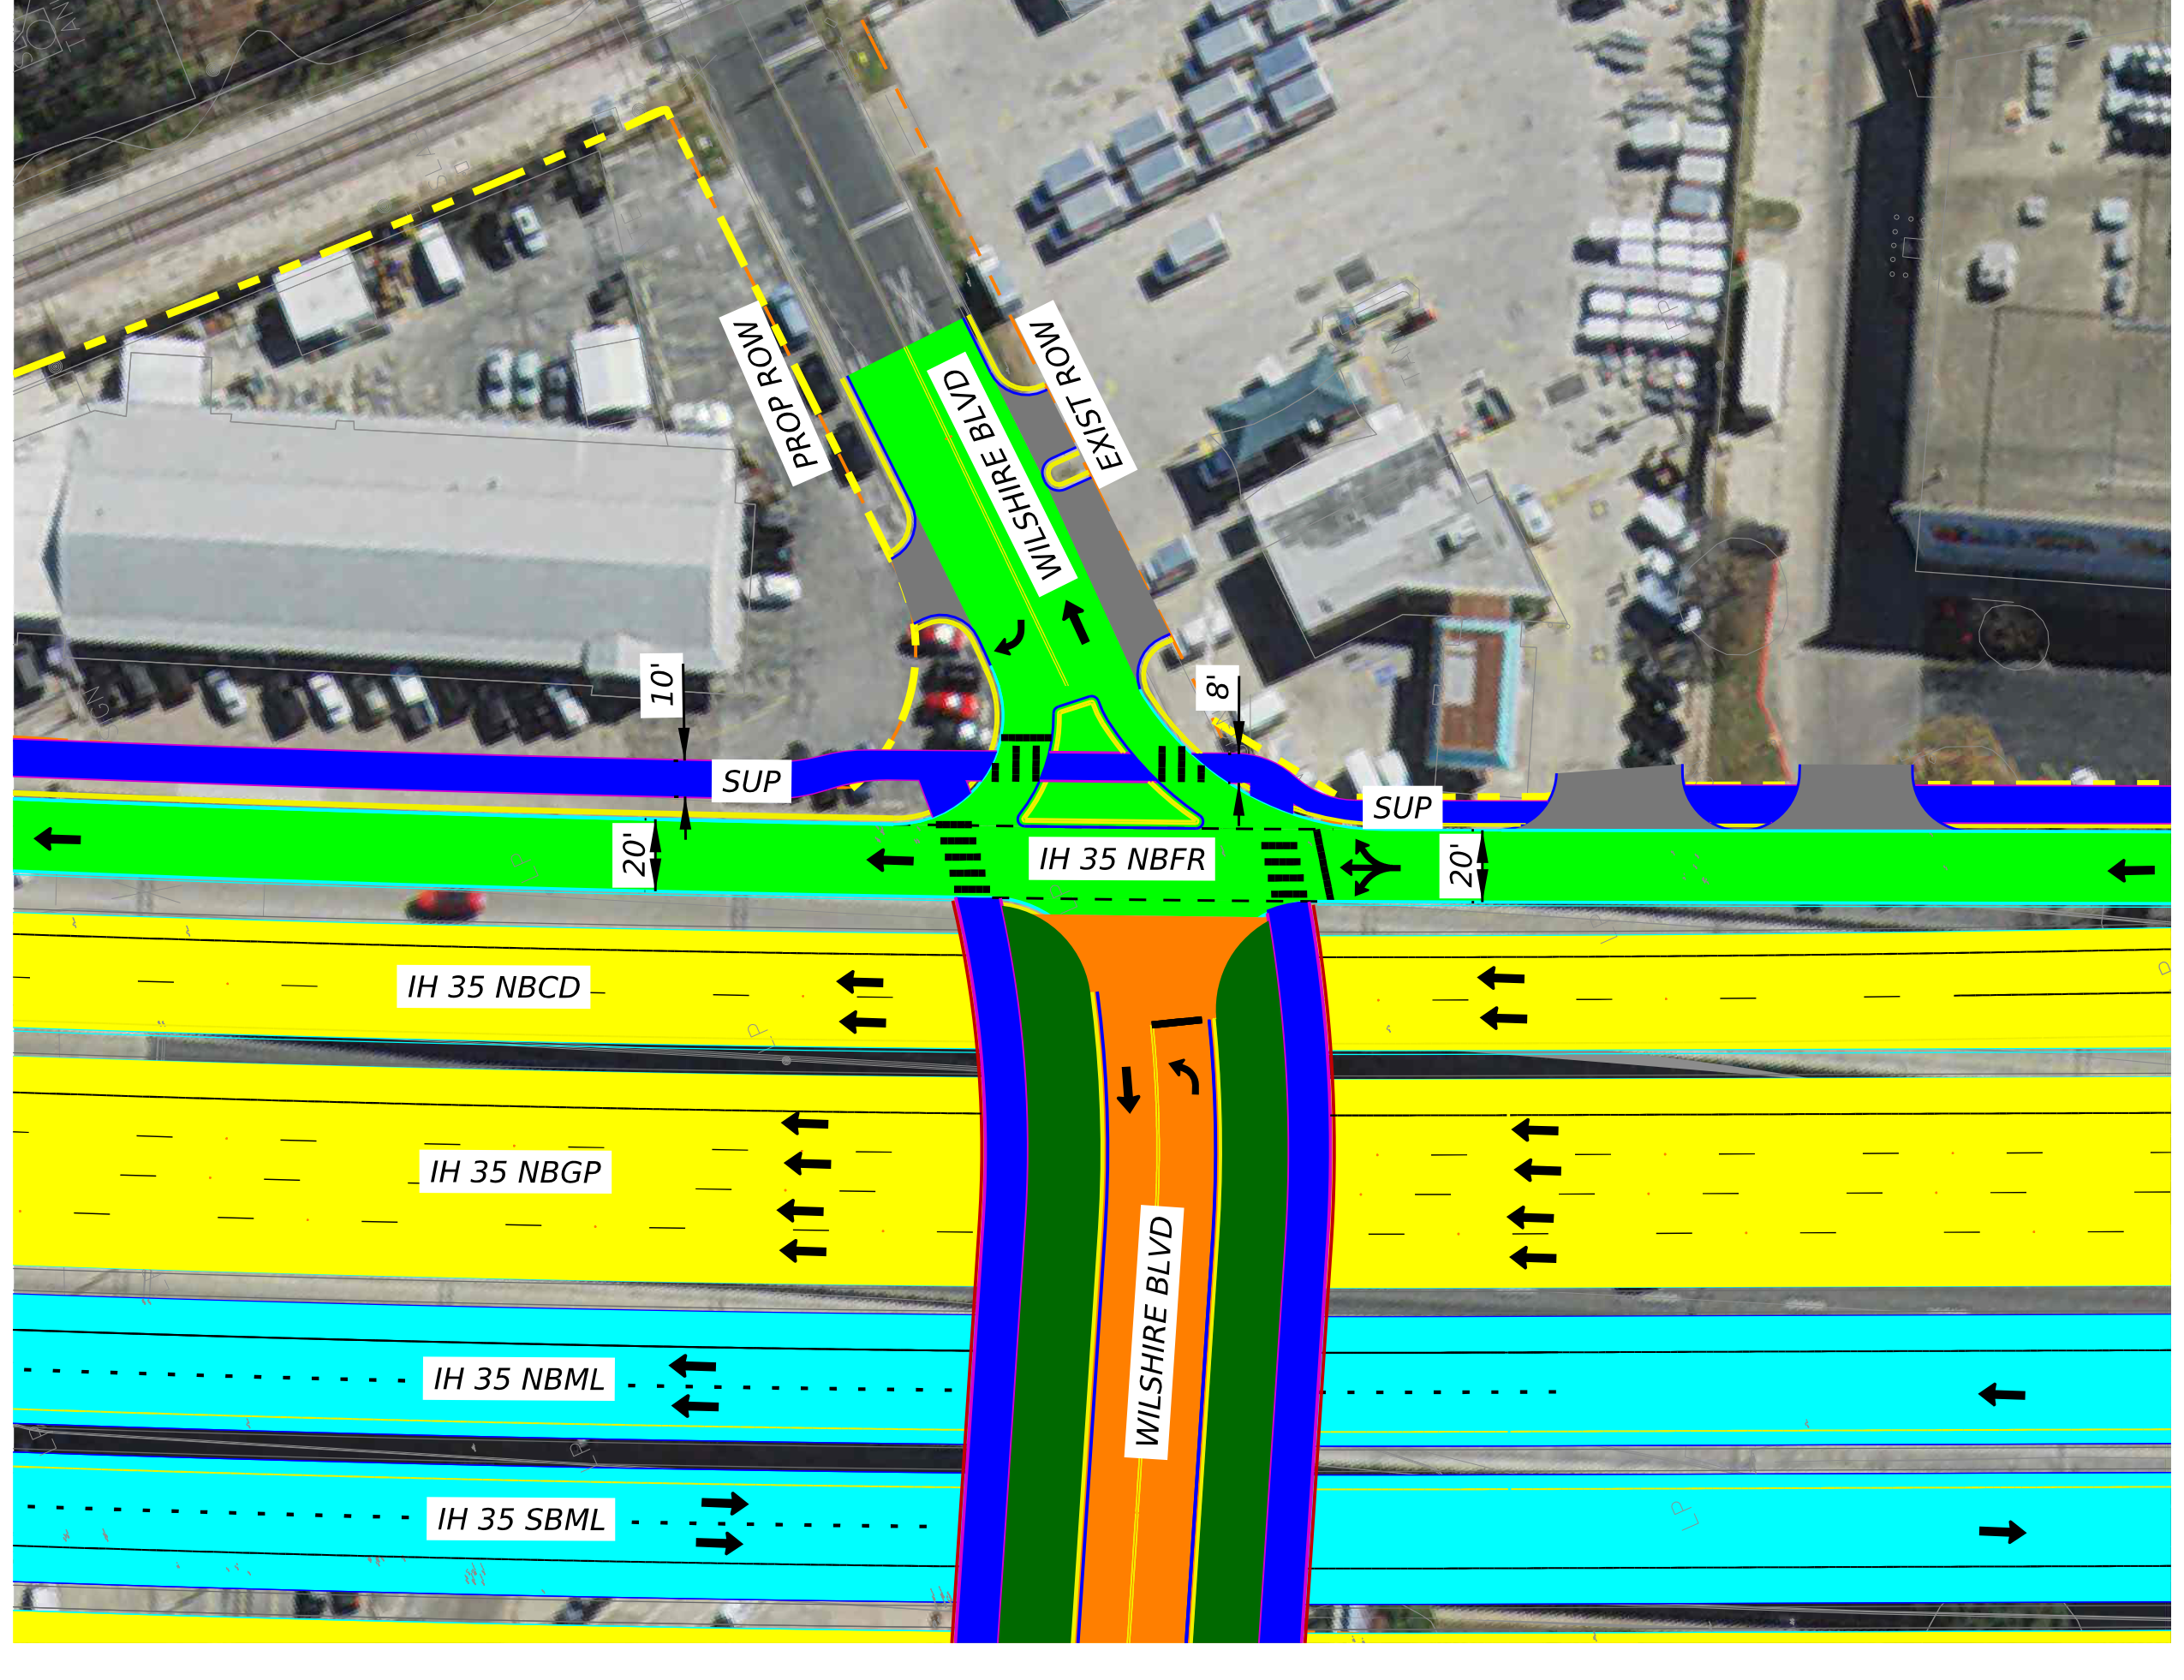
Wilshire Boulevard Connection
What We Heard: The 2023 design allowed through traffic in the Wilshire neighborhood.
What We Did: Access at Wilshire Boulevard/41st Street will be limited to right-in and right-out traffic, with no through access from 41st Street.
August 2023 design
New design

Slide 13
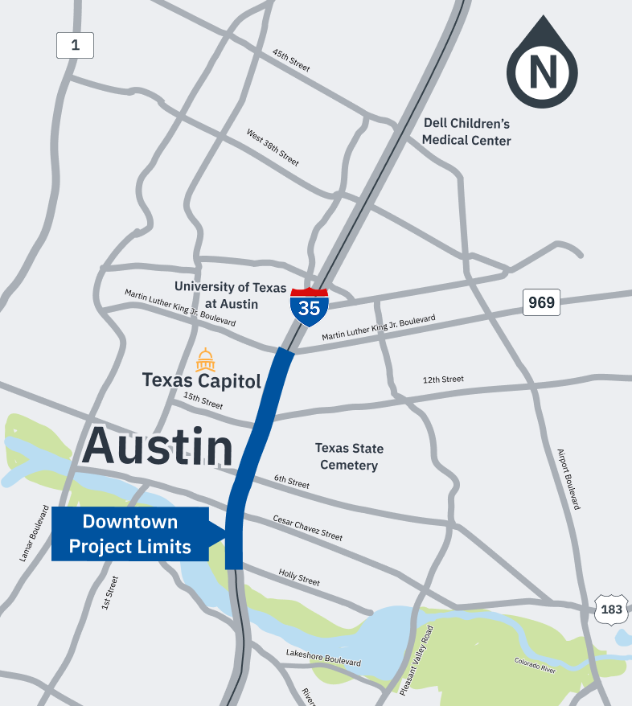
Downtown Segment Overview
Limits: Martin Luther King Jr. Boulevard to Holly Street.
Details:
  Add a new boulevard-style frontage road through downtown.
  Lower the I-35 mainlanes.
  Reconstruct east-west crossings to be widened bridges at Holly Street, Cesar Chavez Street, 5th Street, 6th Street, 7th Street, 11th Street and 12th Street.
  Construct new bridge at 16th Street.
  Construct pedestrian-only bridges at 4th Street.
  Construct bicycle and pedestrian paths along the corridor.
Construction start: 2026
Map of Downtown segment

Slide 14
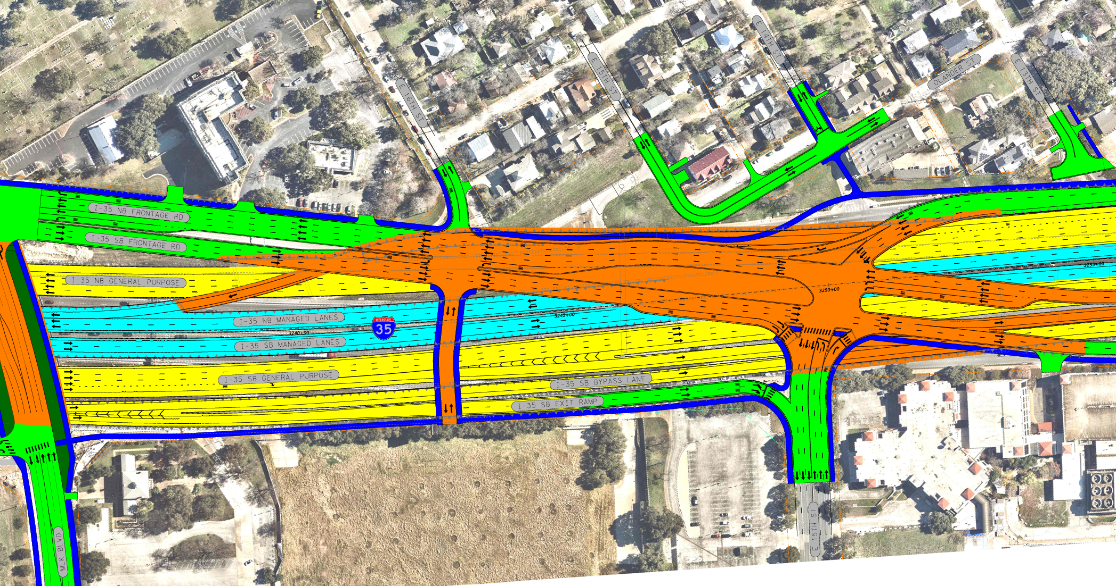
16th Street Connection
What We Heard: The 2023 design limited east-west connectivity between Martin Luther King Jr. Boulevard and 15th Street to downtown.
What We Did: Added new signalized 16th Street bridge, funded by the University of Texas at Austin, to provide access between Martin Luther King Jr. Boulevard and downtown. The bridge will be signalized and allow drivers to merge onto the I-35 boulevard in either direction.
New design

Slide 15
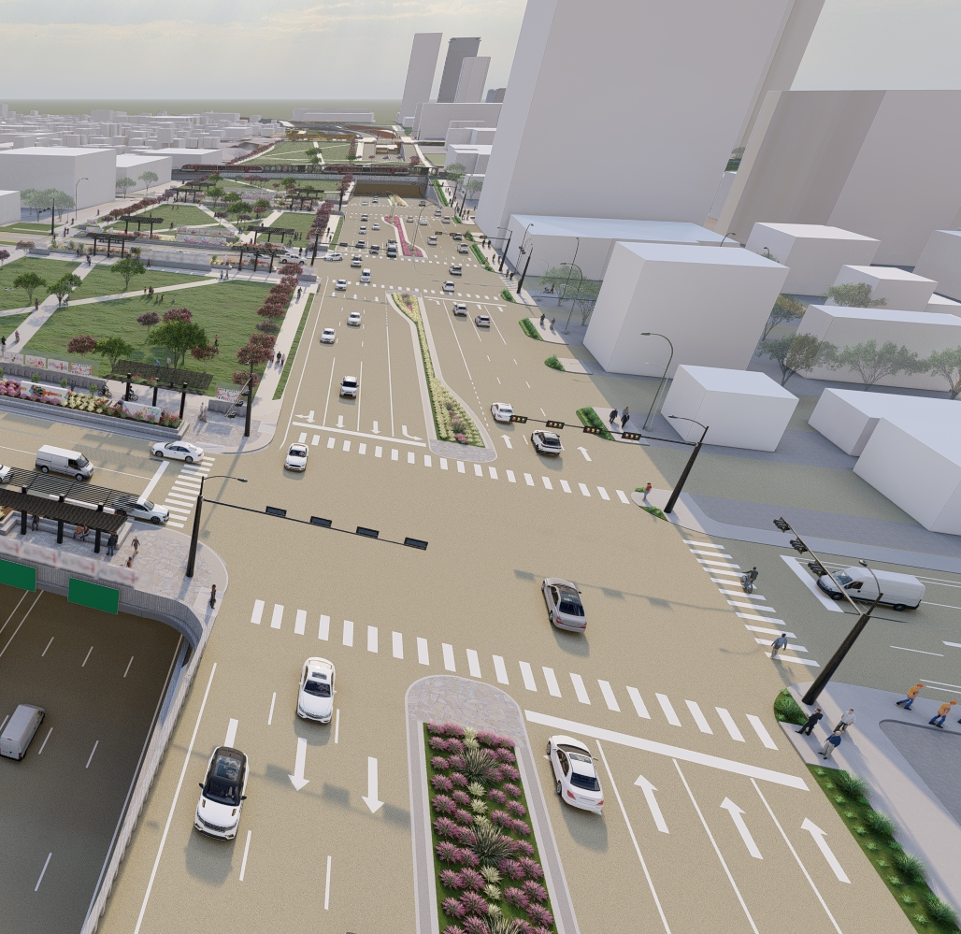
Boulevard Overview
Limits: Dean Keeton Street to Cesar Chavez Street.
Features:
  Shifts northbound I-35 frontage road west of I-35 through downtown.
  Shifts southbound I-35 frontage road east of I-35 between 15th Street and Dean Keeton Street.
  Reduces speed limits to 35 miles per hour (mph).
Benefits:
  Minimizes right-of-way impacts.
  Provides pedestrian-bicycle friendly experience.
  Design features informed by community feedback to create an urban feel.
Frontage road boulevard at 8th Street, looking south.
Foundational elements to support deck plazas and all surface amenities to be funded by others.

Slide 16
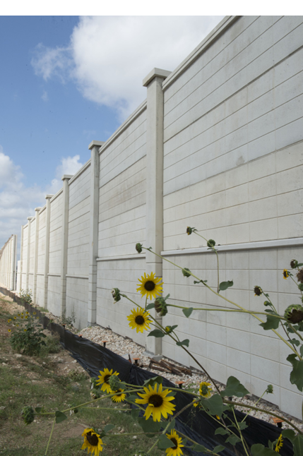
Noise Walls – Holly Street
When TxDOT builds in new areas or adds capacity to existing roads, a noise study is performed in accordance with federal and state policies. The study will determine potential traffic noise impacts and whether a noise wall is appropriate for mitigation.
During final design of the Downtown segment, TxDOT identified the need for a new sound wall along northbound I-35 between Holly Street and Cesar Chavez Street.
Next steps:
  TxDOT will host a noise wall meeting with benefited receivers along this corridor.
  Expected meeting date: early 2026.

Slide 17
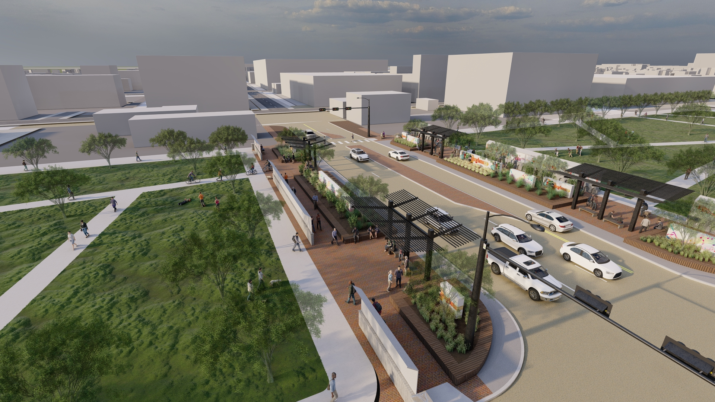
Widened Bridges
Located at:
  Airport Boulevard, 41st Street, 38th 1/2 Street, 32nd Street, Dean Keeton Street, Manor Road, MLK Jr. Boulevard, 16th Street, 12th Street, 11th Street, 7th Street, 6th Street, 5th Street, Cesar Chavez Street, and Holly Street.
Features:
  30 feet on each side for bicycle and pedestrian paths.
  ​Supports multi-modal accessibility.
  Buffer zones for safety.
  Shade structures.
Future 6th Street widened bridge.
Foundational elements to support deck plazas and all surface amenities to be funded by others.

Slide 18
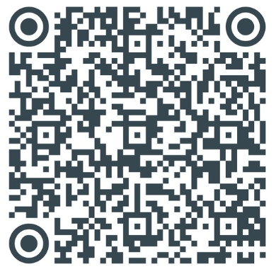
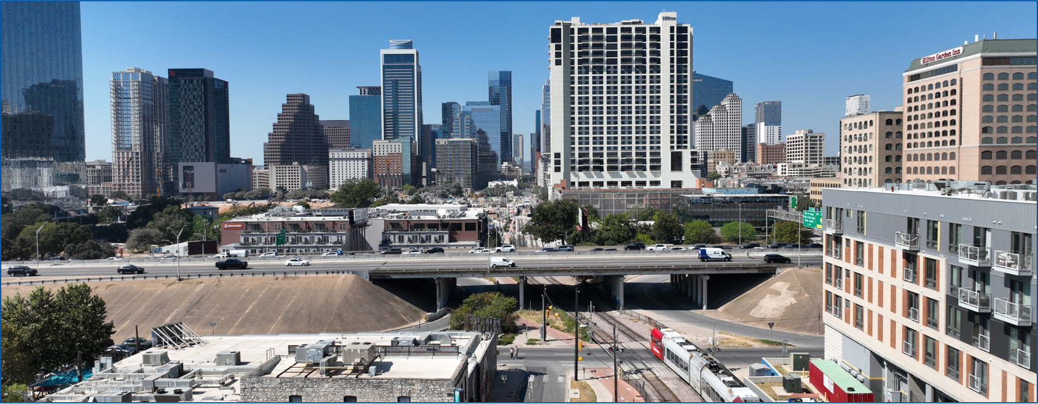
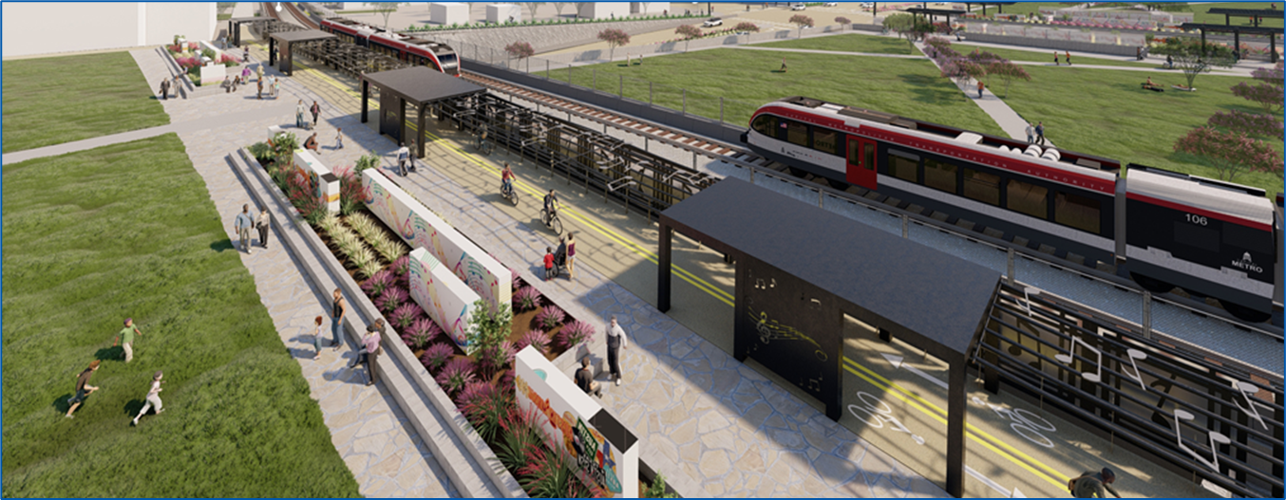
Caps and Stitches: City of Austin Overview
City of Austin Website
to learn more:
In 2017, TxDOT collaborated with the City of Austin on the design of roadway elements over I-35.​
The Central project offers an opportunity to cap more than 20 acres of highway, including:​
  Eight acres of downtown Austin.​
  Two acres in Austin’s Historic Black district (11th/12th Street).​
In May 2025, City of Austin Council authorized funding agreement for $104 million in roadway elements from:​
  Cesar Chavez Street to 7th Street.​
  11th Street to 12th Street.​
  Two 300-foot stitches between the CapMetro Red Line Rail Bridge and 41st Street.​
Above: 4th Street – Now
Below: 4th Street – After construction
Foundational elements to support deck plazas and all surface amenities to be funded by others.

Slide 19
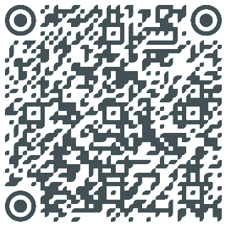
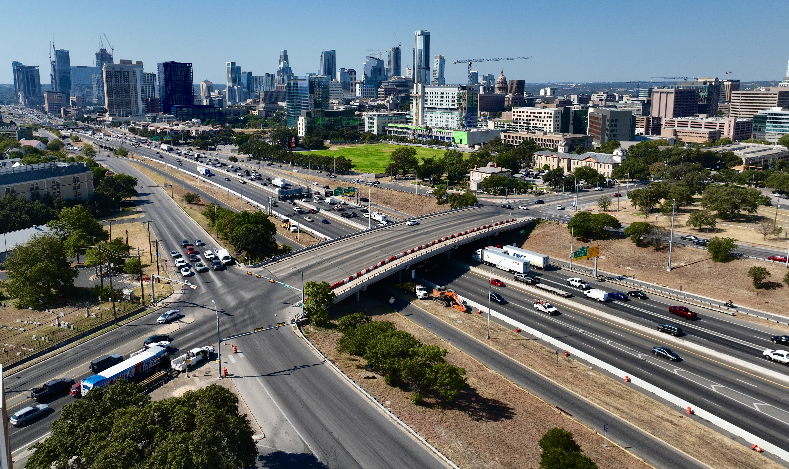
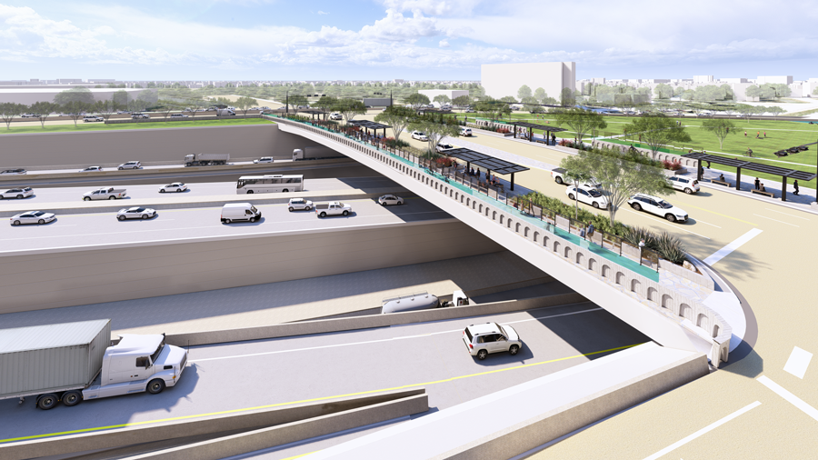
Caps and Stitches: University of Texas Overview
In May 2024, the University of Texas approved funding for $106 million of the construction of foundational elements covering 13 acres from:
  Martin Luther King Jr. Boulevard to 15th Street.
  Manor Road/Clyde Littlefield Drive to Martin Luther King Jr. Boulevard.
UT Austin Website
to learn more:
MLK Boulevard – 2024
MLK Boulevard – After construction
Foundational elements to support deck plazas and all surface amenities to be funded by others.

Slide 20
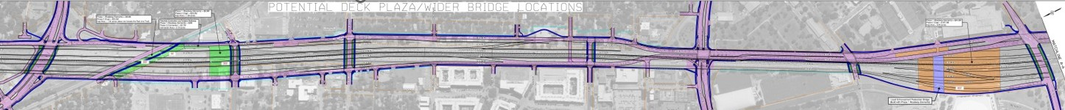
Proposed Deck Caps
Manor Road/Clyde Littlefield Drive
CapMetro Red Line
Dean Keeton Street
Martin Luther King Jr.
Boulevard
Airport Boulevard
41st Street
38th 1/2 Street
32nd Street
Local Enhancement Pedestrian Bridge
(Build with Phase 1 Roadway Elements)
Proposed deck cap locations as of Aug. 7, 2025.
City of Austin Stitches*
North of 41st Street.
South of CapMetro Redline Railroad Crossing.
University of Texas Cap
Between Martin Luther King Jr. Boulevard and Manor Road/Clyde Littlefield Drive.
*These proposed configuration of the stitches are subject to Austin City Council approval.
Foundational elements to support deck plazas and all surface amenities to be funded by others.

Slide 21
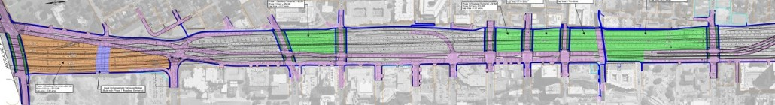
Proposed Deck Caps Continued
CapMetro Red Line/4th Street
Martin Luther King Jr.
Boulevard
Cesar Chavez Street
16th Street
15th Street
12th Street
11th Street
7th Street
6th Street
5th Street
Phase 1 (Roadway Elements) = $8.5 M
Phase 2 (Cap) = $52.8M
Cap Area = 2.17 acres
Phase 1 (Roadway Elements) = $47.0M
Phase 2 (Cap) = $210.0M
Cap Area = 6.89 acres
Local Enhancement Vehicular Bridge
(Build with Phase 1 Roadway Elements)
Proposed deck cap locations as of Aug. 7, 2025.
City of Austin Caps
Cesar Chavez Street to 7th Street.
11th Street to 12th Street.
University of Texas Cap
15th Street to Martin Luther King Jr. Boulevard.
Foundational elements to support deck plazas and all surface amenities to be funded by others.

Slide 22
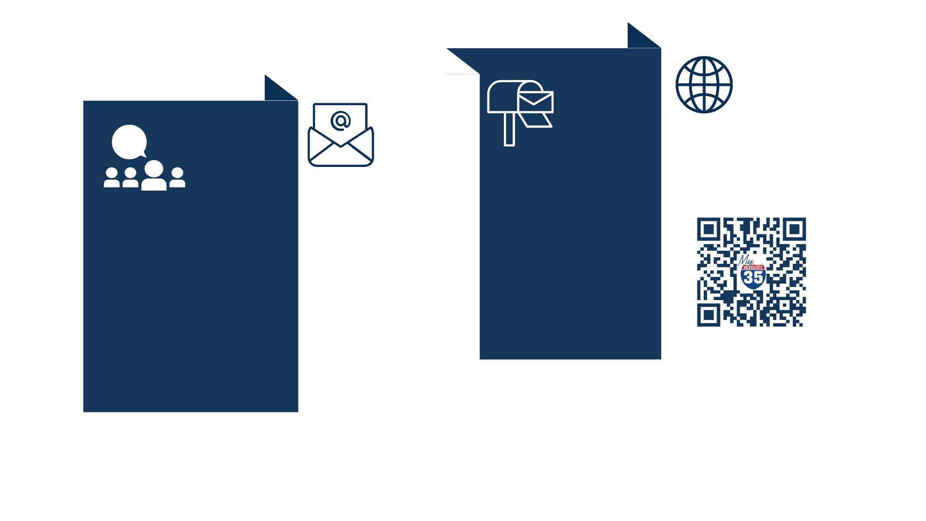
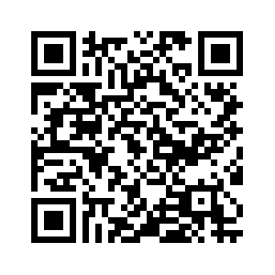
Stay Connected!
ONLINE
MAIL
I-35 Capital Express Central Project Team
1949 S. I-35 Frontage Road
Austin, TX 78741
www.mymobility35.com
EMAIL
VOICEMAIL
(512) 366-3229
CapExCentral@txdot.gov

